Slide 1
How to build and maintain a successful Natural Health practice
Gilles A. Lamarche BS DC

Slide 2
What starts here changes the world…

Slide 3
COURAGE
The ability to do something that frightens one. Strength in the face of pain or grief.
Synonyms; bravery, courageousness, pluck, pluckiness, valor, fearlessness, nerve, daring, audacity, boldness, grit, true grit, hardihood, heroism, gallantry, spunk, moxie, cojones, balls, brass ovaries.

Slide 4
COURAGE
Feeling Fear
Yet Choosing to Act
Following Your Heart
Persevering in the Face of Adversity
Standing Up For What Is Right

Slide 5


Slide 6
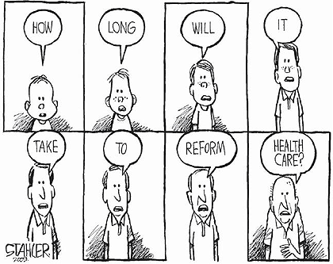

Slide 7
What does one TRILLION dollars look like?
All this talk about "stimulus packages" and "bailouts"...
A billion dollars...
A hundred billion dollars...
Eight hundred billion dollars...
One TRILLION dollars...
Notes:
7

Slide 8
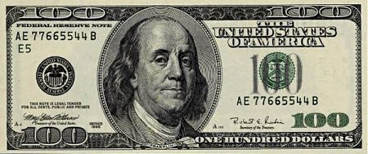
We'll start with a $100 dollar bill. Currently the largest U.S. denomination in general circulation. Most everyone has seen them, slightly fewer have owned them. Guaranteed to make friends wherever they go.
Notes:
8

Slide 9
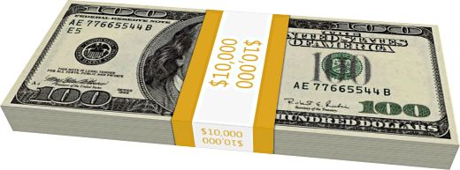
A packet of one hundred $100 bills is less than 1/2" thick and contains
$10,000. Fits in your pocket easily and is more than enough for week or
two of shamefully decadent fun.
Notes:
9

Slide 10
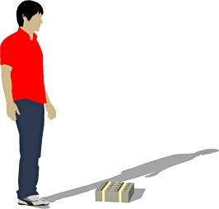
Believe it or not, this next little pile is $1 million dollars (100 packets of $10,000). You could stuff that into a grocery bag and walk around with it.
Notes:
10

Slide 11
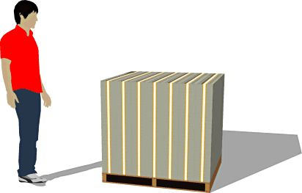
While a measly $1 million looked a little unimpressive, $100 million is a little more respectable. It fits neatly on a standard pallet...
Notes:
11

Slide 12
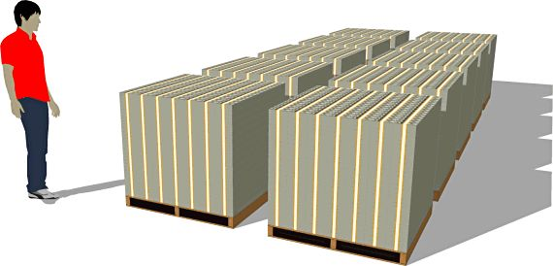
And $1 BILLION dollars... now we're really getting somewhere...
Notes:
12

Slide 13
One Trillion Dollars
Next we'll look at ONE TRILLION dollars. This is that number we've been hearing about so much.
What is a trillion dollars? Well, it's a million million. It's a thousand billion. It's a one followed by 12 zeros.
You ready for this?
It's pretty surprising.
Go ahead...
Turn the page...
Ladies and gentlemen... I give you $1 trillion dollars...
Notes:
13

Slide 14
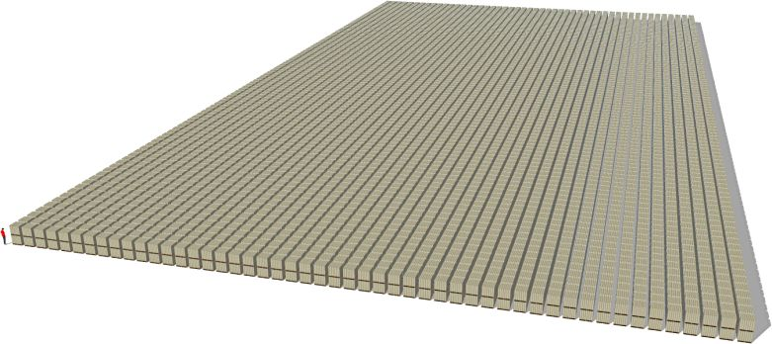
$1,000,000,000,000
(And notice those pallets are double stacked.)
So the next time you hear someone toss around the phrase "trillion
dollars"... that's what they're talking about.
Does this bother you??? It will certainly bother your grand children!!!
Notes:
14

Slide 15
U.S. Health Care Costs Skyrocketed to $3.65 Trillion in 2018
A new analysis from U.S. federal government actuaries say that Americans
spent $3.65 trillion on health care in 2018, according to a report from Axios.
The amount is larger than the GDPs of such countries as Brazil, the U.K., Mexico, Spain, and Canada.
The level of spending is by far the highest in the developed world, according to data from
the Organization for Economic Co-Operation and Development.
That was an increase of 4.4% over 2017 and, according to the analysis, things will get even worse.
The report in the journal Health Affairs estimates an average annual growth rate of 5.5% from 2018 to 2027.
The current inflation rate is 1.6%. Wage growth, while up from recent years, remains below 4%, according to the
Federal Reserve Bank of Atlanta. At this rate, by 2027, health care will be 19.4% of the country’s entire GDP.

Slide 16
The $3.65 trillion in spending represents $11,212 per person, with 59% of the spending going to hospitals, doctors, and clinical services. Prescription drug spending was up 3.3% year over year. Most of the increase was due to higher prices, not increased use of services.
Under private health insurance, spending per person rose 4.5% between 2017 and 2018, even though the same number of people were enrolled.
With such a level of economic increase, people will increasingly face difficulty in obtaining medical care.

Slide 17
Influence and Persuasion
Influence is an ability/power to affect yourself, another person, thing or course of events.
Persuasion is the art of helping someone into a position they do not currently hold to a position or understanding that gives them a better outcome.
Notes:
Process not an event; what opportunities resonate with you?

Slide 18
INFLUENCE
“Few of us have the greatness to change history, but each of us can work to change a small portion of events.”
Robert Fitzgerald Kennedy
“We live in a constantly expanding innate horizon, uniting with others of like thought to form a fighting phalanx to push back impregnable horizons, to place a living light where before darkness existed.”
BJ Palmer

Slide 19
Living Your Ultimate Destiny
Fate
Choice
Courage
Compassion
Discipline/willingness
Accountability

Slide 20
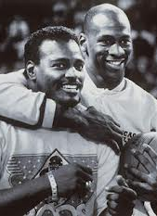
“We are what we repeatedly do. Excellence
then, is not an act, but a habit.”
- Aristotle

Slide 21
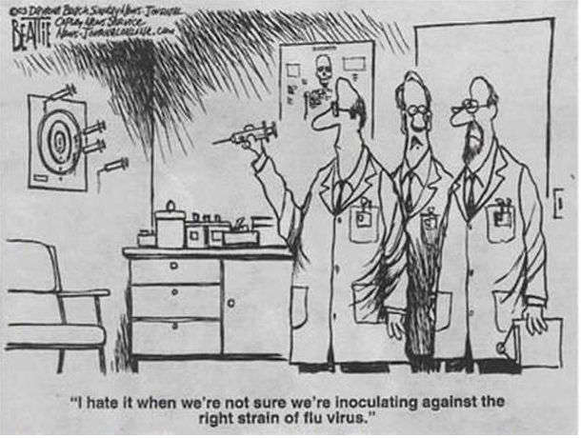

Slide 22
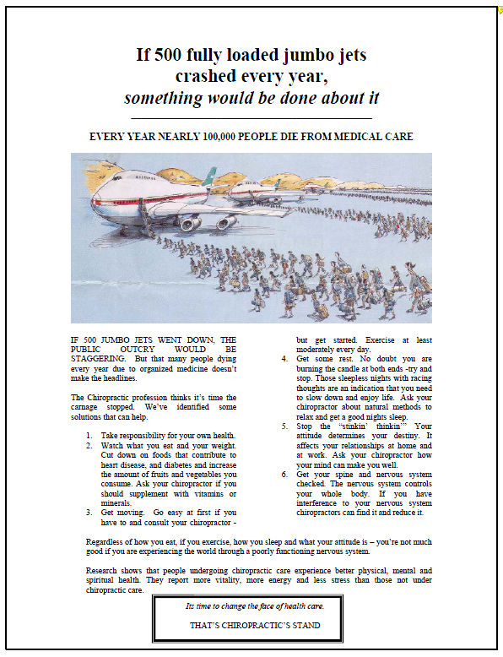

Slide 23
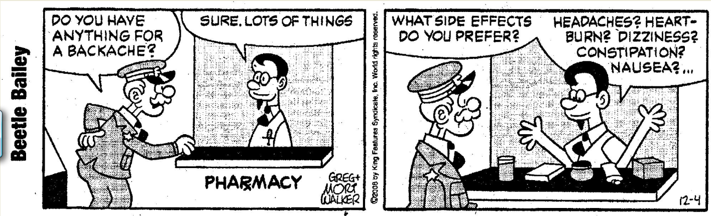

Slide 24
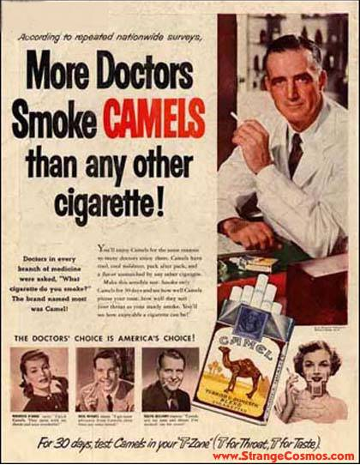

Slide 25
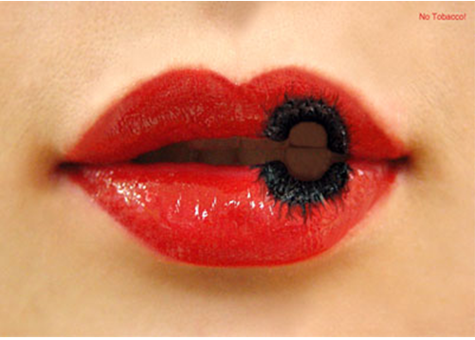

Slide 26
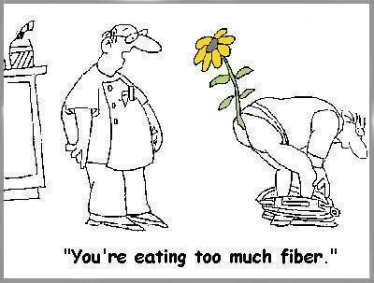

Slide 27
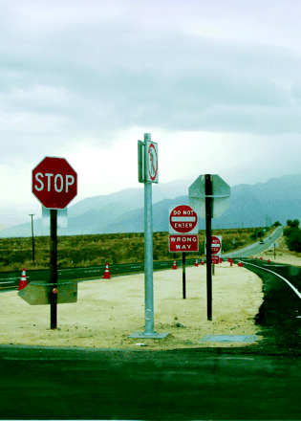
Treatments Thought to Work but Shown Ineffective
Sulphuric acid for scurvy
Leeches for almost anything
Insulin for schizophrenia
Vitamin K for myocardial infarction
HRT to prevent cardiovascular disease
Flecainide for ventricular tachycardia
Routine blood tests prior to surgery
Autologous Bone Marrow Transplant for late stage Breast CA
BMJFebruary 28 2004; 324:474-5.

Slide 28
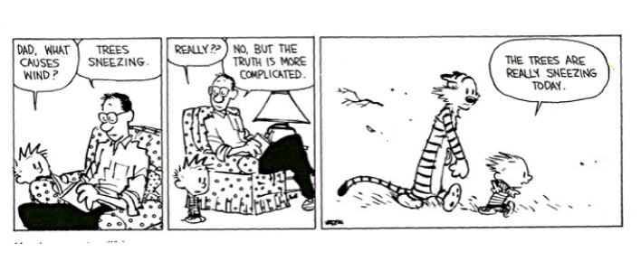

Slide 29
Bridging the Quality Chasm
Where We Where We
Are Want To Be
Implementation
Innovation
Education
Diffusion
Adoption
TRIP

Slide 30
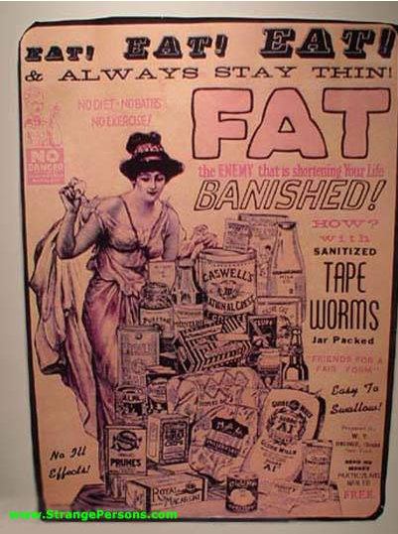

Slide 31
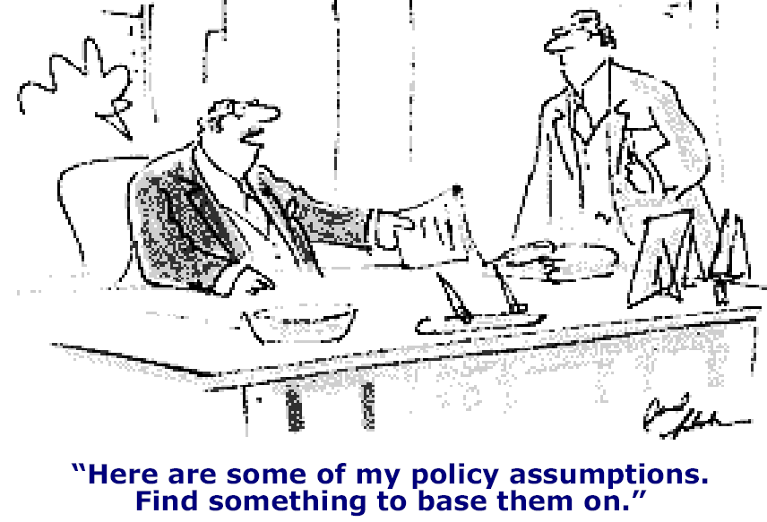

Slide 32
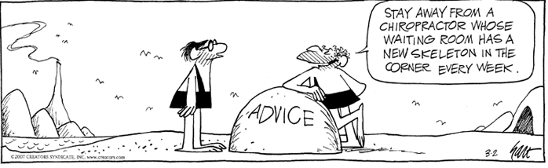

Slide 33


