Slide 1
Treatment Resistant Depression
Gregory L. Howard, MD

Slide 2
Treatment Resistant Depression
Definitions
Patients with the inability to adequately produce neurotransmitters which are responsible for a sense of personal contentment and happiness
Patients non-responsive to adequate doses of antidepressants taken for a sufficient duration of time, usually considered 6 weeks
1/3 of patients with major depression are non-responsive to antidepressants
Practically: patients with a combination of depression, anxiety, fatigue, headaches, chronic pain, and PTSD

Slide 3
Standard of Care Medicine for Treatment Resistant Depression
All patients receive “Medical Clearance”
Monoamine Hypothesis - Abnormal Levels of Serotonin, Dopamine, and Norepinephrine
Onset of action for an anti-depressant is one month, and efficacy is comparable to placebo
Results in intolerable side-effects including anxiety, POTS Syndrome, dry mouth, sexual dysfunction, weight gain, Type II Diabetes, and increased cardiovascular risk factors

Slide 4
Unique Perspective
Over 30,000 Electroconvulsive Therapy (ECT) Cases
One Million Dollars of Blood Tests on 200 Patients with TRD
Over 15 years of patient follow-up
Conclusion: TRD is a systemic disease with limitless root causes, over 90 percent have undiagnosed or undertreated medical conditions
Understanding of why patients with TRD don’t make adequate amounts of neurotransmitters or respond to antidepressants

Slide 5
Traditional
Electroconvulsive Therapy (ECT)
Bilateral or Unilateral
Stimulus titrated - 20 to 25 second generalized seizure
12 treatments total (given M-W-F)
Historically ECT has many side-effects
Transient memory Loss
Requires Anesthesia
Onset of action is typically one week
During pregnancy is one of the least harmful treatments to the fetus
Unknown Mechanism of Action

Slide 6
How does ECT Work?
Numerous Hypotheses
Reboot the brain like a computer?
Something magical about seizures? However, patients with epilepsy have normal risk for depression
Increase neurotransmitter production?
Increase cerebral blood flow?
No generalized consensus

Slide 7
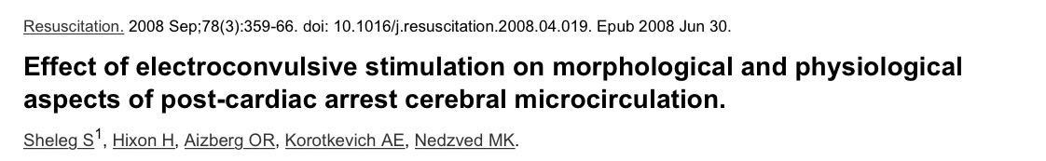
Effects of ECT on Patients in Cardiac Arrest
Decreased Rouleaux Formations
Helped Normalize Cerebral Blood Flow

Slide 8
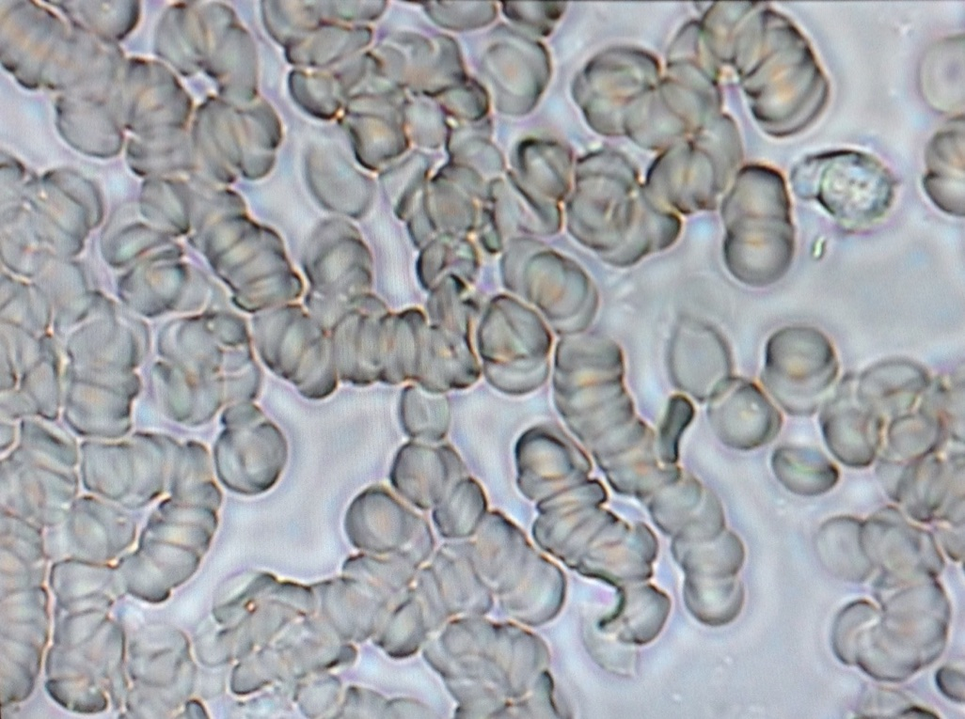
Rouleaux Formations
Peripheral Blood Smear

Slide 9
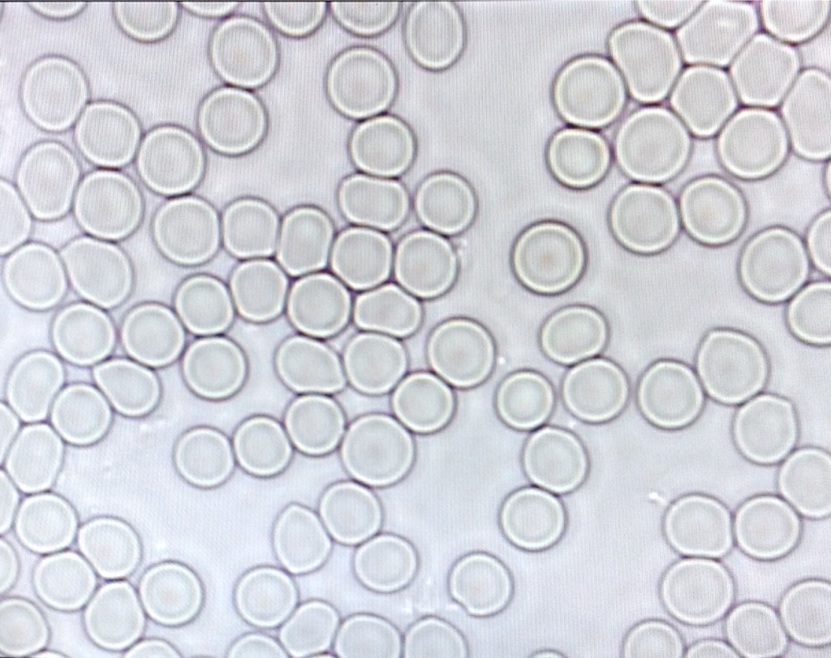
Normal
Peripheral Blood Smear

Slide 10
Inflammatory Hypothesis of
Treatment Resistant Depression
Inflammation -> Acute Phase Proteins (Fibrinogen, Hs-CRP)
Acute Phase Protein -> Bridging Molecules
Bridging Molecules -> RBC Rouleaux Formations
RBC Rouleaux Formations -> Increased Blood Viscosity
Increased Blood Viscosity -> Decreased Cerebral Perfusion
Decreased Cerebral Perfusion -> Decreased Neurotransmitters
Decreased Neurotransmitter Production -> TRD

Slide 11
Modified
Electroconvulsive Therapy (ECT)
Ultrabrief pulse width ECT
Modified Anesthesia combined with a magnesium infusion to facilitate normalization of cerebral blood flow
Onset of Action – One to two days compared to one week with Standard ECT
Normalizes Cerebral Blood Flow

Slide 12
Decreased Life Expectancy
Depression – 10 year reduction
Schizophrenia – 15 to 20 year reduction
Common Comorbid Diseases – Obesity, Type II Diabetes,
Heart Disease, Stroke, TIA, Cancer, Seizures, Migraines,
Thyroid Disease, GERD, POTS, Poor Dentition

Slide 13

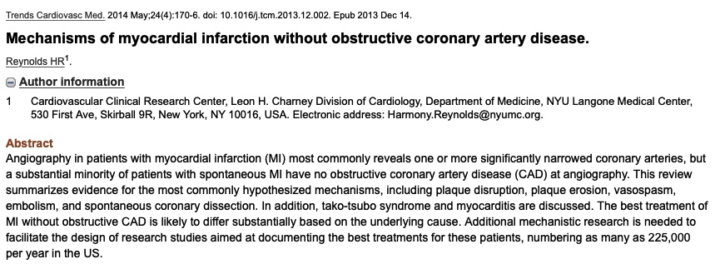
Heart Disease and TRD

Slide 14
Abnormal Laboratory Tests
Inflammatory: Elevated Hs-CRP, LpPLA2, Fibrinogen, Myeloperoxidase
Diabetic: Elevated Glucose, HgA1C, Insulin
Liver Function: Elevated SGOT, SGPT, GGT
Blood: Elevated WBC, Hemoglobin, Hematocrit
Lipids: Elevated TC, LDL, Triglycerides, Low HDL
Thyroid: TSH, T3, T4, Reverse T3, Thyroid Antibodies
Hormones: Testosterone, Parathyroid, Cortisol
Antibodies: H. Pylori IgA, IgG, IgM
Genetic: MTHFR

Slide 15
Insulin Levels
Normal – Zero to Five
Type I Diabetes – Zero
Type II Diabetes – 20 to 100
Some thin patients with bipolar depression have elevated insulin levels without elevated glucose levels

Slide 16
Mitochondrial Dysfunction
Difficult to Measure
VO2 Max Exercise Testing
Phase Angle - Bioimpedance Analysis

Slide 17
MTHFR Testing
Abnormal in 98% of patients with TRD
Prescription activated methylfolate is FDA approved for TRD
At our facility 100 patients were prescribed Activated Methylfolate and depressive symptoms were unchanged

Slide 18
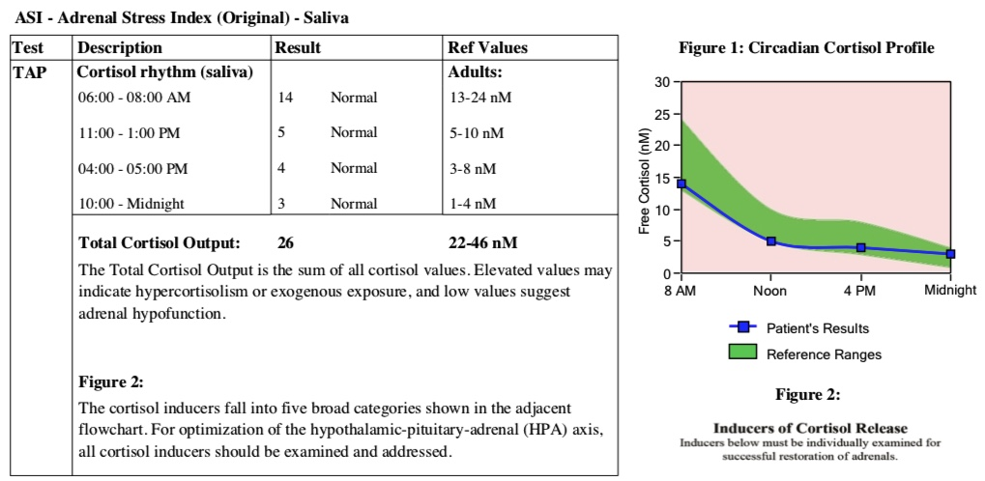
Saliva Cortisol Test
DiagnosTechs

Slide 19
NeuroStar
FDA Approved for TRD
Pulsed Electromagnetic Field Device
Does not Require Anesthesia
Unknown Mechanism of Action
Normalizes Cerebral Blood Flow

Slide 20
Personal
PEMF Devices
Uses – Acute and chronic pain, prostate hypertrophy, wound healing, increase athletic performance, stroke rehabilitation
Manufactures – Bemer, Curatron, Micro-Pulse.com

Slide 21
NMDA Receptor Antagonists
Ketamine – Injection only
Esketamine – Inhaled Ketamine
Nuedexta – Dextromethorphan/Quinidine
Zinc
Magnesium

Slide 22
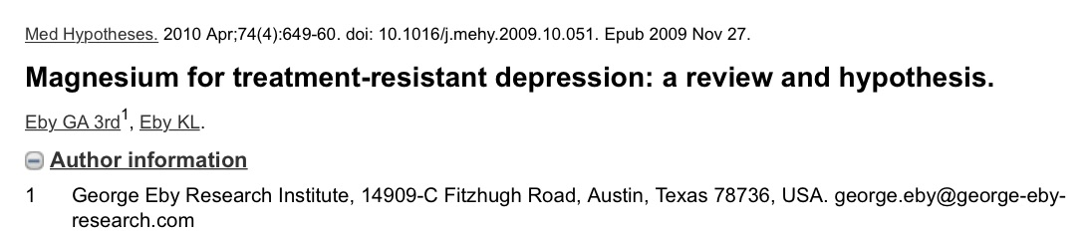
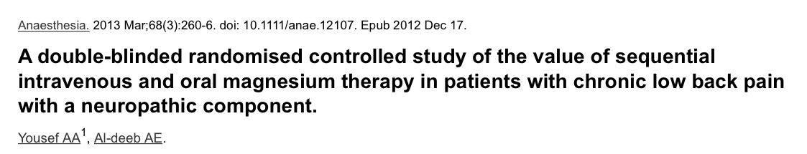
Magnesium Infusions Treat
TRD and Chronic Pain

Slide 23
Estimate Intracellular
Magnesium Levels
Only 1% of total body Magnesium found in blood
Blood Testing - poor indicator of tissue magnesium
EXA Test – Good research using Buccal Cells
Hair Tissue Mineral Analysis – Controversial

Slide 24
Diseases Associated with
Increase Blood Viscosity
Treatment Resistant Depression
Chronic Pain
Autism
Migraines
Cardiovascular Disease
Stroke
Migraines
Deep Venous Thrombosis

Slide 25
Causes of Increased
Blood Viscosity
All known cardiac risk factors
Inflammation - Fibrinogen
Infection
Obesity – Diabetes – Sleep Apnea – Polycythemia
Cancer
Lectins – Leaky Gut
NSAIDs
Heavy Metals

Slide 26
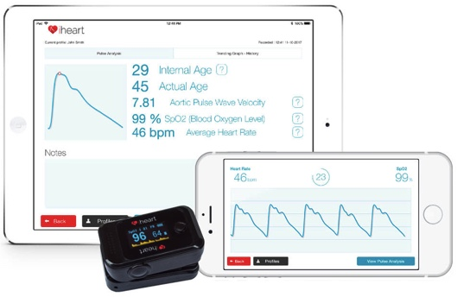
Measure Blood Viscosity
No routine tests available
iHeart Device?
Viscometer by
RheoSense

Slide 27
Normalize Blood Viscosity
Without Increased Bleeding
Donate Blood – Improves deformability of RBCs
Fasting – Decreases macromolecular bridging
Hydration
PEMF Devices
Micro-current Devices
Electron Donors – Anions, Antioxidants (Vitamin Complete from SE)
Citrate – Sodium, Potassium, or Magnesium
Digestive Enzymes – Wobenzym
Near Infrared Light

Slide 28
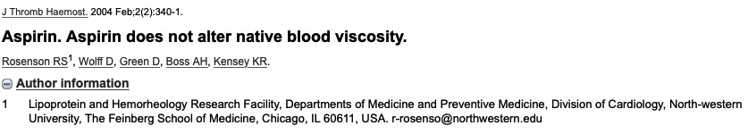
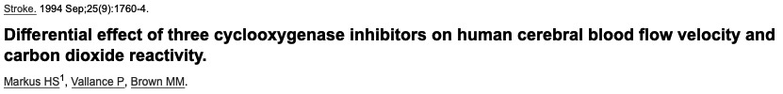
Platelet Inhibition
Minimal Effect on Blood Viscosity

Slide 29
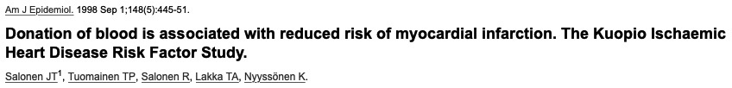
Blood Donation
Reduces Risk of Heart Attack
Ongoing study of middle-aged men in Finland – Results over 9 year period
1 of 153 had MI (0.7%) – MI within 24 months of Blood Donation
316 of 2529 had MI in control group (12.5%)

Slide 30
Personal
Micro-current Devices
Different than TENS unit
Many devices available from different manufacturers
InterX Device – Programmable with constantly changing frequency and intensity based on electrodermal impedance

Slide 31
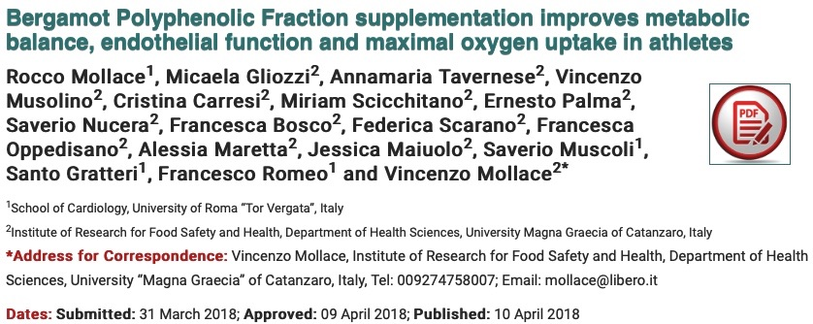
Bergamot
Bergamot 500mg twice daily improves glucose and cholesterol

Slide 32
Conclusions
Treatment resistant depression is a growing epidemic affecting the lives of millions of Americans
Procedures such as ECT and Neurostar are therapeutic applications of micro-current and pulsed electromagnetic fields
Both micro-current and pulsed electromagnetic fields are known to decrease blood viscosity
Normalization of blood viscosity is fundamental to tissue perfusion and oxygenation
TRD and many chronic healthcare conditions respond positively to simple hydration, fasting, and blood donation which help normalize blood viscosity

