Slide 1
Cancer Free with Food
Liana Werner-Gray

Slide 2
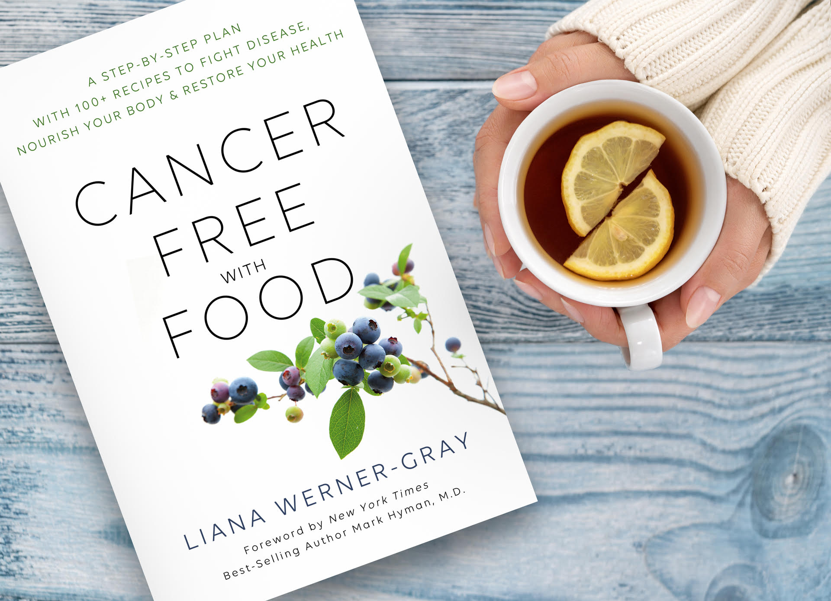
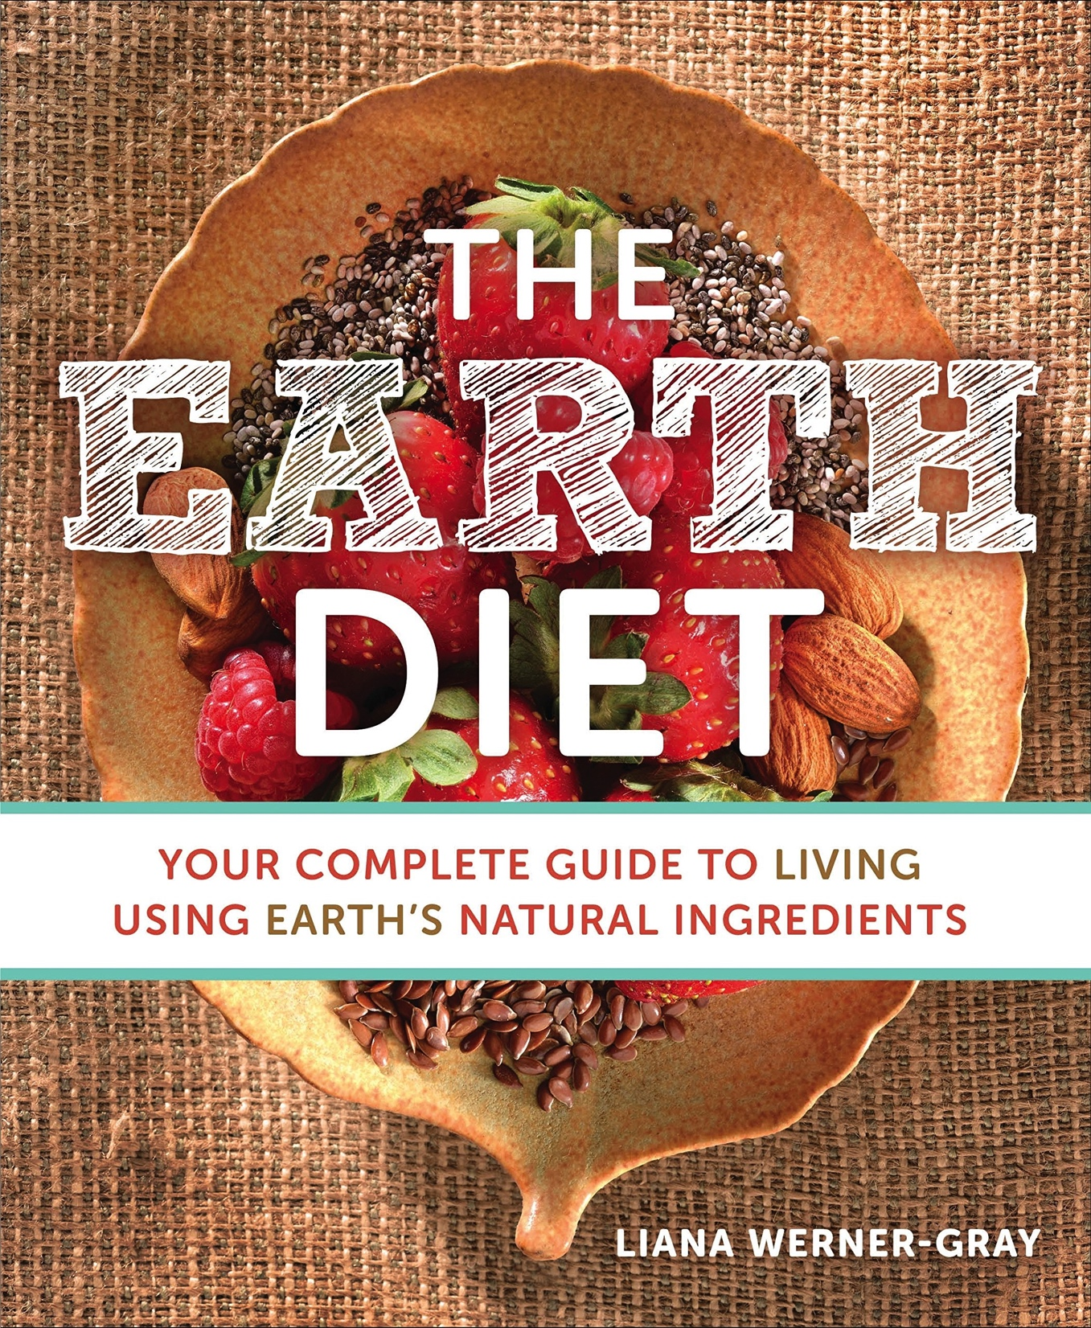
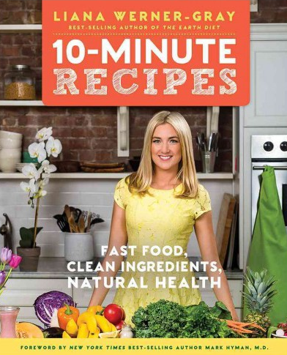
New book

Slide 3
What % of all cancers are related to diet?
“In my oncology rotation in medical school, I asked my professor what percentage of cancer was related to diet. Expecting a gracious, but insignificant nod to the role of diet as a cause of cancer, I was surprised when he said that 70 percent of all cancers are related to diet. Given this, in her book Liana answers the incredibly important question: If I’ve got or want to avoid cancer, what should I eat? Ultimately, Cancer-Free with Food is a recipe book that answers this question—one that is also filled with an abundance of evidence that diet, exercise, thoughts, feelings, and environmental toxins all can play a role in the initiation, growth, and progression of cancer. We are not at the mercy of our genetic predispositions. There is a lot we can do to stay healthy. If a nutrient-poor diet full of sugar and chemicals, lack of exercise, chronic stress, and persistent exposure to pollutants like heavy metals can cause cancer, doesn’t it make sense that a nutrient-dense, plant-based diet, physical activity, changing thoughts and reactions to stress, and detoxification can prevent and help heal cancer? To me, it does.”
Mark Hyman, M.D.,
Director of the Cleveland Clinic Center f or Functional Medicine

Slide 4
CANCER IS NOW THE LEADING CAUSE OF DEATH IN USA AND CHINA!
Cancer will affect one in two men, and one in three women
It was important for me to write this book for many reasons. The statistics on cancer are alarming. Cancer will affect one in two men and one in three women in the United States at some point in their lifetime, and the number of new cases of cancer is set to nearly double by the year 2050. Both predictions are based on statistics collected by the Surveillance, Epidemiology, and End Results (SEER) program at the National Cancer Institute (NCI).1 None of us can afford to ignore these statistics.
My personal reason for writing this book is that cancer has been prevalent in my family and circle of friends. The first time I lost someone to this disease was at age nine, when one of my grandfathers died from colon cancer. Then at 11, my friend Danielle was diagnosed with a brain tumor. I vividly remember my sister and I visiting her at the hospital after her surgery. After a yearlong battle, she passed away. Next, when I was 12 years old, my second grandfather died from cancer. It started in his stomach and ended up spreading everywhere. A few years ago, my mum was diagnosed with breast cancer.
Cancer just sucks. Learning that our nutritional choices affect whether or not we get cancer and can help us heal has given me a sense of control over my health destiny that I believe everyone should feel. That’s the ultimate reason this book exists. I wanted to put together a resource that would ensure that my younger sisters, my friends, and you and your friends and family never have to go through this same pain. Once we know what to eat and what not to eat, everything is easier.
My family is not unique and lots of people have similar stories to tell. Here’s mine . . .
In 2009, I had a major wakeup call. Although I was only 21, I ended up in the hospital with a golf ball–size lump sticking out of the right side of my neck. At first, I thought it was just a swollen gland, so I went to see my holistic therapist, Mae Rose O’Connell. She told me to immediately go to the hospital and get it checked out further. A biopsy revealed I had a 3.7-centimeter (1.45-inch) solid mass in my neck.

Slide 5
My personal healing protocol:
So what was involved in my recovery? Instead of conventional treatment, I:
Changed my diet and consumed a lot of nutrients. Created A LOT of recipes.
Juiced up to six times a day.
Bathed in bentonite clay, used it as a plaster to draw out toxins, and drank it.
Had sessions of integrative-health therapies, like refexology and massage.
Received a colonic or a coffee enema every day for two months.
Rested, relaxed, and did everything I could to reduce stress.
The lump in my neck started to noticeably get smaller and smaller, and within three months of commencing this regimen, it had completely broken down and dissolved. I have been tumor-free and cancer-free for 10 years as of this moment.

Slide 6
FOOD IS MEDICINE
Cancer cells are distorted versions of healthy cells. Knowing this, we can focus on feeding the body the nutrients that support healthy cellular function. The fastest way to promote healing is to put a high number of nutritious compounds into the body so it has what it needs to kill aggressive cancer cells.
Disclaimer: Real food aka natural food, whole food, unprocessed is medicine. Highly processed foods are toxic and known to cause cancer.

Slide 7
There are two reasons why we get cancer: toxicity and stress.
If cancer is in your genes, you only get it if you trigger those marks, like I did.
In recent years, scientists have come to realize that it’s not just our genes that decide whether we get cancer. From the emerging science of epigenetics, we know that we can influence the way our genes express themselves through the lifestyles we lead and the foods we choose to eat. Describing a study conducted by the acclaimed cardiologist Dean Ornish, Mark Hyman, M.D., writes: “After just three months on an intensive lifestyle program including a whole-foods, plant-based diet, over 500 genes that regulate cancer were beneficial affected, either turning off the cancer-causing genes or turning on the cancer-protective genes. No medication can do that.”2
Physical stress can come from chemical exposure, lack of sleep, and overworking for an extended period. These things make the body vulnerable to illness.
Mental stress includes negative thoughts, whether your own self-talk based on your belief system or ongoing exposure to outside criticism. Sadness and anxiety make us more vulnerable to illness.
Emotional stress includes wounds from traumas in your past that haven’t healed yet. If you had a car crash, lost your job, are mourning a loss, or are in the middle of a divorce, this could be an emotional stress factor.
Through lifestyle modification alone, we can literally rewrite our genetic code. Just because your parents, grandparents, or siblings had cancer doesn’t mean you have to!

Slide 8
7 nutritional principles to prevent and heal cancer:
Nutrition matters when it comes to preventing and healing cancer. Certain nutrients are most effective for fighting cancer overall, as well as for healing certain types of cancer. To increase your chances of preventing and overcoming cancer at any stage, here are the seven key nutritional principles that have proven to be most effective.
#1. Eat More Whole Foods
#2. Drink at Least One Juice Daily
#3. Buy Organic, Non-GMO Foods
#4. Cut Out Refined Sugars
#5. Avoid Refined Carbs; Eat High-Fiber Carbs
#6. Cultivate a Healthy Gut
#7. Hydrate with Purified Water

Slide 9
Should I give up sugar?
Safe sugar vs Unsafe sugar
Is there ever a need for refined sugar in our diets? No. It causes far too many health problems for us to accept it in our food. Sugar feeds cancer and supports its growth. I’ve come across two types of people with cancer. When they get diagnosed, one type feels the need to give up sugars altogether, including fruits, while the other type prefers to adopt my upgrade system.
SAFE LIST:
Fruits
Dates
Figs
Maple syrup
Honey
Stevia
Monk fruit sweetener
^{UNSAFE LIST:}
• Refined white sugar (cane or beet sugar)
^{• Raw sugar (cane sugar)}
^{• Brown sugar}
• Corn syrup (regular and high-fructose corn syrup)
^{• Artificial sweeteners}
^{• Acesulfame potassium}
^{(Sunett, Sweet One)}
^{• Neotame}
• Saccharin (Sugar Twin, Sweet’N Low)
^{• Sucralose}

Slide 10
THE LASTEST RESEARCH ON THE
TOP 15 CANCER-KILLING FOODS
Woo-hoo! We’ve got this! Habits can be broken. Choices can be changed. As the proverb states, “No matter how far you have gone on the wrong road, you can always turn back.”
#1 Cancer-Healing Food: Broccoli Sprouts
#2 Cancer-Healing Food: Turmeric
#3 Cancer-Healing Food: Blueberries
#4 Cancer-Healing Food: Broccoli
#5 Cancer-Healing Food: Flaxseed
#6 Cancer-Healing Food: Dark leafy greens
#7 Cancer-Healing Food: Garlic
#8 Cancer-Healing Food: Mushrooms
#9 Cancer-Healing Food: Cacao
#10 Cancer-Healing Food: Tigernuts

Slide 11
#1 Broccoli Sprouts
Broccoli sprouts are incredibly potent killers of cancer cells because of their unusually high sulforaphane content. Sulforaphane is also found in broccoli, spinach, kale, cauliflower, bok choy, cabbage, and brussels sprouts. But broccoli sprouts contain the most of any other vegetable on the planet.
In one particular study, sulforaphane eliminates breast cancer stem cells in 2 weeks after cell inoculation, animals were daily injected with 50g of sulforaphane. And then even better news, sulforaphane decreased positive cell population by 65% - 80% in human breast cancer cells.
Paul Talalay, M.D., a professor of pharmacology and molecular sciences at the Johns Hopkins University School of Medicine, who has done research for 25 years on vegetable compounds, is a major advocate of broccoli spouts. He says: “Three-day-old broccoli sprouts consistently contain 20 to 50 times the amount of chemoprotective compounds found in mature broccoli heads and may offer a simple dietary means of chemically reducing cancer risk.”2 In 1992, Talalay and his research team found that sulforaphane has the ability to reinforce the body’s natural defenses against oxidative stress, inflammation, and DNA damage.3
Over the years, many studies by other researchers have supported Dr. Talalay’s conclusions. One by Jed Fahey, Sc.D., director of the Cullman Chemoprotection Center at Johns Hopkins University, proved that broccoli sprouts provide “dramatic protection” against digestive issues, including stomach cancer, ulcers, gastritis, and overgrowths of Helicobacter pylori, a bacterium “strongly associated with inflammation related to digestive cancers.”5
During an experiment involving 48 patients with H. pylori infections in which half the volunteers ate 2.5 ounces of broccoli sprouts per day for two months, and half ate the equivalent amount of alfalfa sprouts, which do not contain sulforaphane, biomarkers of infection dropped for the volunteers eating the broccoli sprouts.
Suggested “Dosage” To heal cancer: 2.5 ounces of broccoli sprouts per day. To prevent cancer: 2.5 ounces of broccoli sprouts every third day

Slide 12
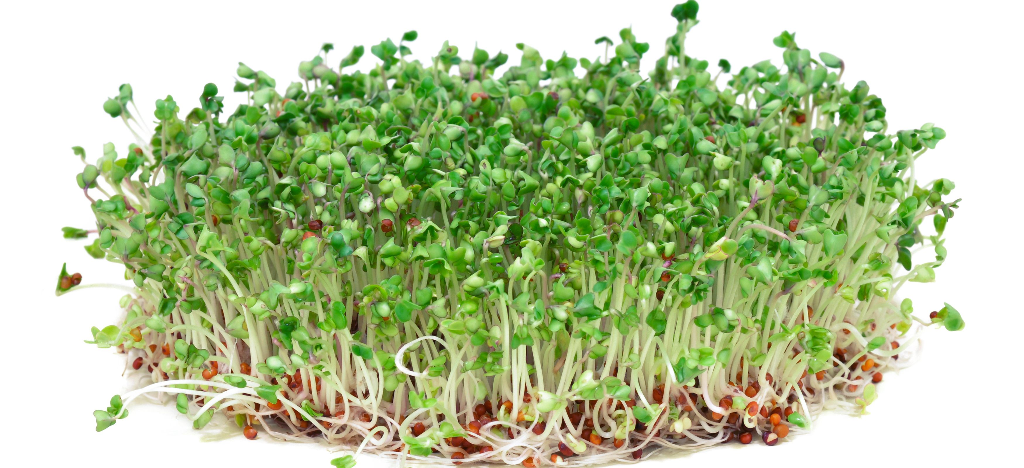

Slide 13
#9 Cancer-Healing Food: Cacao
Cacao is the main ingredient in pure chocolate before it is made into the treat as we know it. Usually, after cacao is harvested, it is taken and heat-processed to make it into cocoa powder. Be- cause of the heat, cocoa does not have as many nutrients as a raw cacao powder. Raw cacao powder is very high in nutrients and minerals.
Cacao is super high in magnesium, a mineral that relaxes our muscles and eases pain in the body; it’s no wonder that we crave chocolate! Cacao contains polyphenolic compounds that are highly beneficial to our health. It has also been proven by the science community to be an anti-inflammatory with anti-tumor activities.68 Cacao has been shown to have many potential anticancer compounds because of its high antioxidant count (40 times that of blueberries!). It has the ability to reduce inflammation, reduce the risk of obesity, and improve cardiovascular circulation. The physiological effects of caffeine and theobromine, the most abundant methylxanthines in cacao, are notable. Theobromine is a heart stimulant and vasodilator—meaning, it widens blood vessels. It is used to treat high blood pressure and is also a diuretic. All these benefits assist in keeping the body in a state less hospitable to cancer. A study showed that theobromine might be extremely effective in preventing human glioblastoma, brain tumors.

Slide 14
The physiological effects of caffeine and theobromine, the most abundant methylxanthines in cacao, are notable. Theobromine is a heart stimulant and vasodilator—meaning, it widens blood vessels. It is used to treat high blood pressure and is also a diuretic. All these benefits assist in keeping the body in a state less hospitable to cancer. A study showed that theobromine might be extremely effective in preventing human glioblastoma, brain tumors. 70
Caffeine from tea or coffee helps increase stamina and focus, and has a positive effect on memory, which can help you if you are experiencing “chemo brain,” the foggy thinking that is a side effect of chemotherapy. It also has many other known health benefits (as long as consumed in moderation) and has been observed to decrease risk of certain cancers, including endometrial cancer.71,72
Caffeine from tea, cacao or coffee helps increase stamina and focus, and has a positive effect on memory, which can help you if you are experiencing “chemo brain,” the foggy thinking that is a side effect of chemotherapy. It also has many other known health benefits (as long as consumed in moderation) and has been observed to decrease risk of certain cancers, including endometrial cancer.

Slide 15
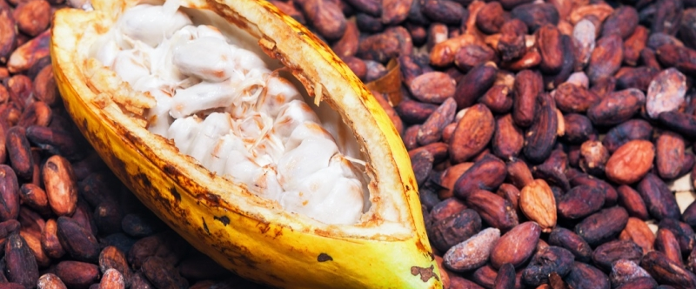
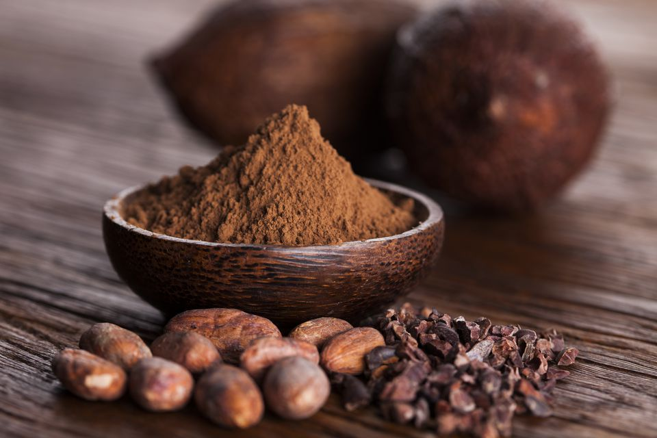

Slide 16
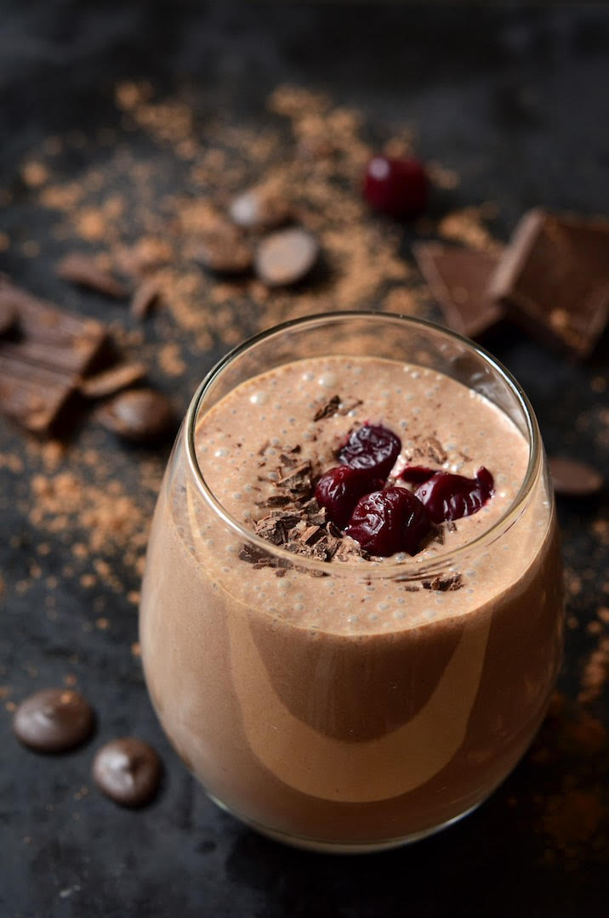
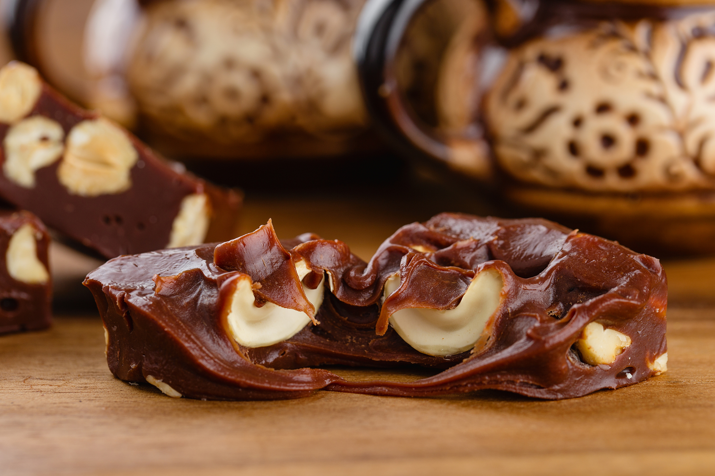

Slide 17
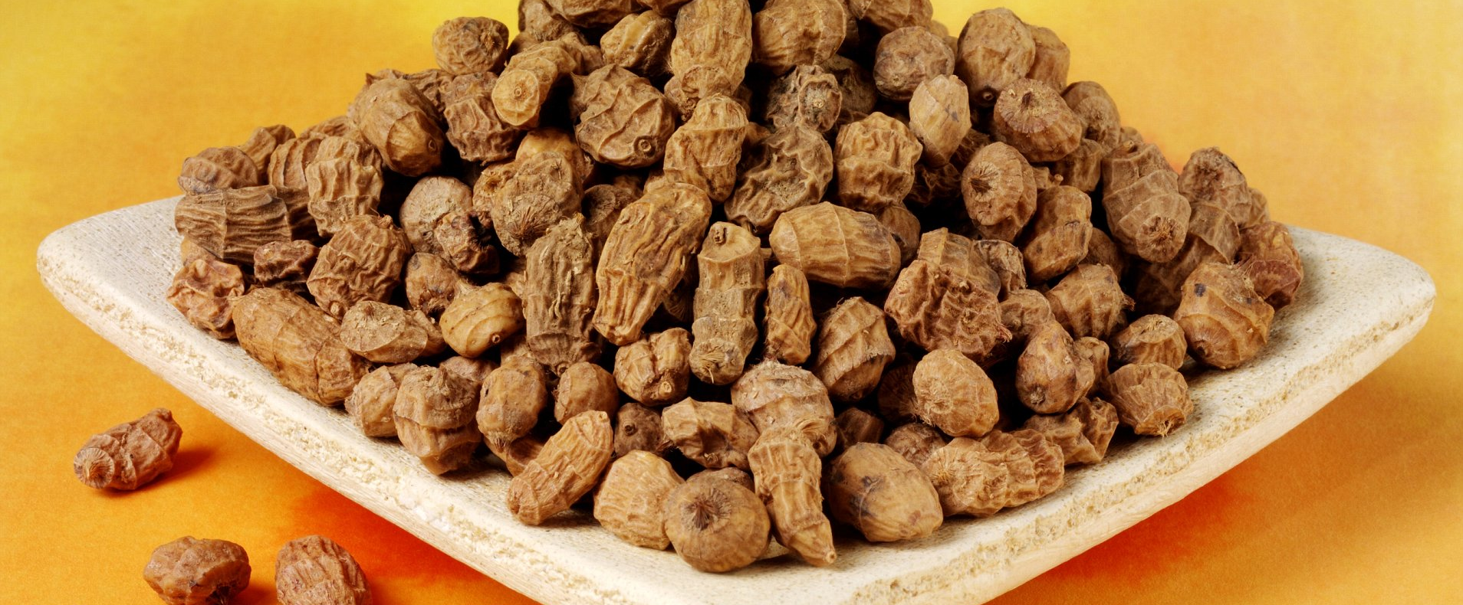
#10 Cancer-Healing Food: Tigernuts

Slide 18
Tigernuts
A tigernut is a root vegetable—a tuber. It is called a tiger “nut” simply because of its appearance. (Once you see one, you’ll know what I mean.) Tigernut is a vegetable our ancestors dis- covered a long time ago and would have relied on as a source of iron and prebiotic starch. A prebiotic starch is a substance that promotes health by encouraging the growth of probiotics, which are “friendly” gut flora (bacteria) such as bi dobacteria and lactobacilli.
Believe it or not, tigernut has the same amount of iron as red meat. Because tigernut is such an excellent source of iron, it is a vegetarian’s best friend! People are just learning about tigernuts as they begin to surface in the mainstream. Every household should be stocked with tigernuts, tigernut our, and tigernut milk because of their incredible health benefits, which include their anticancer properties.
One of my favorite root vegetables, tigernuts are high in fiber and resistant starch. Resistant starch has a similar physiologic effect as dietary fiber and can function as a milk laxative. Tigernuts are a viscous starch that is highly valued as a component in some functional foods.79 They won me over as soon as I heard about them.
It’s easy to grow your own tigernuts. When you purchase a bag of them, simply plant some in soil and water them every couple of days. Soon you will start to see grass-like shoots come up, and after about a month, you can pull a whole cluster of new tigernuts up. These low-maintenance plants grow like weeds, independently, without pesticides.
Eating tigernuts is good for the environment as well as your body. Tigernut Milk can be made simply by tossing a quarter cup of tigernuts in four cups of water and giving them a spin in a blender. By contrast, almond trees require a lot of water and are often farmed using pesticides. Plus, store-bought almond milk is often pasteurized, which changes its nutritional value. Tigernut milk is naturally sweet—no cane sugar is generally added to the store-bought variety, like it is to many brands of nut milk.
One study showed that tigernut milk can be useful for preventing liver damage from the pain reliever acetaminophen! Researchers concluded that the phytochemicals in tigernut milk significantly prevented liver injury.80 So drink tigernut milk for its liver-protecting properties during chemotherapy, when your liver is in danger of being overwhelmed with toxins.

Slide 19
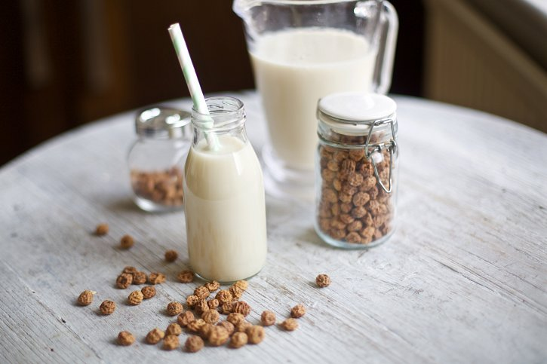
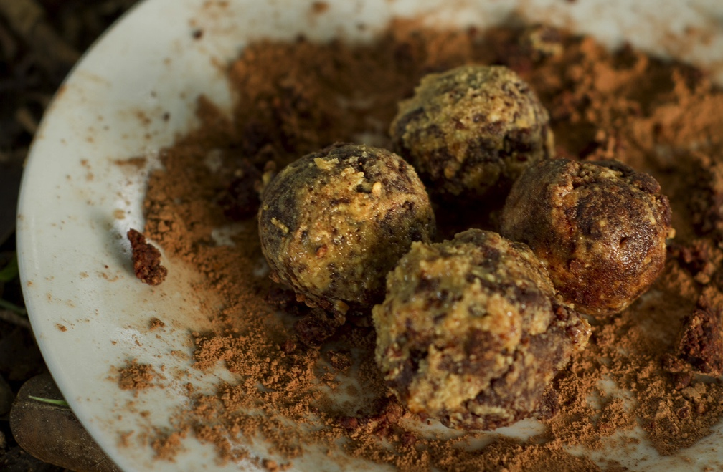
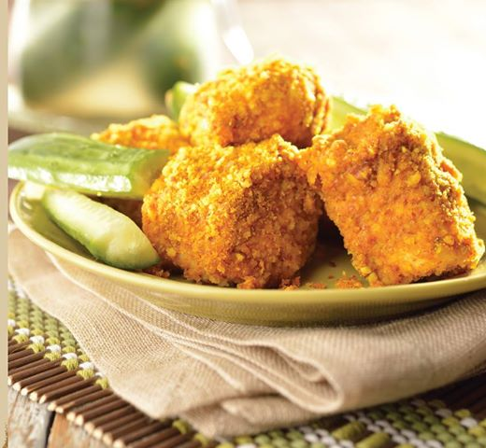

Slide 20
Chlorophyll
Chlorophyll is a light-absorbing green pigment present in plants that helps them feed on the energy of sunlight. Chlorophyll is nontoxic to humans and contains magnesium. The molecule is similar to the hemoglobin in our bloodstreams that carries oxygen to our cells. As far as cancer goes, a study showed that the growth of melanoma cells in mouse tumors were effectively inhibited after being treated with chlorophyll. This is an indication there may be promise for using chlorophyll as an anticancer supplement. 23
You consume chlorophyll every time you eat a green vegetable, have a leafy salad, or drink a green juice. If you are not consuming these foods, a supplement could effectively provide your body with chlorophyll. Because of its dark green tint, I use chlorophyll as a food dye, and so do many other natural-food chefs, for making things green like a green frosting.
Suggested dosage: You can buy it in liquid or capsule form. Follow the package instructions; a small amount goes a long way.

Slide 21
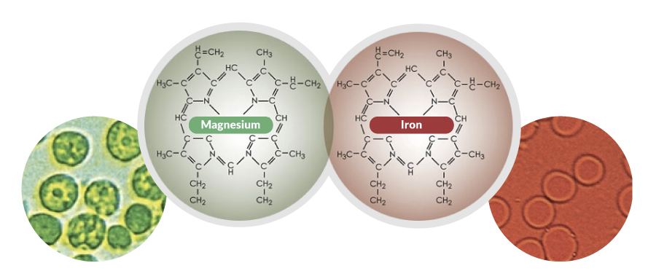

Slide 22
Cancer-Free HACK: One juice everyday
Drink at Least One Juice Daily
When I committed myself to healing, I researched ways to put high amounts of nutrition in my body as quickly as possible. I knew that to support my immune system so that it could play its role in healing my body, I would have to essentially feast on nutrients. Having deprived my body of proper foods for many years, I knew my body didn’t have the resources it needed to function properly and keep me well.
I learned that an extremely fast way to get the vitamins and phytochemicals we need is to drink fresh juices. An alternative method of healing is for a quali ed health-care practitioner to give an antioxidant-rich vitamin drip from an IV. However, I knew that wasn’t for me. (I don’t like needles and the cost was prohibitive.) Intuitively, I knew that through daily juicing, my cells would be nourished and detoxified.
Every time I had a juice, I imagined it as liquid medicine going into my bloodstream and pumping energy straight into my cells. I visualized cancer cells and my cravings for junk food being forced out of my body. I knew that the nutrients I was taking in were helping me create new cells and build a new body.

Slide 23
BENTONITE CLAY
Bentonite clay is ash that has accumulated from volcanoes over millions of years. This remarkable clay has magnetic properties that can assist us in expelling impurities, toxins, worms, parasites, and heavy metals from the blood, gut, and body. It is a natural chelator that absorbs toxins so they can be excreted safely. Bentonite clay contains an abundance of minerals, including magnesium, calcium, iron, potassium, and silica. There are some great studies on bentonite clay and cancer, including one that talks about chickens with an accumulation of carcinogens in their tissue. After treatment, the chickens that received bentonite clay had reduced levels of aflatoxins in their livers and increased longevity.
This is one of the known benefits of drinking bentonite clay—it assists the liver in the natural detoxification process to ensure toxins are kept out. The clay absorbs toxins, which are then expelled with the remnants of the clay when we poop.
Based on different studies, here are two things the clay does. An in vitro study showed the clay inhibits the growth of spinal cord and brain tumors (glioblastomas). Researchers tested the urine of people in an at-risk population and found that the clay reduces the bioavailability of carcinogens (aflatoxins and fumonisins). It reduces our risk of liver cancer (hepatocellular carcinoma) and esophageal cancer.
BENTONITE CLAY DRINK
Use a wooden spoon to mix the clay into the water, because a metal utensil will change the molecular structure.
Total time: 5 minutes Makes 1 serving
Ingredients: 1 teaspoon bentonite clay and 1 cup filtered water
Actions: Use a wooden spoon to mix the clay into the water, stirring until there are no lumps.
Tip: If you let this drink sit for 30 minutes before stirring, lumps often dissolve on their own, making it possible to
achieve a smoother consistency.
Calories: 0 | Protein: 0g | Carbs: 0g | Dietary Fiber: 0g | Fat: 0g | Vitamin C: 0mg | Vitamin D: 0 IU | Vitamin E: 0mg |
Calcium: 7.1mg | Iron: 0mg | Magnesium: 2.3mg | Potassium: 0mg

Slide 24
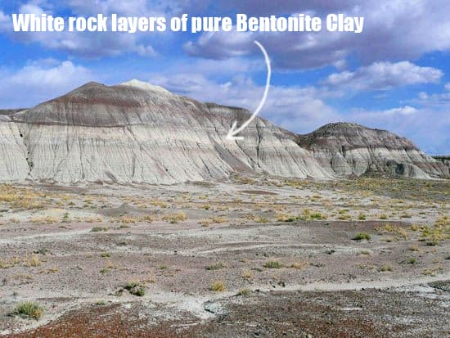
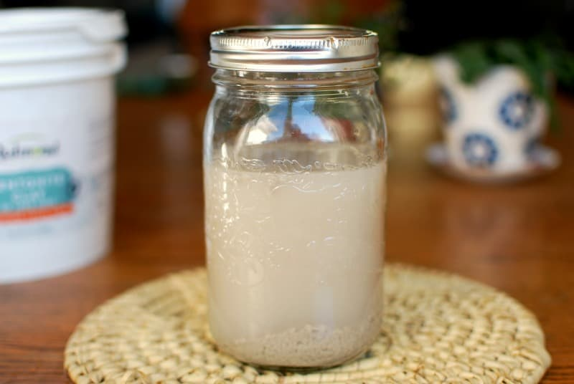
Bentonite Clay Drink

Slide 25
AVOID THE 15 MOST TOXIC
FOODS ON THE PLANET
What you don’t know may kill you -
I hope this information can be taught in schools someday, so children can get a great head start in knowing what foods to avoid, both as their bodies and minds are developing and for the rest of their lives. Even if we are not able to eliminate all of these items from our diet completely, every human being should at least cut down on their intake of these substances.
1. Refined sugar: white sugar, brown sugar, and corn syrup
2. Food additives: artificial sweeteners (e.g., aspartame), stabilizers, and preservatives (e.g., benzoate)
3. Soda
4. Food from cans and plastics made with BPA
5. Genetically modified organisms (GMOs)
6. Conventional white our (GMO), which contains gluten
7. Excessive alcohol
8. Meat from animals treated with hormones or fed nonorganic food
9. Meats that are charred or processed
10. Nonorganic fruits and vegetables
11. Nonorganic dairy products
12. Farmed seafood
13. Pasteurized food
14. Foods containing trans fats and partially hydrogenated oils (for example, margarine and processed cakes, cookies, and potato chips)
15. Microwaved food

Slide 26
Reasons To Cut Out Refined Sugars
Cancer cells are basically “addicted” to refined sugar. In fact, when they can’t consume enough, they begin to die. The sugar molecules feed the cancer, creating an environment in the body in which it can thrive. For these reasons, highly processed sugar (which has no nutritional value) should be banned, especially in hospitals and schools.
Sugar creates problems for the body, the mind, and the emotions. The average American consumes way too much sugar—152 pounds a year. Every time sugar is consumed, it triggers the release of the hormone insulin, which causes blood sugar to drop. Then there are cravings for more glucose (the molecule in table sugar), and the cycle is perpetuated. It leads to crazy swings in energy and mood—real highs and lows.
The bottom line is: If you cut white sugar out of your diet, you will reduce your risk of cancer. Cancer is ravenous for sugar.

Slide 27
Reasons To Cut Out Artificial Food Additives
One of the most common, and toxic, preservatives in processed foods is benzoic acid. Sodium benzoate (the salt form of benzoic acid) is used in foods like processed fruit juice, syrup, jams, jelly, preserves, sauerkraut, pickles, and so on. Its purpose is to keep them from spoiling by limiting the growth of microbes. Sometimes, when benzoic acid comes into contact with citric acid, it is converted into benzene, a chemical that has been linked to leukemia and other blood cancers.3 Journalist Deborah Mitchell writes: “In a laboratory study, scientists evaluated the genotoxic impact of sodium benzoate in cultured human cells. They found that the chemical significantly increased damage to DNA (which triggers cell mutation and cancer) when it was added to the cells in various concentrations.”4
Sodium benzoate and potassium benzoate were investigated and discovered to be toxic to living cells and an agent of mutation. Both damage chromosomes.5 Sodium nitrate and sodium nitrite were classified by the International Agency for Research on Cancer as probably carcinogenic to humans, particularly in the colon.6

Slide 28
BHA and BHT (E320) are stabilizers for foods containing oils and fats whose purpose as additives is to keep those foods from becoming rancid too soon or under high heat. They are actually considered antioxidants. Found in potato chips, gum, cereal, frozen sausages, enriched rice, lard, shortening, candy, and gelatin, supposedly they’re safe for human consumption, but we know they cause cancer in lab rats—and, oh yeah, they’re used to manufacture rubber.7 Ick!
Artificial sweeteners such as aspartame, saccharine, and sucralose generate damaging free radicals in the body when we digest them. Preliminary research suggests they may contribute to the development of urinary or bladder cancers.8 After digestion, they also can remain present in the liver, kidneys, and the brain for a while. Mental side effects can include headaches, migraines, dizziness, and mood swings.
Food dye is carcinogenic partly because the body cannot digest it properly. The Center for Science in the Public Interest published a report titled “Food Dyes: A Rainbow of Risks,” laying out the evidence on nine common blue, red, green, orange, and yellow dyes that have been derived from petroleum products and coal tar—things we would never eat wittingly. And now you know, so you can avoid them!9

Slide 29
LIVING THE FOOD UPGRADE MIND-SET
After my diagnosis, I still felt the urge to eat junk food. This troubled me very much, because I knew that eating like this would not help me heal and would only worsen my condition, yet there was a part of me that wanted to go out and eat food that was terrible for me. This is one of those confusing human moments that at the end of the day we can laugh at, although it may seem overwhelming while it’s occurring.
REMEMBER: It’s a process, and it’s upgrading one thing at a time. Be proud of every single step you do make.
The upgrade thought process:
When you have a craving think, How can I satisfy this in the best way possible?
Worst-case scenario: Low-quality, fast-food and conventional options; GMO and nonorganic ingredients; high-sugar, high-fat foods; anything with artificial colorings, flavors, and preservatives. The solution here is: do not add extra stress while eating this.
Better upgrade: The organic option is purchasing with clean ingredients.
Best upgrade: Make your own with the highest-quality ingredients you can buy.

Slide 30
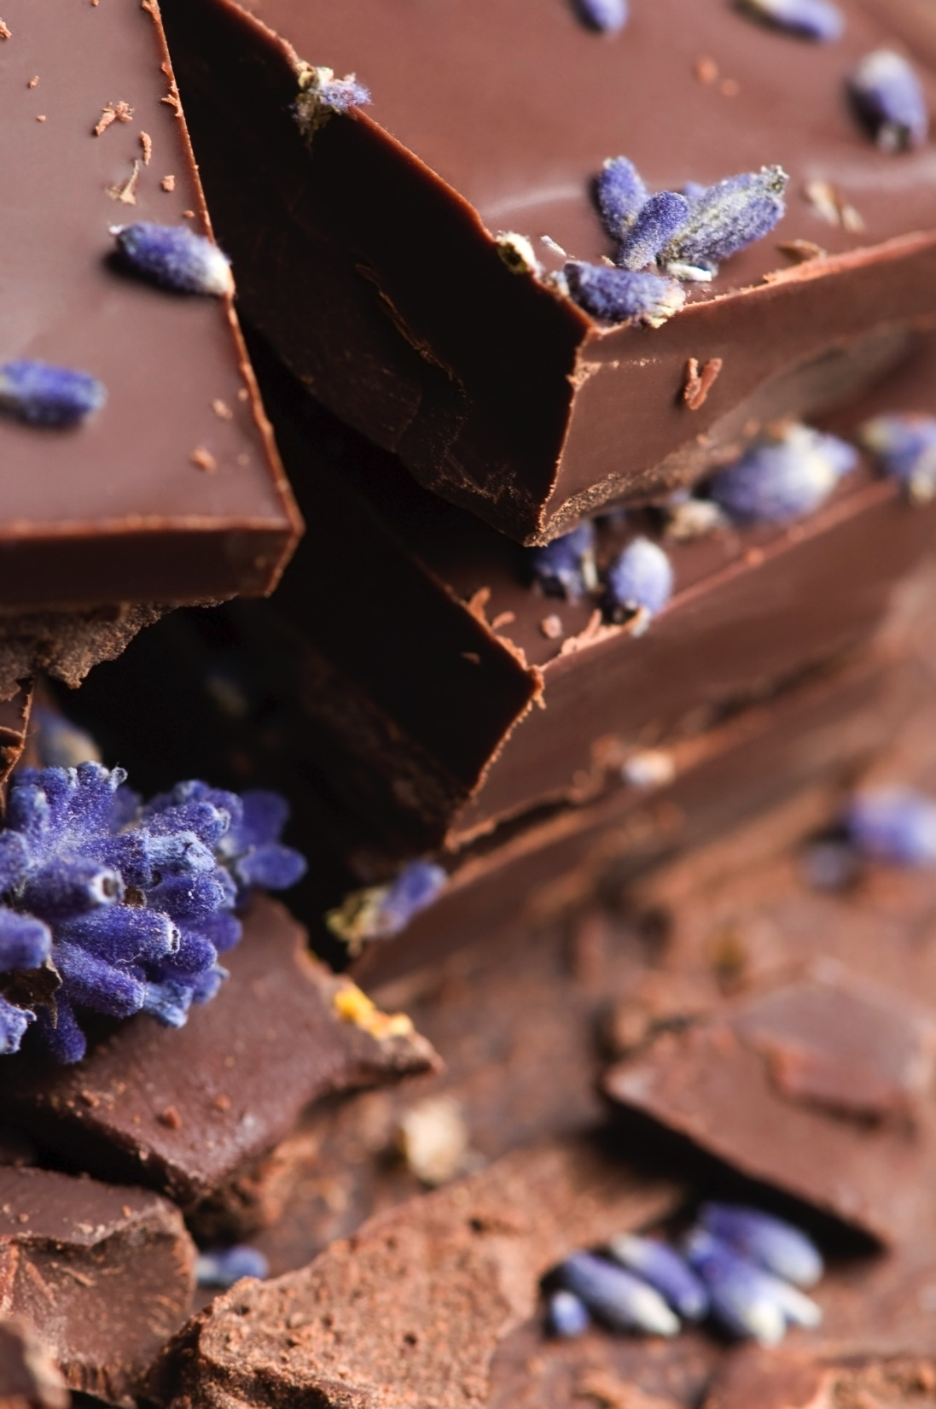
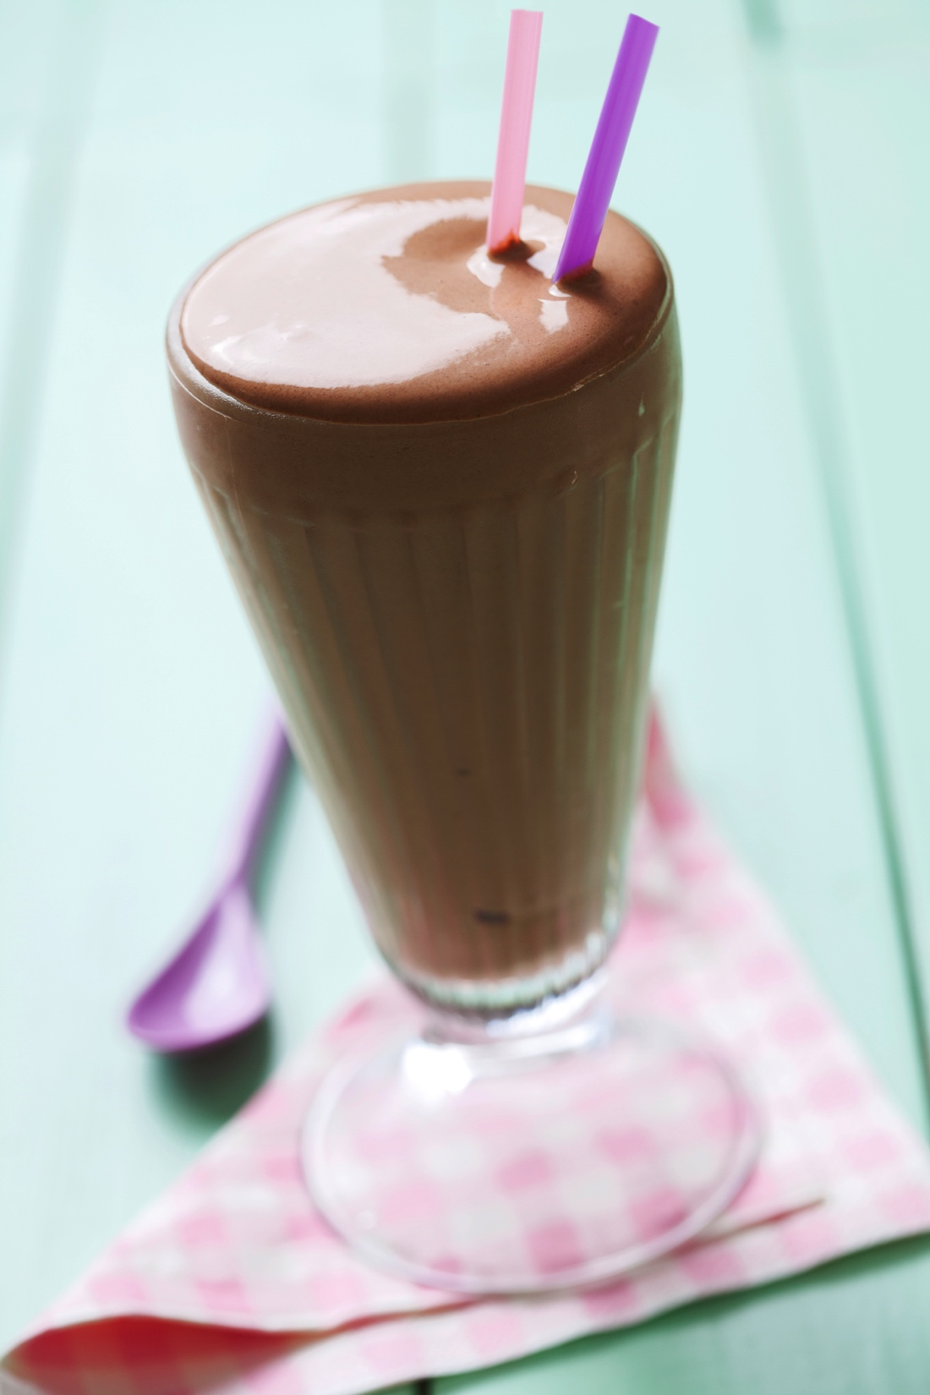
The Chocolate Upgrade
Buy it better
Make your own!

Slide 31
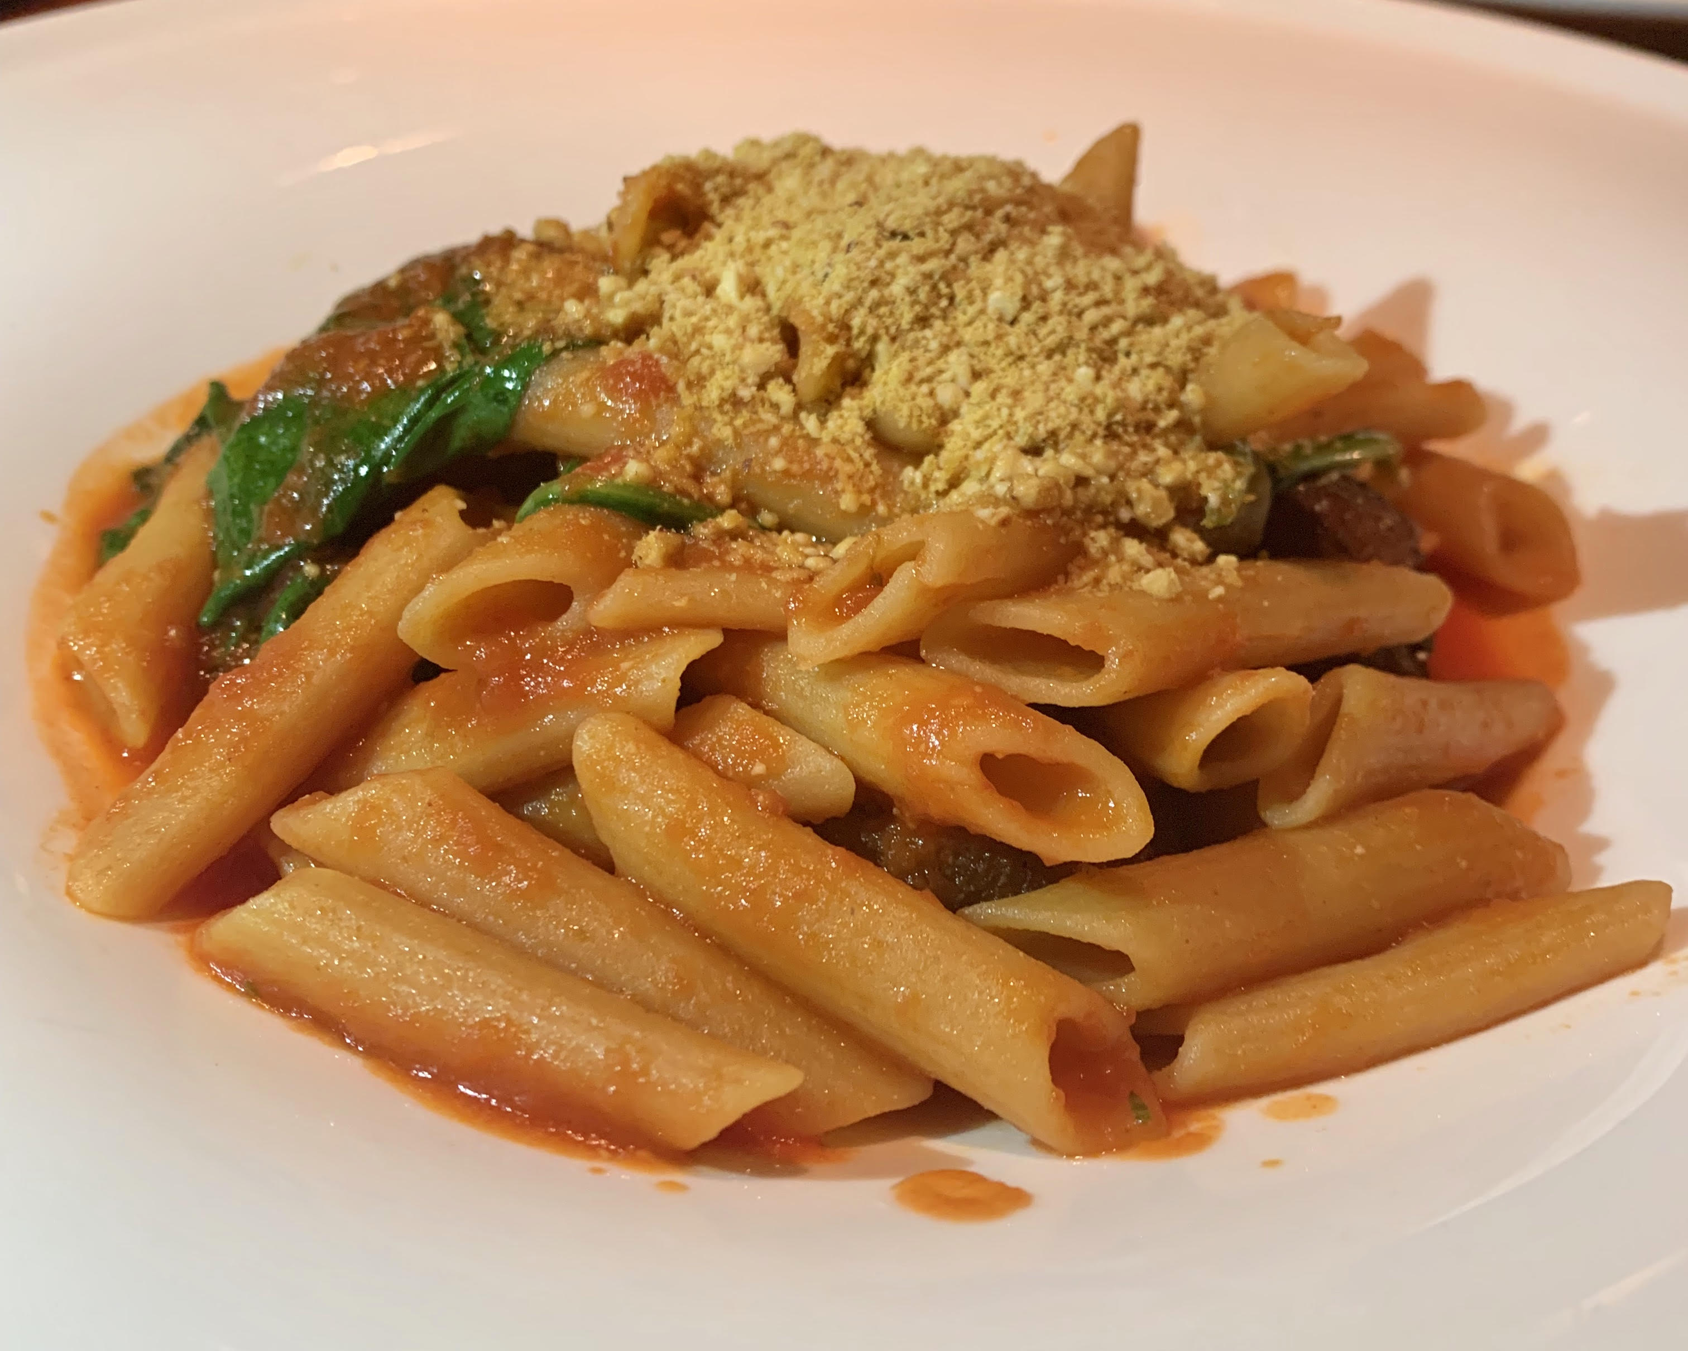
Red Lentil Penne sayyy whattttttt!

Slide 32
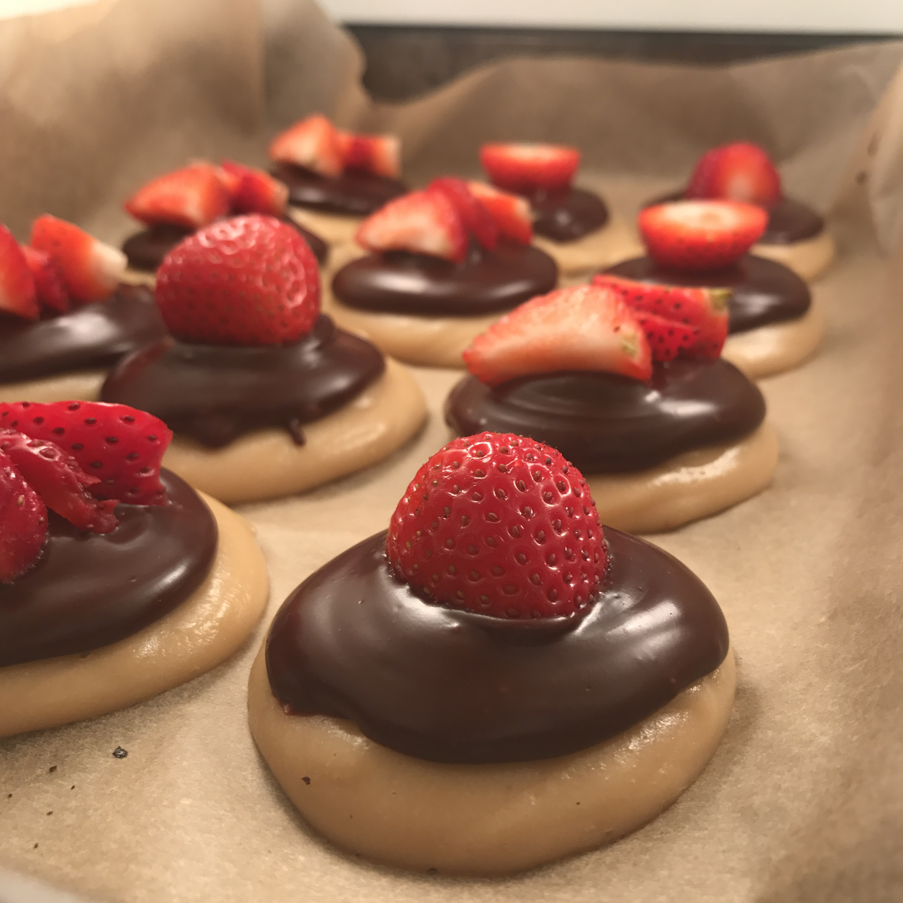
The Ice Cream Upgrade
Soak cashews in water
Blend with coconut oil, lemon, vanilla and maple syrup
Freeze

Slide 33
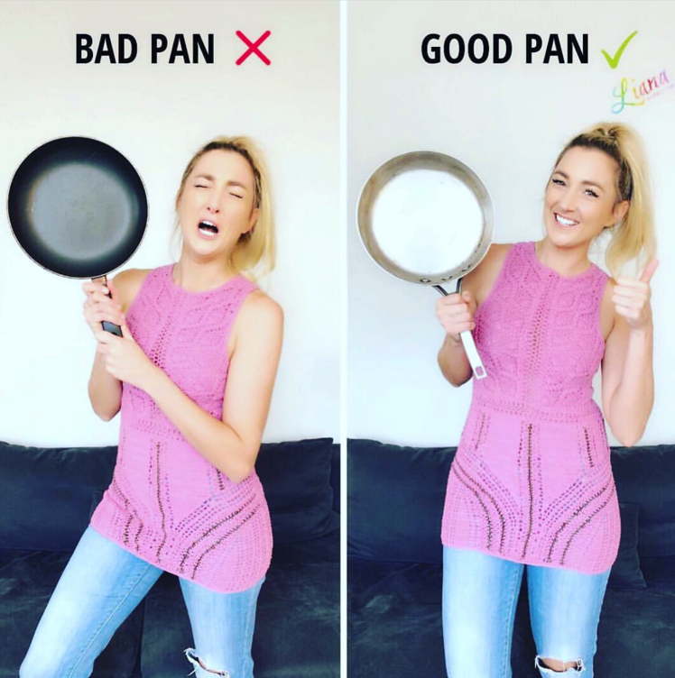
THE PAN UPGRADE

Slide 34
Beet Juice
Beets are a great cancer cleanser. This juice not only detoxifies the blood and liver, it also helps lift compacted waste from the bowel wall. I drank this every single day during my healing and it cleaned out my body.
Total time: 10 minutes Makes 1 serving
Ingredients:
1 small beet
2 red apples
4 carrots
Thumb size piece of ginger
3 celery stalks
½ lemon, peeled
Actions:
1. Put all the ingredients in a juicer.
2. Juice and drink.
Calories: 385.4 | Protein: 4.7g | Carbs: 90.8g | Dietary Fiber: 18.8g | Fat: 1.5g | Vitamin C: 18.4mg | Vitamin D: 0 IU | Vitamin E: 2.6mg | Calcium: 119mg | Iron: 1.8mg | Magnesium: 69.3mg | Potassium: 1,488mg

Slide 35
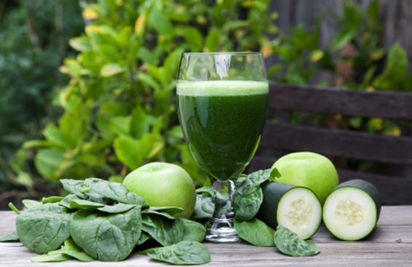
SUPER-POWERFUL GREEN JUICE
You can get all your essential greens in one drink with this recipe. The greens in this juice are so nutrient-rich and intense that the juice puts oxygen into your cells, which creates an alkaline environment where cancer cells are unwelcome. This is the green juice I drink most often.
Total time: 10 minutes Makes 1 serving
Ingredients:
1 cucumber
3 celery stalks
cup kale
cup spinach
cup parsley
cup cilantro
cup dandelion greens
cup watercress
1 cup broccoli sprouts
lemon (you can juice the rind) 1 thumb-size piece of ginger
Optional, for sweetness add 1 green apple or cup pineapple
Actions:
1. Put all the ingredients in a juicer.
2. Juice and drink.
Calories: 148.7 | Protein: 9.9g | Carbs: 23.7g | Dietary Fiber: 6.7g | Fat: 2.3g | Vitamin C: 197.5mg | Vitamin D: 0 IU | Vitamin E: 2mg | Calcium: 437mg | Iron: 5.8mg | Magnesium: 117.1mg | Potassium: 1,557mg

Slide 36
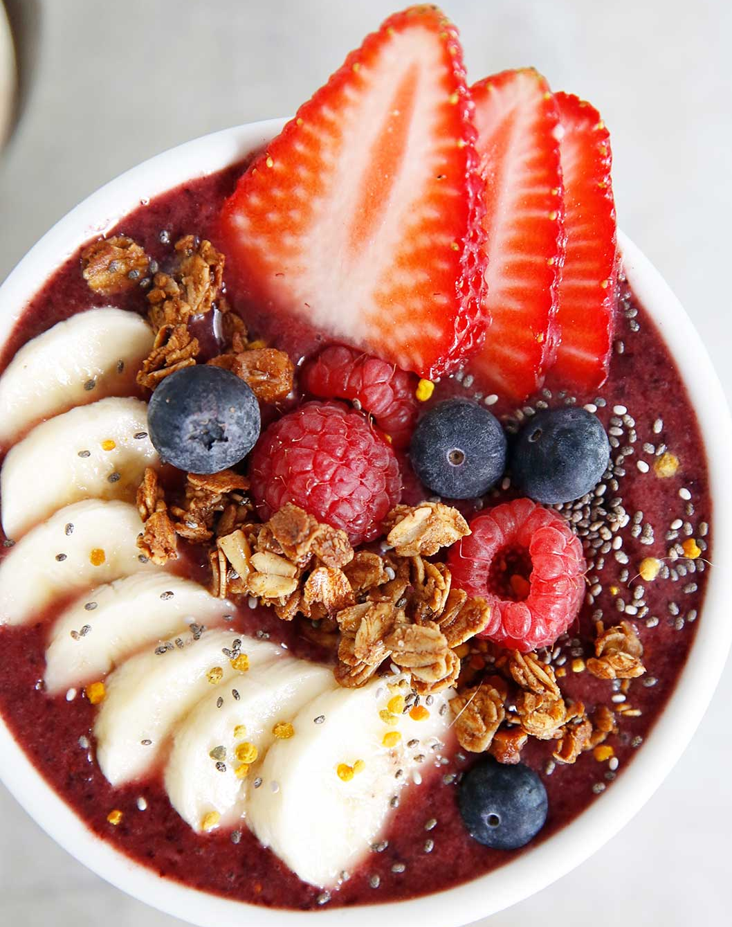
LIANA’S FAVORITE SMOOTHIE BOWL
This is my favorite bowl because of the combination of berries with almond butter and cacao powder as a base.
And then I love the crunchiness, textures, and flavor of the toppings. From Brain-Protecting Smoothies and Smoothie Bowls
Total time: 10 minutes Makes 2 servings
Ingredients:
Smoothie:
2 cups frozen berries (strawberries, raspberries, and blueberries)
1up filtered water
3 tablespoons almond butter 1 tablespoon cacao powder 1 tablespoon raw
honey
Toppings:
1 teaspoon bee pollen, 2 teaspoons hemp seeds, 1 teaspoon ax meal or
seeds , 1 tablespoon
roasted chopped almonds, 1 tablespoon roasted chopped hazelnuts, 1
\ tablespoon fresh blueberries
4 strawberries, sliced, Sprinkle of blue-green algae
Actions:
Add all smoothie ingredients to a blender and blend until completely smooth. Add the
toppings and
enjoy.
Calories: 337.1 | Protein: 9.6g | Carbs: 37.1g | Dietary Fiber: 10.9g | Fat: 19.6g |
Vitamin C: 60.3mg | Vitamin D: 0 IU | Vitamin E: 7mg | Calcium: 139.2mg | Iron: 3.1mg | Magnesium: 137.9mg |
Potassium: 532.4mg

Slide 37
ANTI-INFLAMMATORY GINGER TEA
If you have cancer, or want to prevent cancer, always have some fresh ginger root in your home. You can cut it up and boil it to make a ginger tea. I recommend drinking a ginger tea every night before bed. Ginger is an incredibly powerful anti-inflammatory and assists in reducing pain, cramps, aches, and bloating. It also suppresses appetite, so it can help curb sugar cravings at nighttime.
Total time: 10 minutes Makes 2 servings
Ingredients:
4 cups filtered water
2-inch piece of ginger, diced
Actions:
Boil the water and ginger in a saucepan for 7 minutes. Strain the liquid as you pour it into teacups. Drink warm.
Tip: Make a huge batch, and then let it cool and later place in the fridge so the next day you have Ginger Water.
Calories: 5.9 | Protein: 0.1g | Carbs: 1.3g | Dietary Fiber: 0.1g | Fat: 0.06g | Vitamin C: 0.3mg | Vitamin D: 0 IU | Vitamin E: 0.02mg | Calcium: 15.3mg | Iron: 0.04mg | Magnesium: 7.9mg | Potassium: 30.5mg

Slide 38
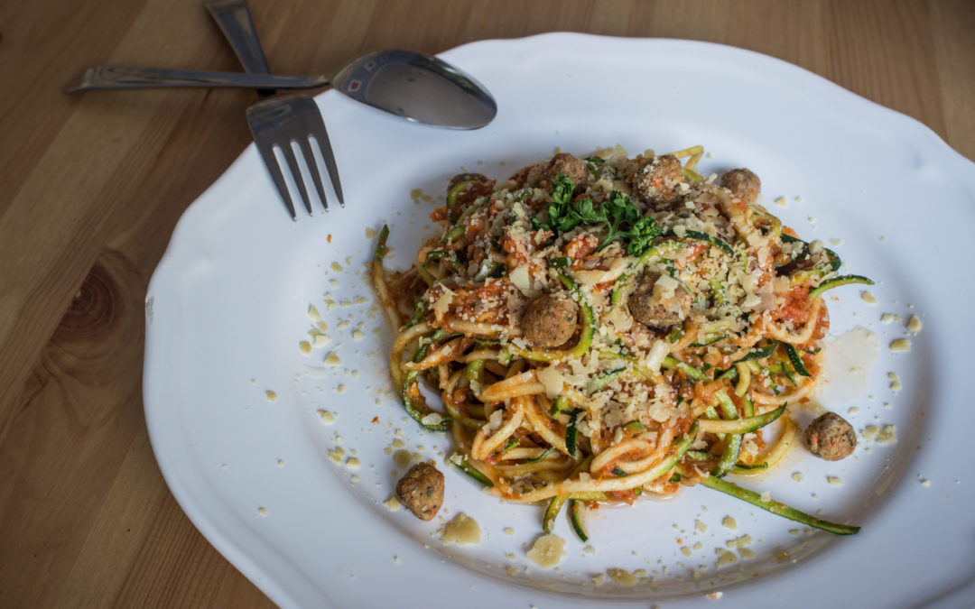
WALNUT “MEATBALLS”
For when you are craving meatballs but want to skip on the red meat, these are a tasty
creative alternative that are surprisingly delicious and even appealing to meat eaters.
Total time: 10 minutes Makes 4 servings
Ingredients:
1 cups walnuts
1 cup sundried tomatoes
2 tablespoons extra-virgin olive oil
1 tablespoon fresh sage 1 teaspoon fennel seeds
1 teaspoon fresh thyme
1 teaspoon fresh rosemary 1 teaspoon fresh marjoram
Pinch of black pepper Pinch of cayenne pepper Pinch of
sea salt
Actions:
Add all the ingredients to a blender and mix for 5 minutes or until
well combined.
This recipe can be used as the meat for Raw Burgers, Raw Tacos,
Zuchetti and Walnut “Meat- balls”, and Raw Lasagna.
Calories: 423 | Protein: 8.8g | Carbs: 20.5g | Dietary Fiber: 5.2g | Fat: 35.7g |
Vitamin C: 8.2mg | Vitamin D: 0 IU | Vitamin E: 1.1mg | Calcium: 54.5mg | Iron: 2.1mg |
Magnesium: 72.7mg | Potassium: 208.4mg

Slide 39
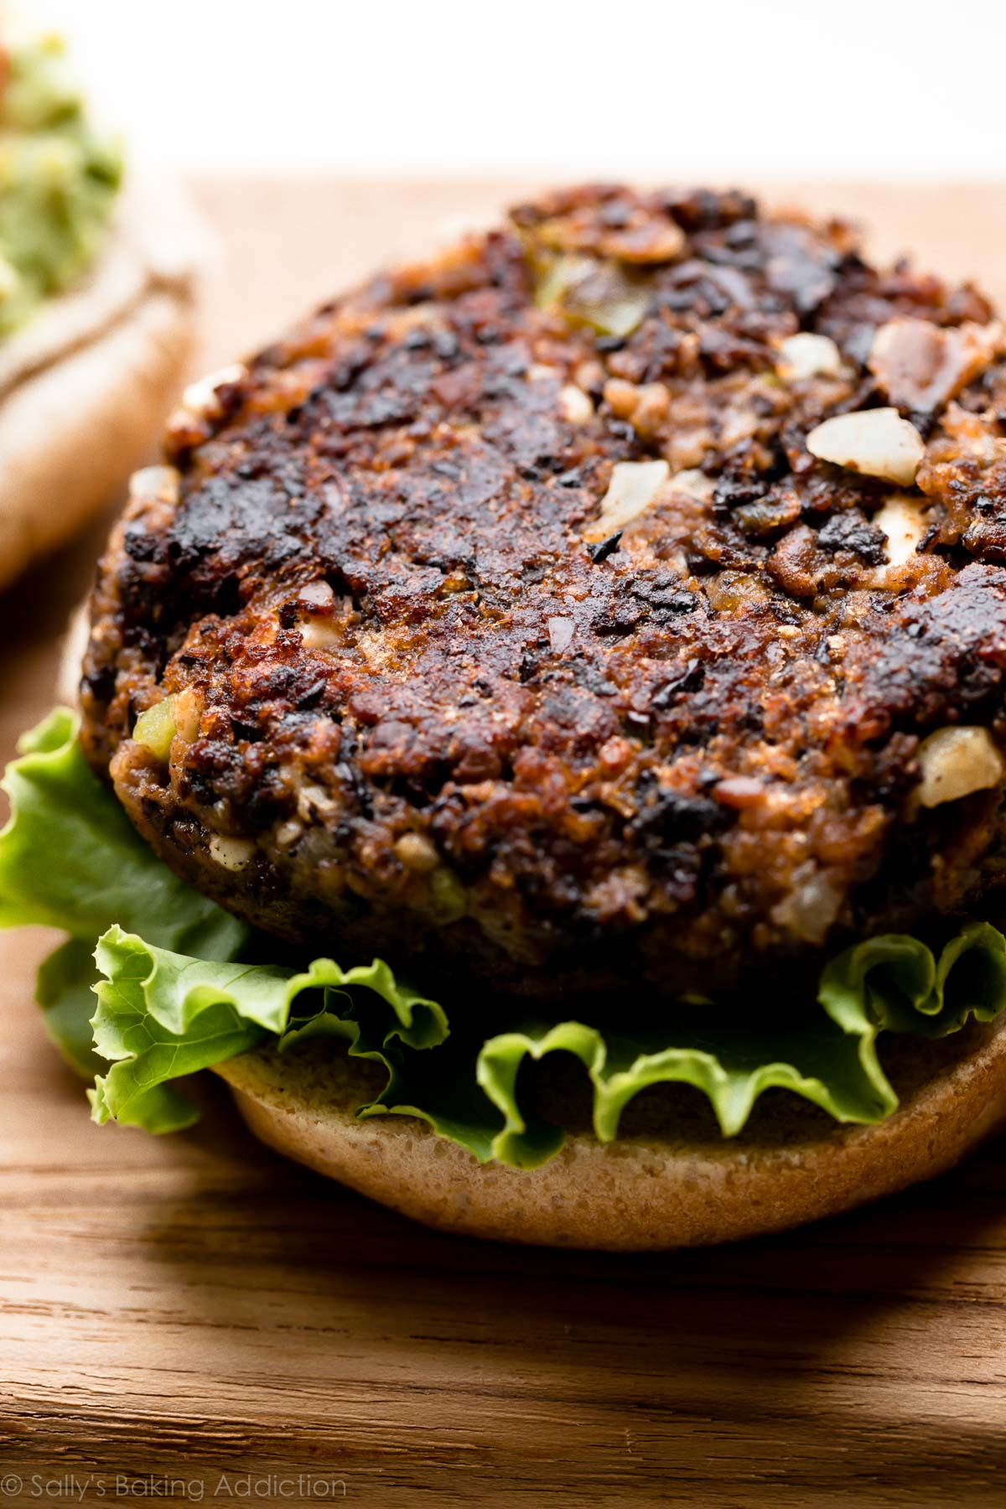
Recipes for life!
Bean Burgers
Cashew Cheesecakes
Cauliflower Mashed “Potato”
Superfood Kale Salad
Homemade Salad Dressings
Immune Boosting Soup
Cancer’s Gone Crackers

Slide 40
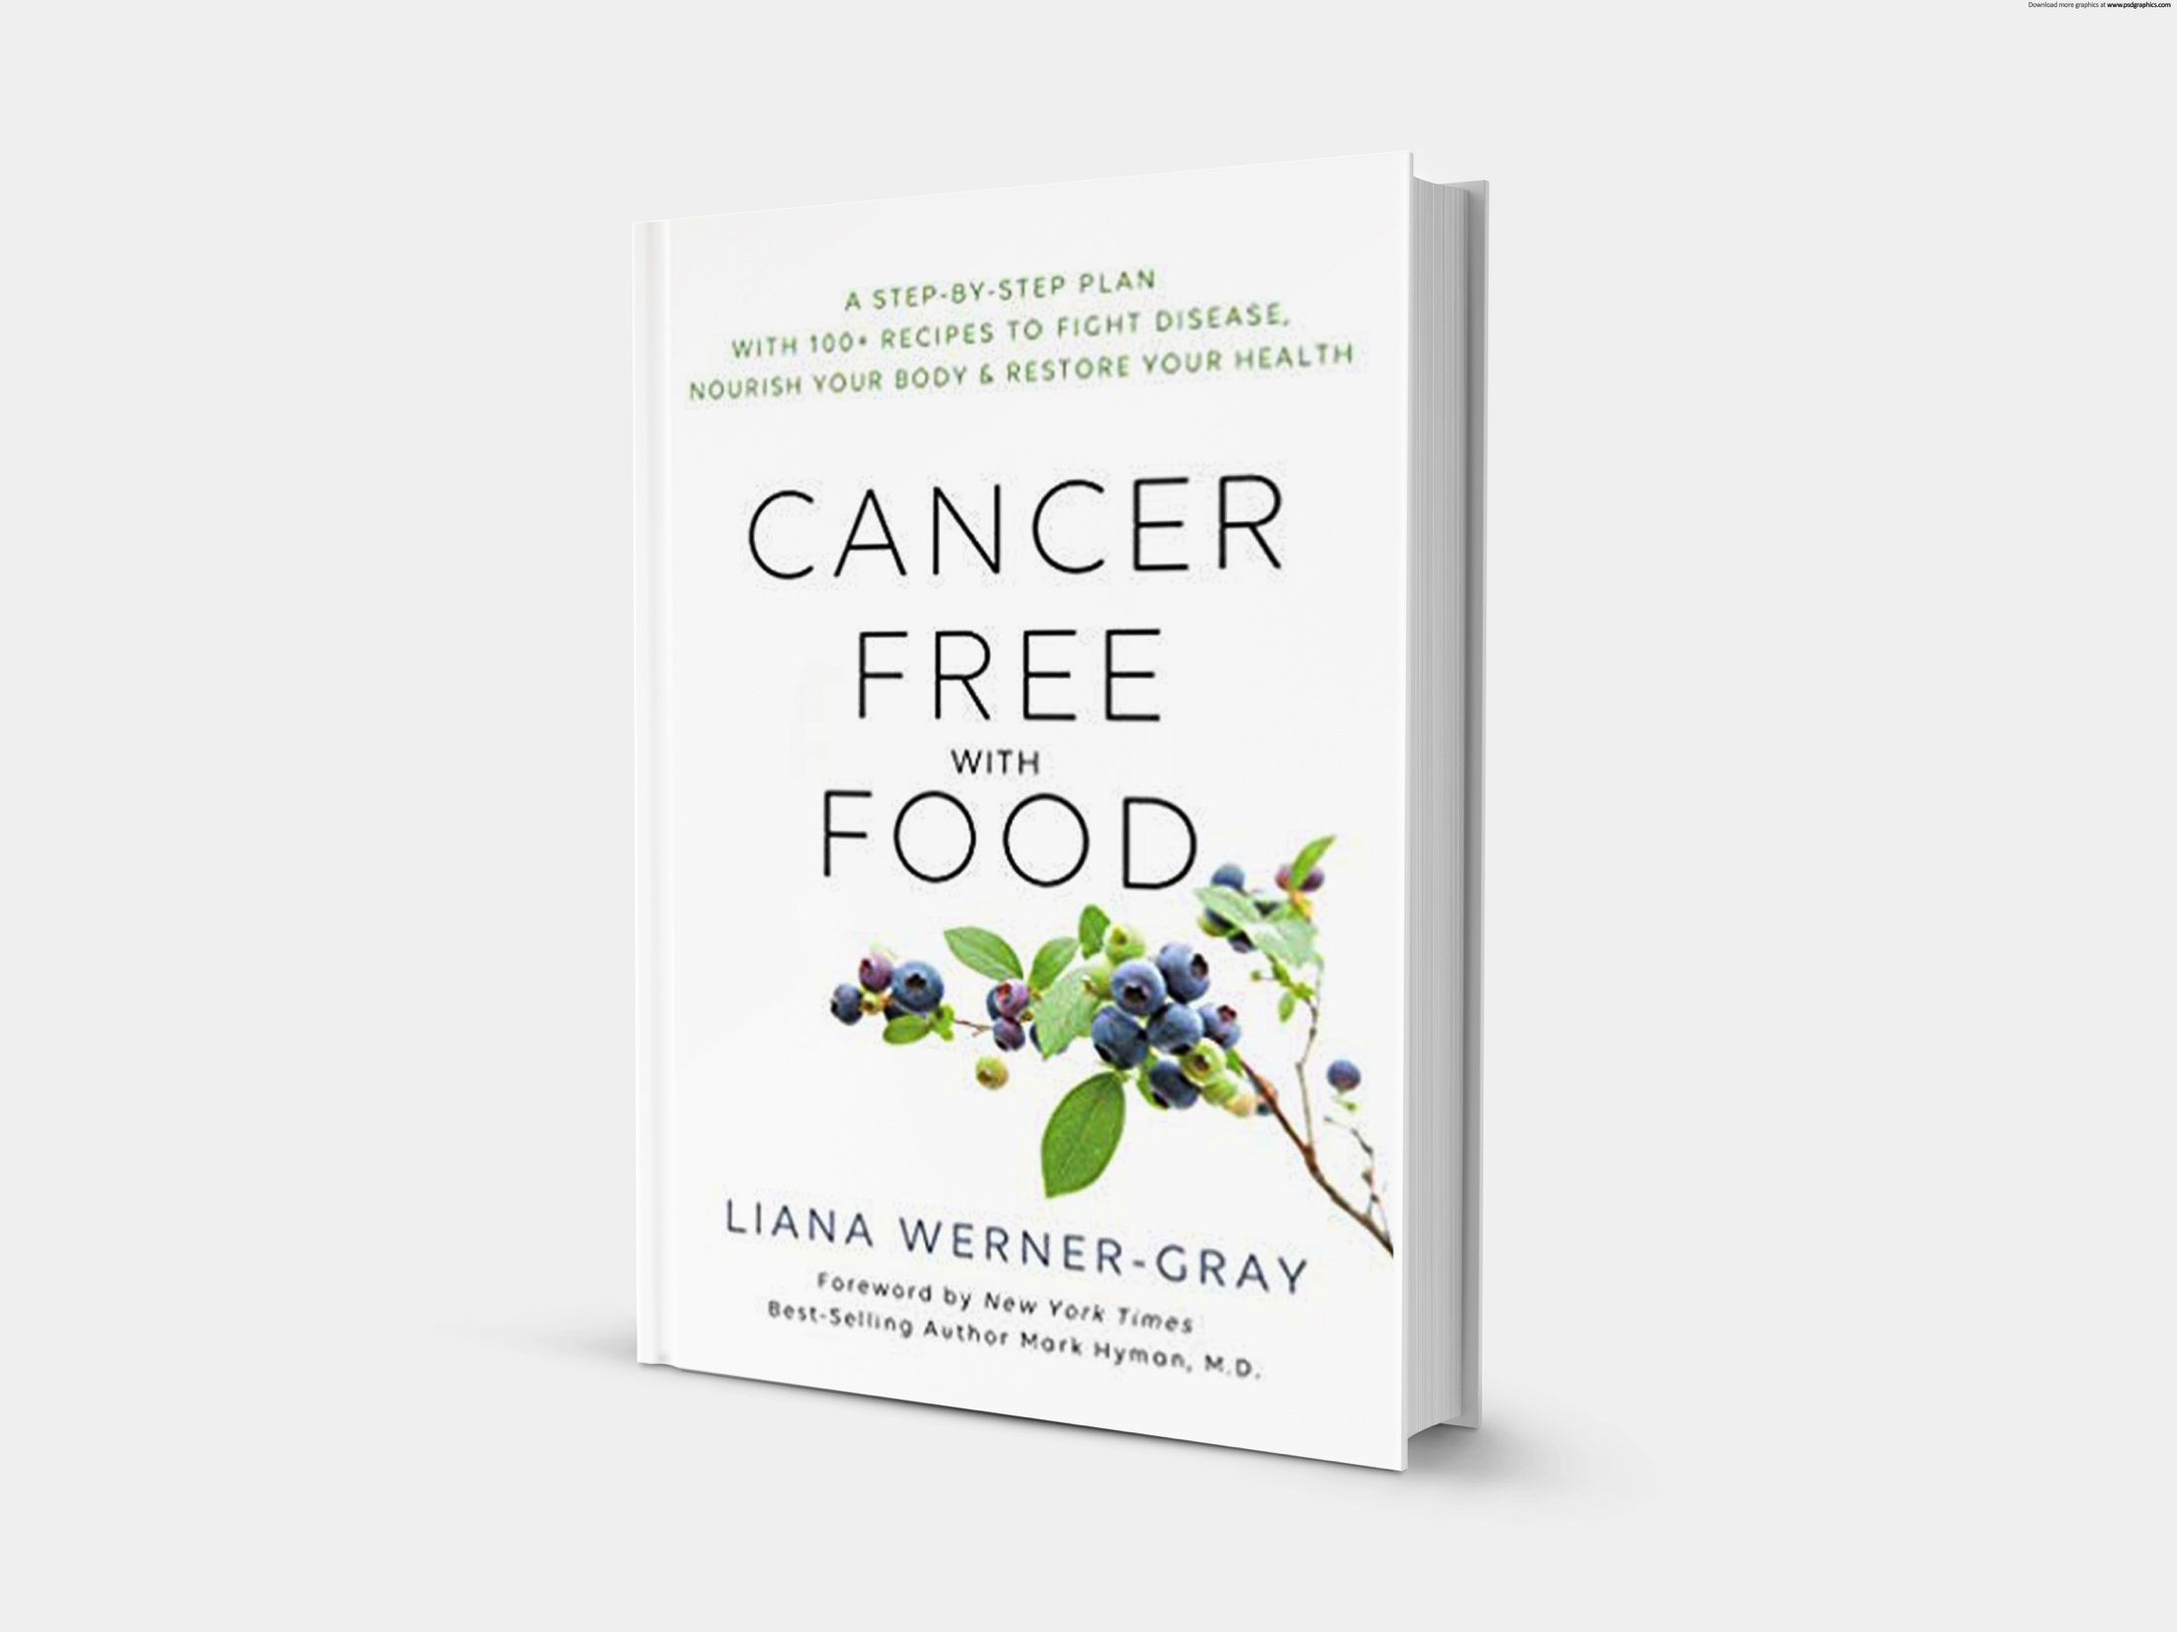
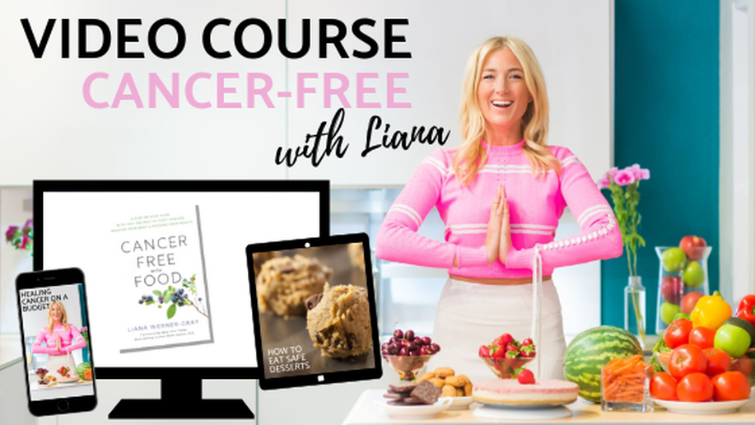
Cancer Free with Food Video Course
Includes the book, plus other bonuses like the “A-Z Guide of All Natural Cancer Treatments known to man”.
CancerFreewithFood.com

Slide 41


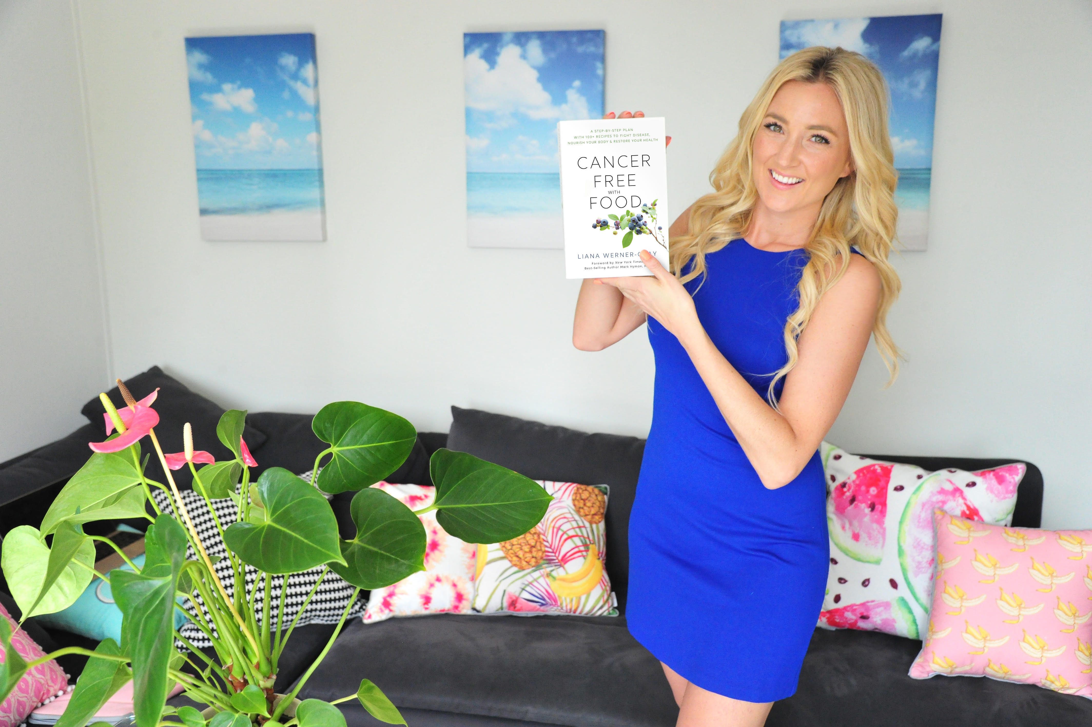
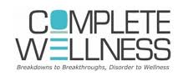
Stay connected:
Instagram: @lianawernergray
Facebook.com/theEarthDiet
Come see me at
Complete Wellness NYC!
CancerFreeWithFood.com

