Slide 1

Todays Healing Platform
The Information Everyone Needs to Know
Presenters
Robby Besner PSc.D

Slide 2
Todays Lite Talking Points
Toxicity = Immune
Understanding Todays Toxic Environment
Methodology for Fixing the Problem
  Identify
  Prevent
  Repair & Restore Your Health
The Impact of InfraRed Sun Light on Good Health
Protocols and Best Practices
Best Choices of InfraRed Devices and Why?

Slide 3
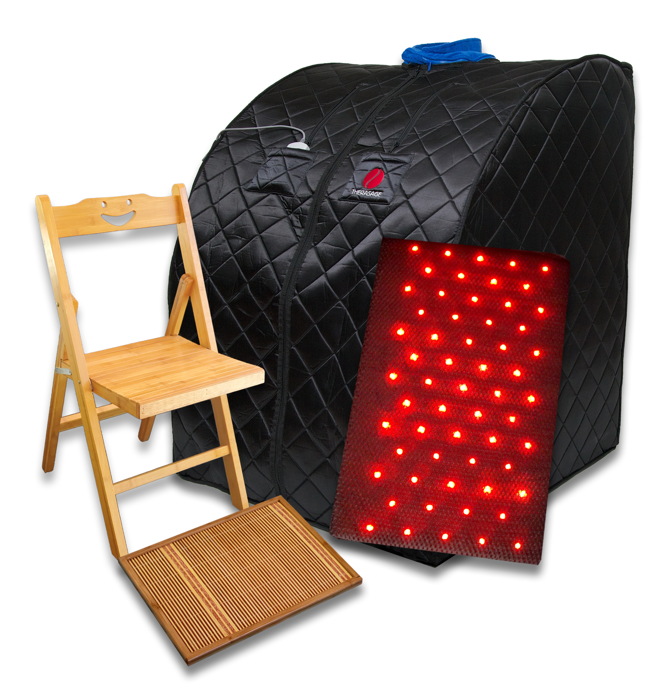
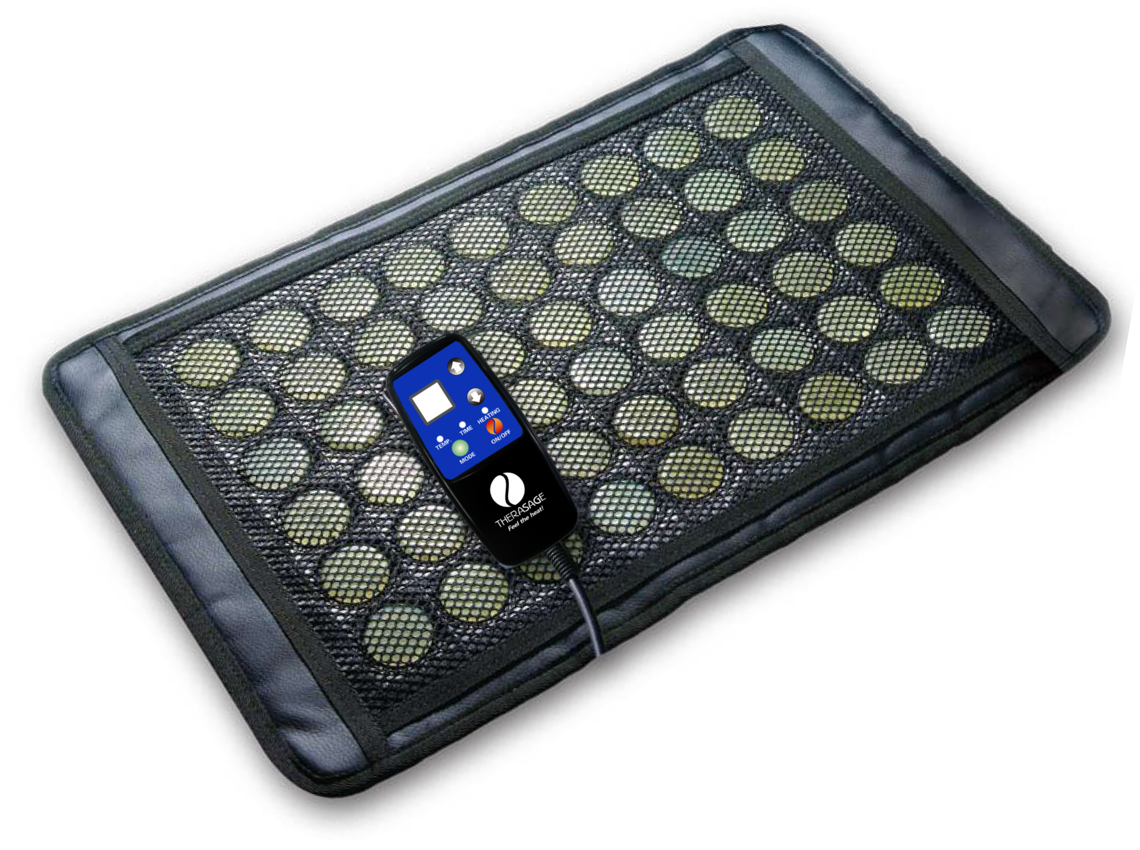
The IR Solutions
Full Body Detox –
  InfraRed Sauna
Focused Detox –
  InfraRed Healing Pads
  Hand Held Devices
Thera360 Plus
Healing Pads

Slide 4


Slide 5
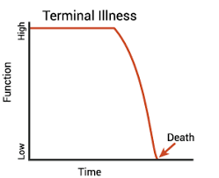
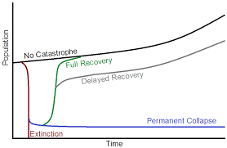
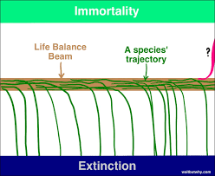

We are on an Extinction Trajectory

Slide 6

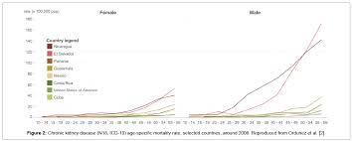
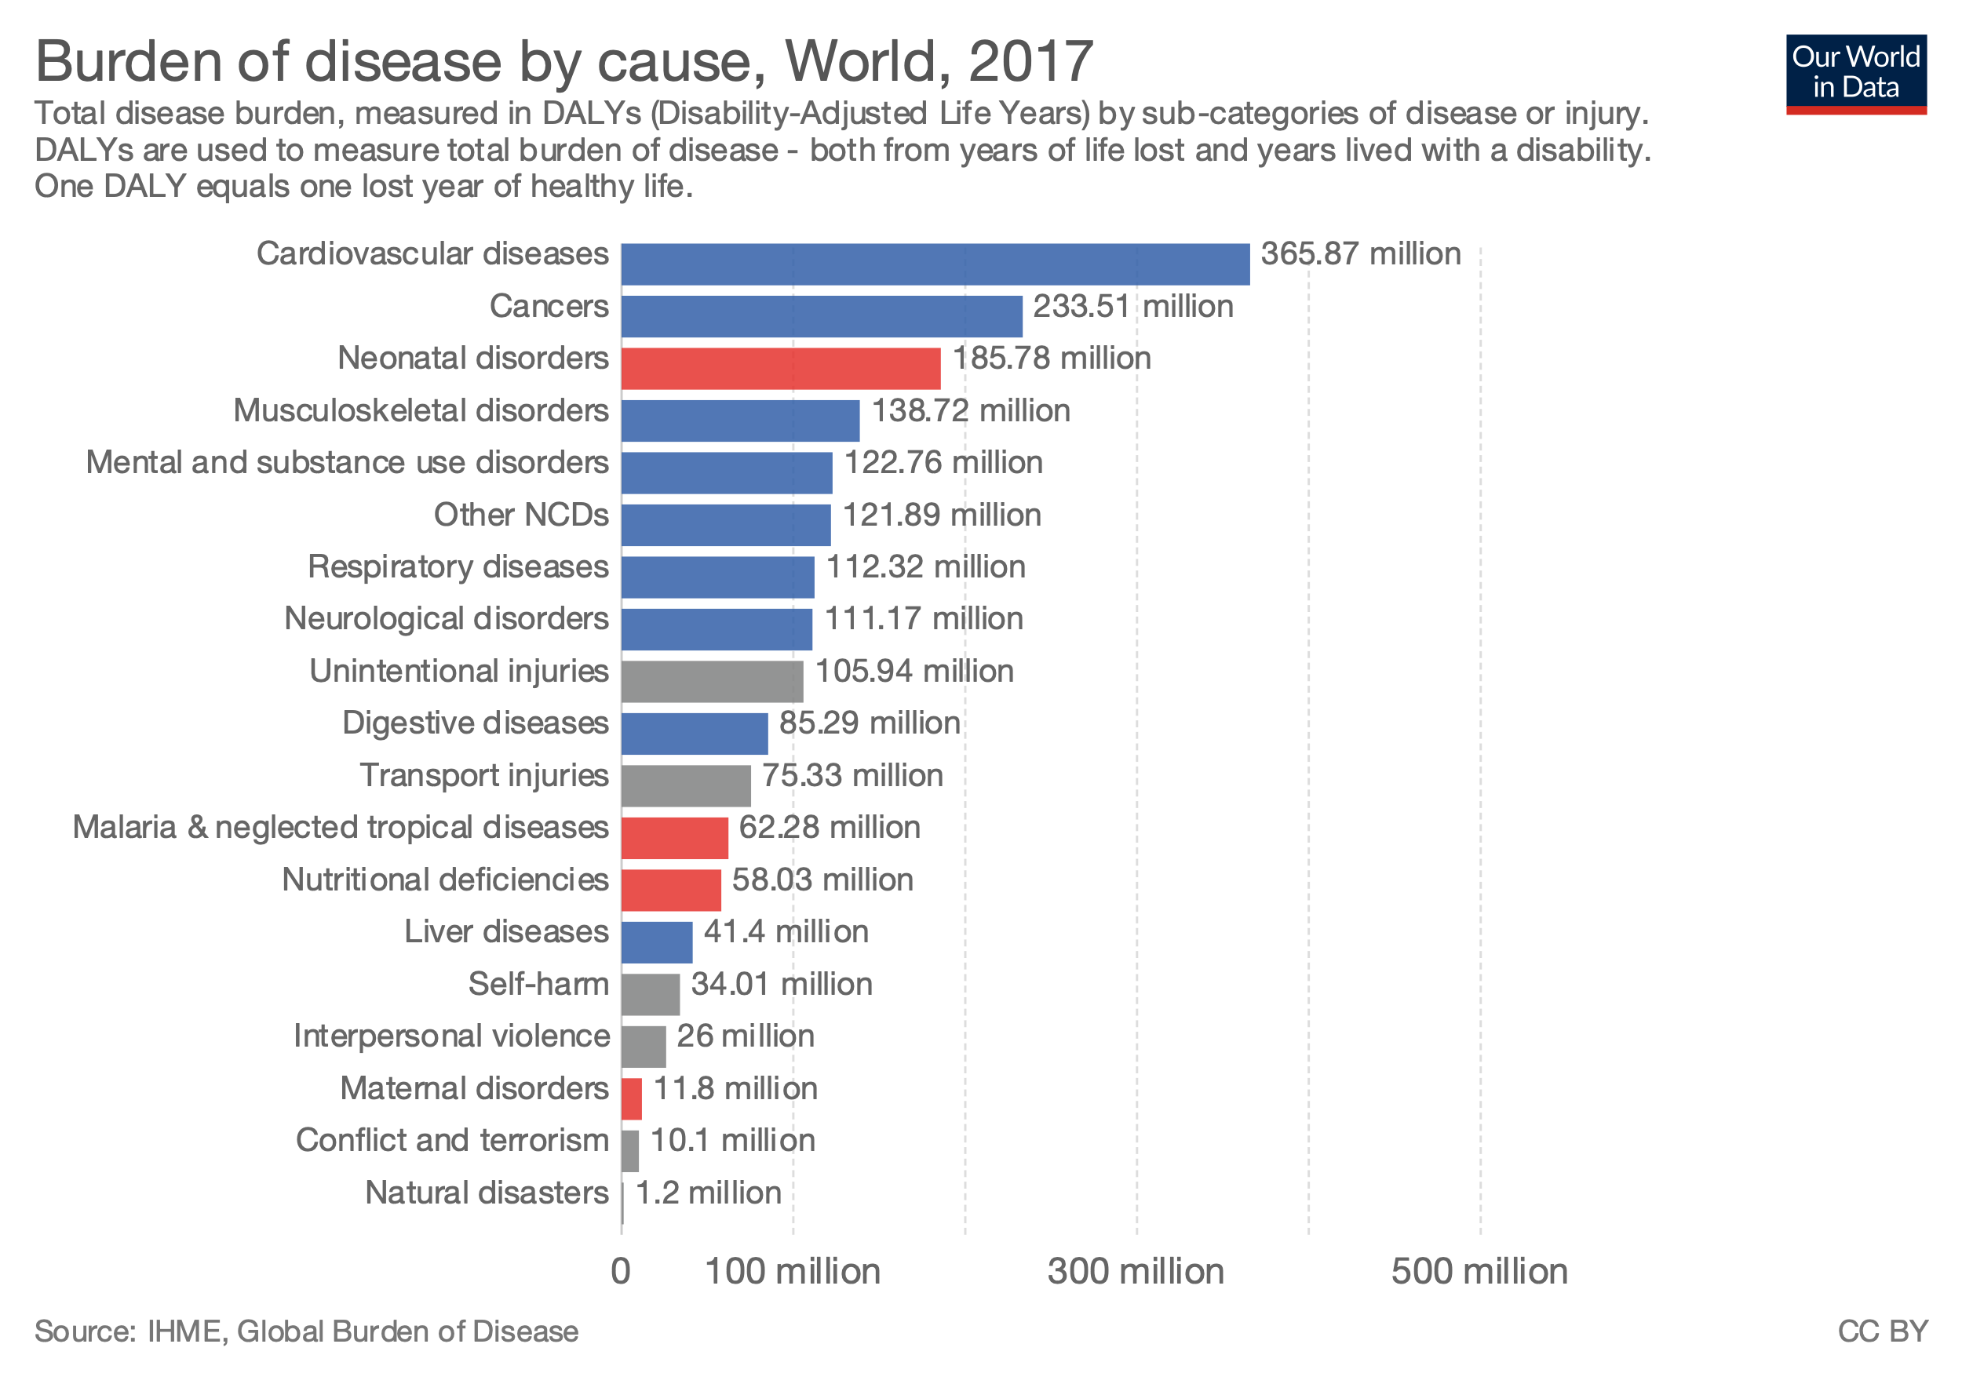
Health Trends
Glyphosate

Slide 7
Stem Cells

Slide 8
The Problems
All of the Below Topics Inhibits Our Immune Response
AIR
WATER
FOOD
EMF - WIRELESS EVERYTHING
SYNTHETICS - BIG PHARMA

Slide 9
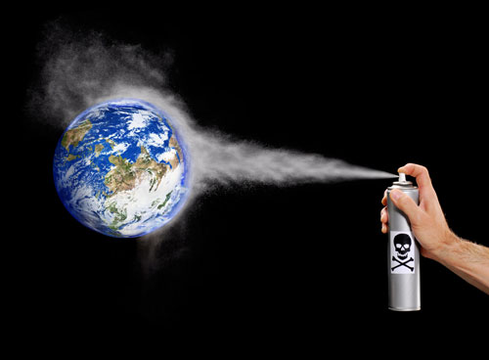
Todays Planet
Chemical Toxins – Glyphosates – Chem Trails – GMO’s – ETC’s
70 % of Environmental Toxins are stored in your Fat
Notes:
And the newest category called the ETC’s…….those are the ones we never knew about and also the ones that are yet to come……ive brought some examples of those with me today

Slide 10
The Air We Breathe
Chem Trails – Aluminum
SMOG
Ozone
Co2
Automobiles & Airplanes
Factories – Industrial Waste – Greenhouse Gases
Radiation – Chernobyl – Fukushima
Notes:
When inhaled, smog irritates our airways, increasing our risk of serious heart and lung diseases. These health risks are why many cities monitor smog levels. On a high ozone-alert day, for example, your eyes and throat may burn, and you may cough and wheeze.
Reducing smog will protect all Americans – especially our kids, older adults and people active outdoors.
China is the largest emitter of carbon dioxide in the world. The country emits more than 10,375 million metric tons per year, which causes serious health problems for the population, especially in the big industrial cities. Beijing is the most polluted city in the world where there are literally weeks when locals don’t see the sun because of the smog. Many citizens wear protective masks when they go outside and the local authorities have installed giant screens, which show sunrises and sunsets, to prevent depression. Nevertheless air pollution in China causes millions of deaths every year and although the country has a thriving economy, it is also the biggest polluter in the world.
USA
The biggest economy in the world so far with high production, oil reserves and giant metropolitan. The U.S. citizens are one of the most mobilized and the traffic on the streets and in the skies is so high, that air pollution is becoming a more and more pressing problem. The whole infrastructure of American cities forces people to travel by cars which combined with the industry emits 5,414 million metric tons of CO2 every years. The air pollution in the USA is a great concern of many people and is causing thousands of people to seek medical attention every year.
One of the biggest problems with living in the big city is the polluted air. The World Health Organization reported that due to air pollution and environmental risks there are 1.7 million child deaths every year.

Slide 11
The Water We Drink
70% of our Rain Water has
Trace amounts of Glyphosates
Fluorides
Chlorines
Industrial Wastes
Pharmaceuticals

Slide 12
The Foods We Eat
Preservatives
GMO’s
Glyphosates
vs
Organic
Farm to Table

Slide 13
The Chemicals We Use
Fat Soluble
Airborne
Water Soluble
Common Chemicals found in Households

Slide 14
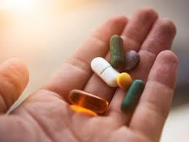

The Medications We Take
Paradigm Shift
VS
Synthetics
Pharmaceuticals
Natural Extracts
Herbal Formulations
Chinese Medicine
Organic Essential Oils
Notes:
What do we choose and when do we choose it……….Story telling is a dying art…….my grandmother used to shop every day….i remember her refrig had a ice block that kept things fresh for the day
We didn’t eat left overs……there werent foods …..like twinkee’s that has a shelf life of 500 years……..no offense to all you twinkee lovers out there……..so lets discuss for a moment some of the foundational components to our lives today……..

Slide 15
The Technology We Use

Slide 16

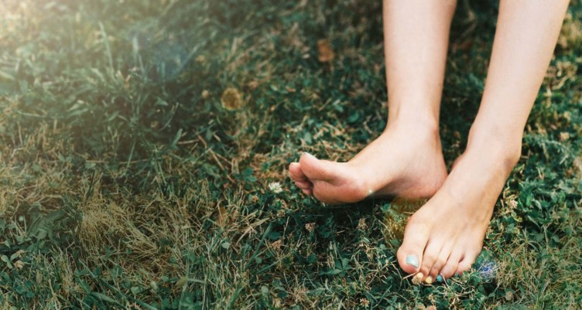
Electrical Toxins
What is E-SMOG ?
Problem
Solution
Electro Magnetic Fields - EMF
Grounding Technology
Why is it important to know about EMF?
  5-G Net Works
Is wireless technology really Body friendly?
Notes:
With every problem comes a solution……….and my colleagues your going to experience this weekend are the pioneers that have the real solutions
Let me explain why EMF is a toxin……..were all drawn in because electricity drives most of our modern lives in one way or another…….but electricity as we know it (alternating current)
Is not natural…….and as most things we have experienced in modern life……if you surround yourself long enough around things that are not natural…..like wireless devices…..blue tooth this or that’s…….blue light devices…….synthetic foods or medications………you…..we pay a price……a HUGE price because they quietly rob us of our health……which prevents us from realizing our full potential…………….so it occurred to me when I started thinking about EMF’s 15 yrs ago……way before the wireless rage…..that if the body had to choose between protecting itself from harmful man made energy’s called EMF’s….. or receiving the amazing healing properties of Full Spectrum Infrared sun frequencies what would choose….
Heck….i wasn’t that smart…..to have anticipated the amount of devices and the crazy amount micro-towers that delivery these energies as we think we see today….i wasn’t that smart…..i just knew the body would always choose to protect……to survive…………….So if I were to deliver to you and have your body receive the best results ….the full effects of the Infrared devices our company makes…..i would have to fix ….shield……..take EMF out of my equation…..so I developed and employed methods to do that….and you to can find real inexpensive solutions to some of them are right next door……anyway…..as I started preaching Anti-EMF……15 years ago……I had lots of challenges…because you cant see them, taste them, smell them see them……….for most of us we can not sense them……..WOW……theres a lot of playing field there…..if you stop and think about it……so I found a photographer that used a special kind of lens that captures auras……its called kirlian…photography….to see if he could capture the elusive butteryfly called EMF…..and here it is

Slide 17

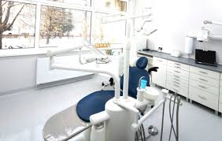
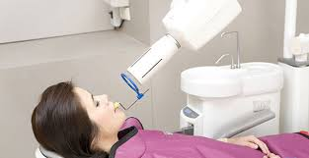
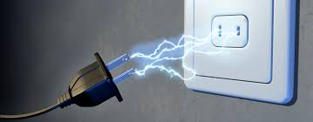
Our Modern Life Styles

Slide 18
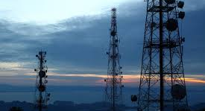
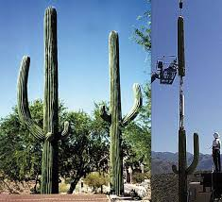
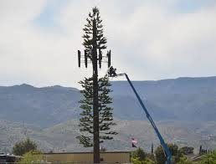
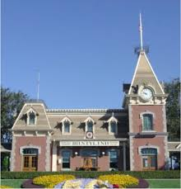
Our Technical World
Cell Towers Blend into
the surroundings

Slide 19
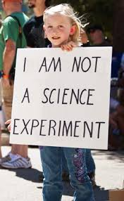
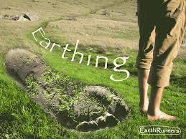
Electro Smog…..….
Silent Killer
Politics-Economics -Technology
Harmful Effects of EMF to your Bio Field
  Attacks the Immune System
Remediation –
  Earthing / Grounding

Slide 20
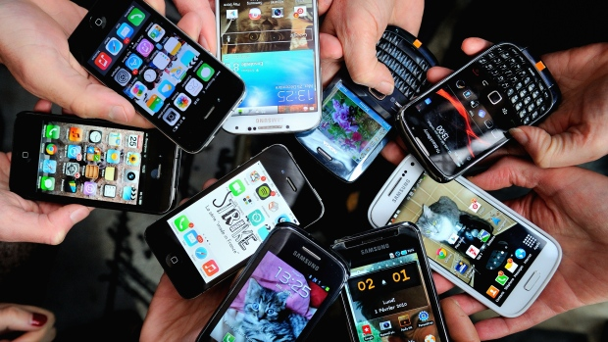
Raise Your Hand if you have a Cell Phone turned ON ?

Slide 21
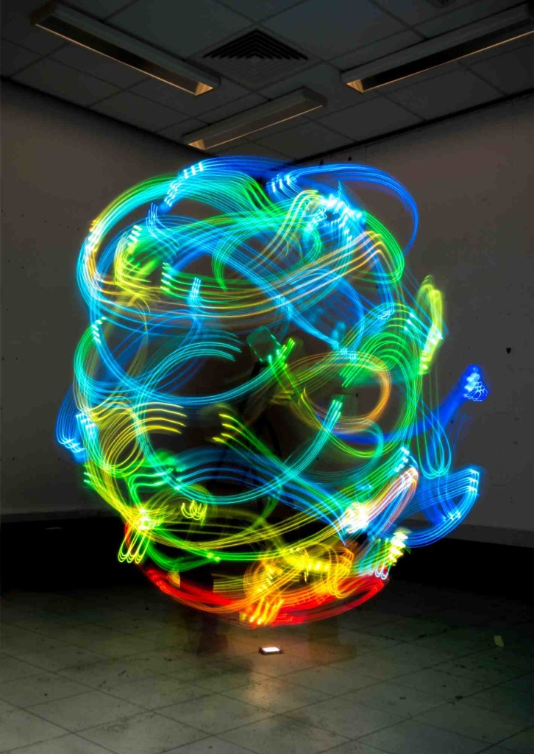
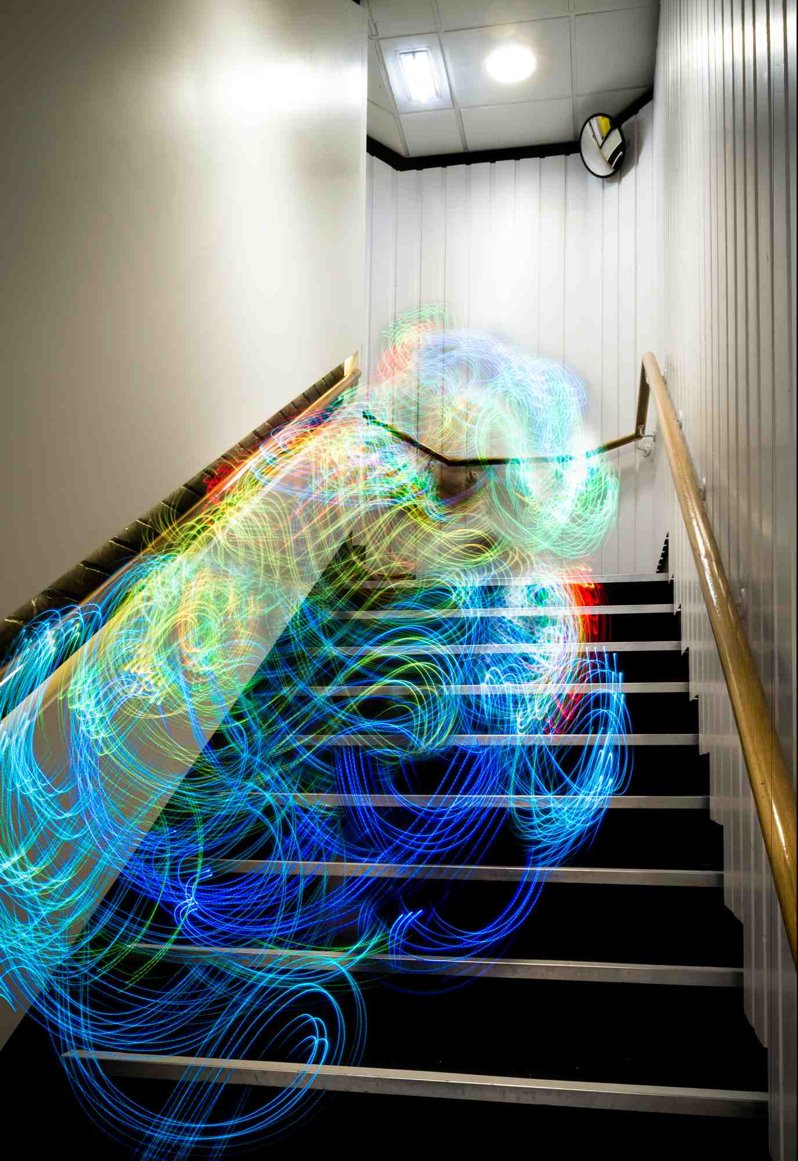
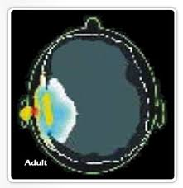
This is what an EMF looks like !!
MRI of Cellphone
1 hour use
Wireless Home Network
Cell Phone
UN NATURAL
Notes:
And next is also things you don’t see

Slide 22

Genesis
Pain
Systemic Inflammation
Systemic Toxicity

Slide 23
Detox or Die
By Dr Sherry Rogers

Slide 24
The Solutions
Full Body Detox –
  InfraRed Sauna
Focused Detox –
  InfraRed Healing Pads
  Hand Held Devices

Slide 25
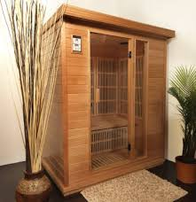
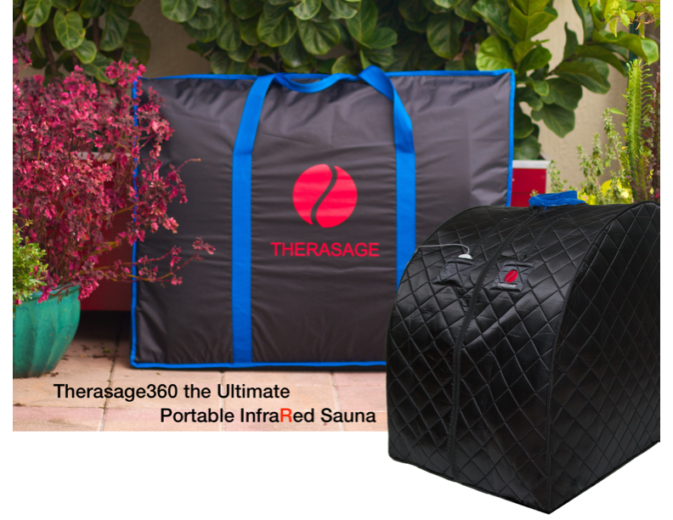
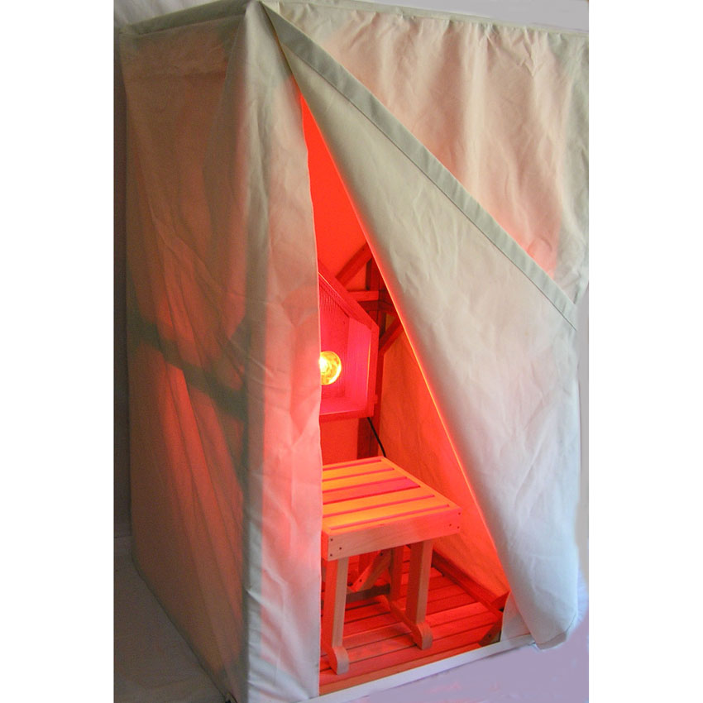
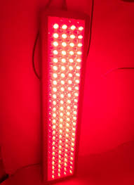
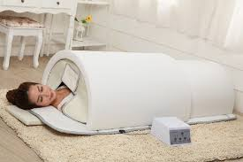
InfraRed Sauna Choices
Wood Sauna
Portable
Tent
Light Panel
Dome

Slide 26
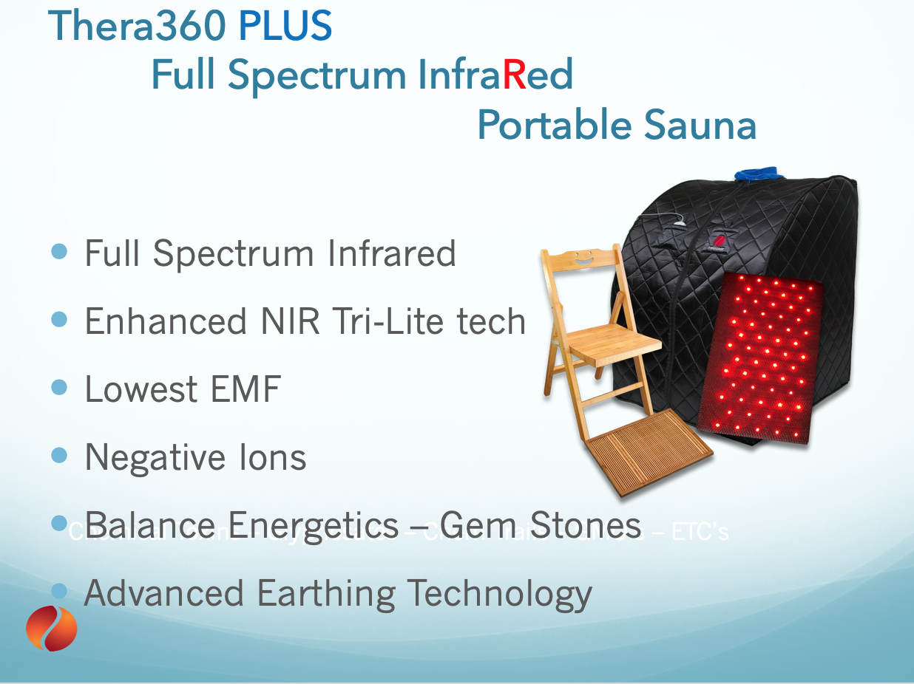
Portable Preference

Slide 27
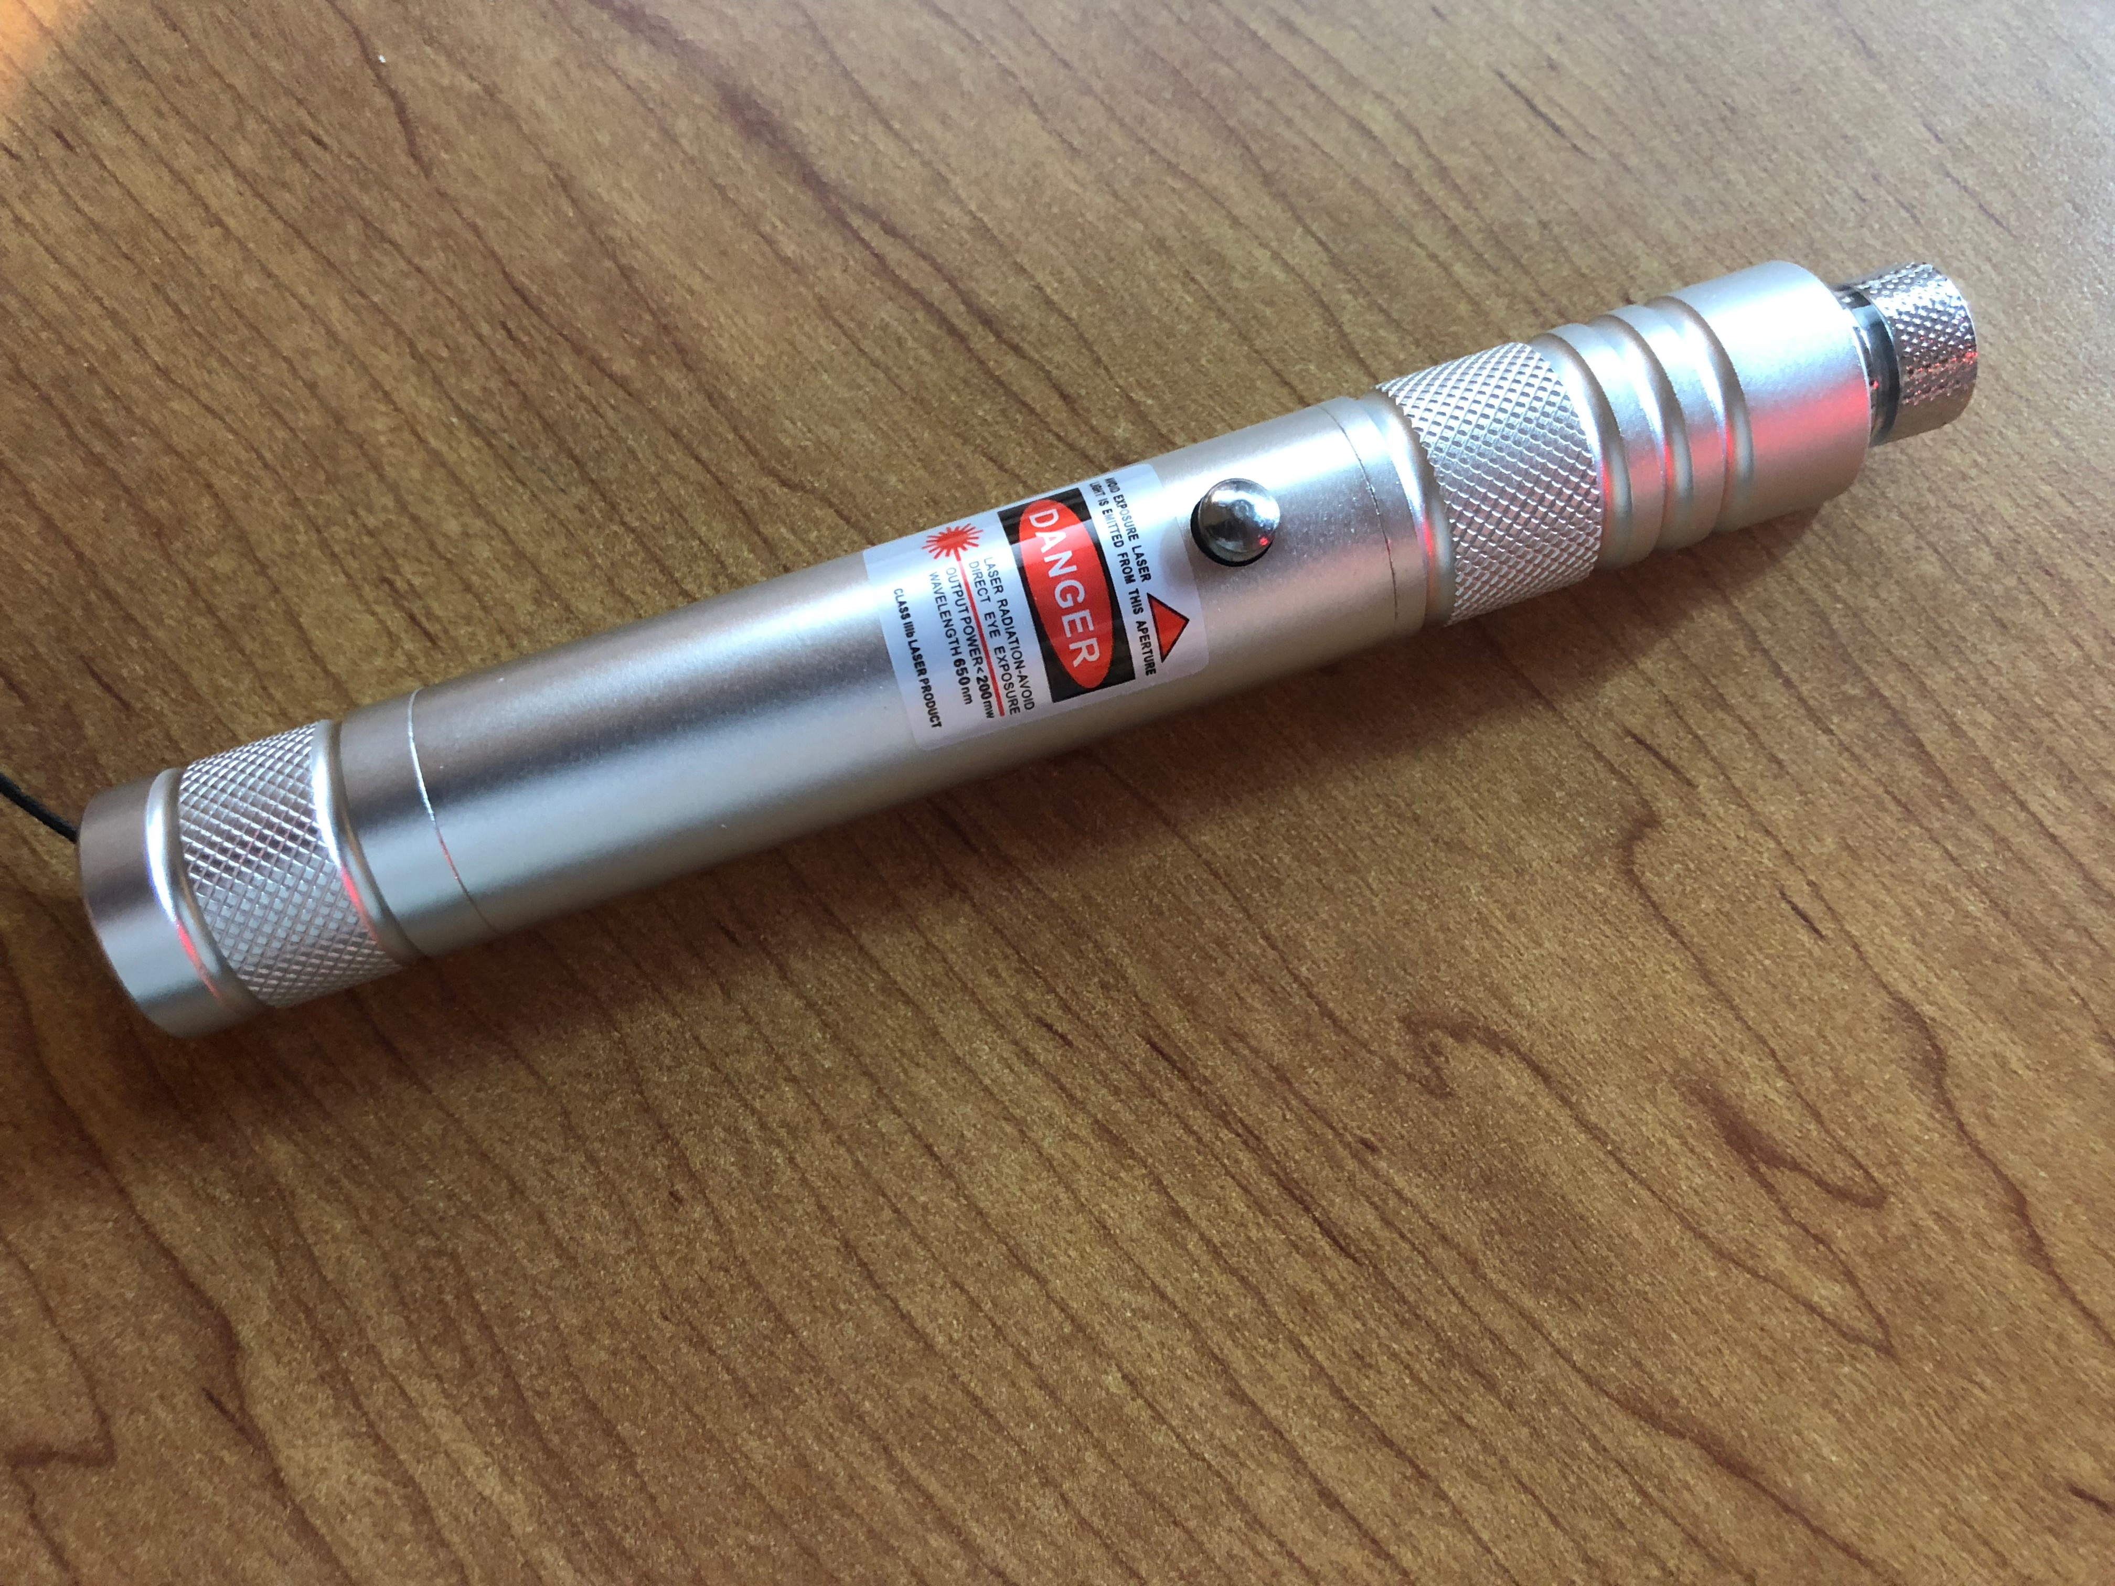
Focused Detox
Laser
Healing Pads

Slide 28

The Science of InfraRed Frequency
Notes:
OK
Let’s dive into the science behind IR

Slide 29
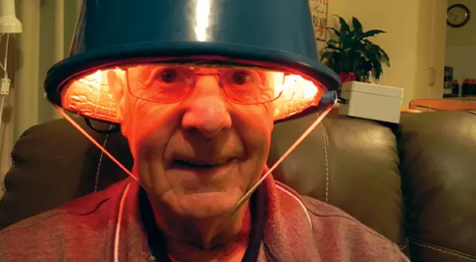
Biophoton Therapy (BPT)
Robby Before Using BPT

Slide 30
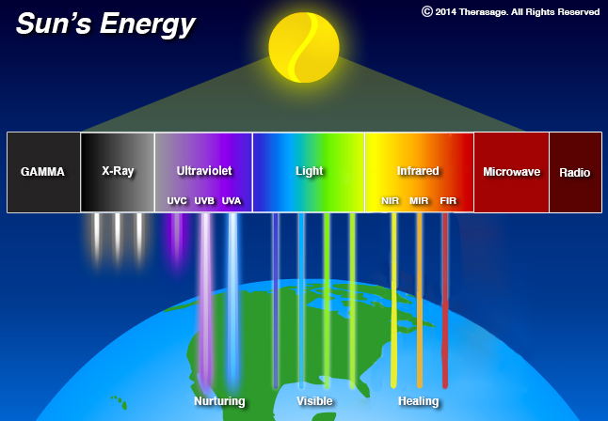
Messages from Nature
Full Spectrum InfraRed

Slide 31

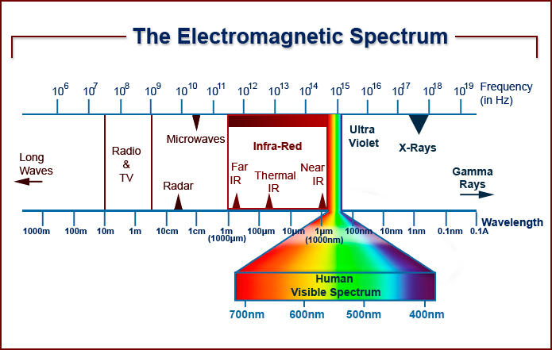
What do these Sun Frequencies do?
NIR - Near
  Any Skin Challenges
  Micro Circulation
  Nitric Oxide
  Cell Energy – Mitochondrial Support
MIR - Mid
  Vascular Support
  Improved Metabolism
FIR - Far
  Deepest Penetration
  Heavy Metal Detox
  Circulation

Slide 32
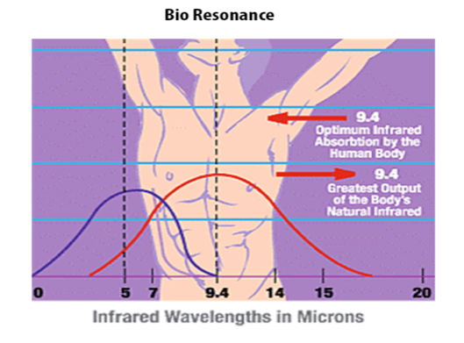
Structured H₂O = Bio Compatible
70% of Our Body
81% of the Brain
98% of the Cell

Slide 33
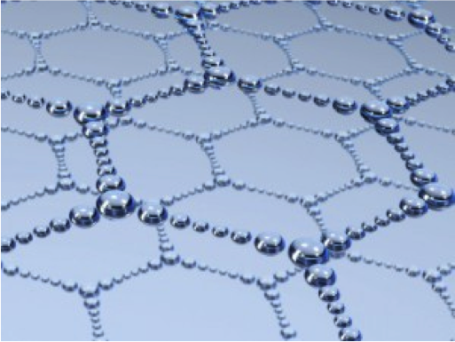
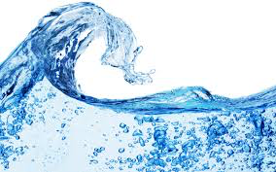
WHY IS WATER SO IMPORTANT ?
BIO-AVAILABLE
Transport System
Cellular Hydration is Essential for Cell Health
Cellular Hydration is Essential for Cell Function
Nutrition and Minerals in – Toxins/Waste Out
STRUCTURED WATER

Slide 34
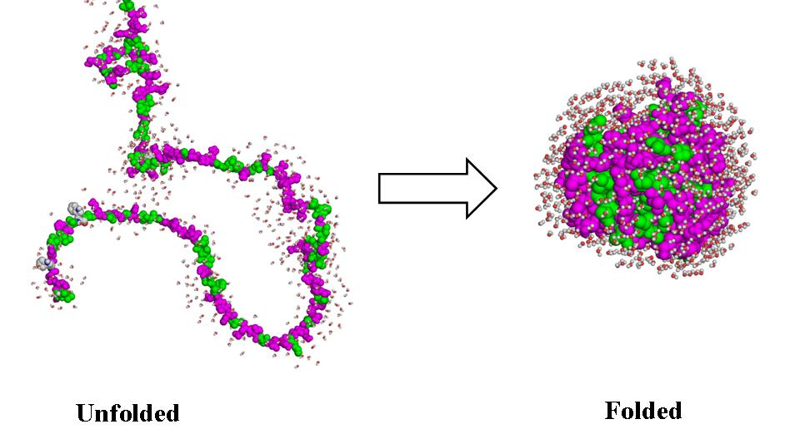
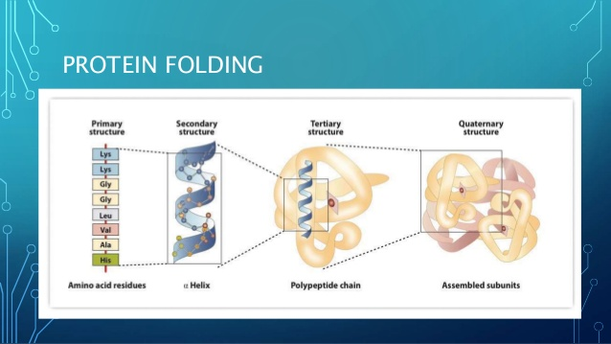

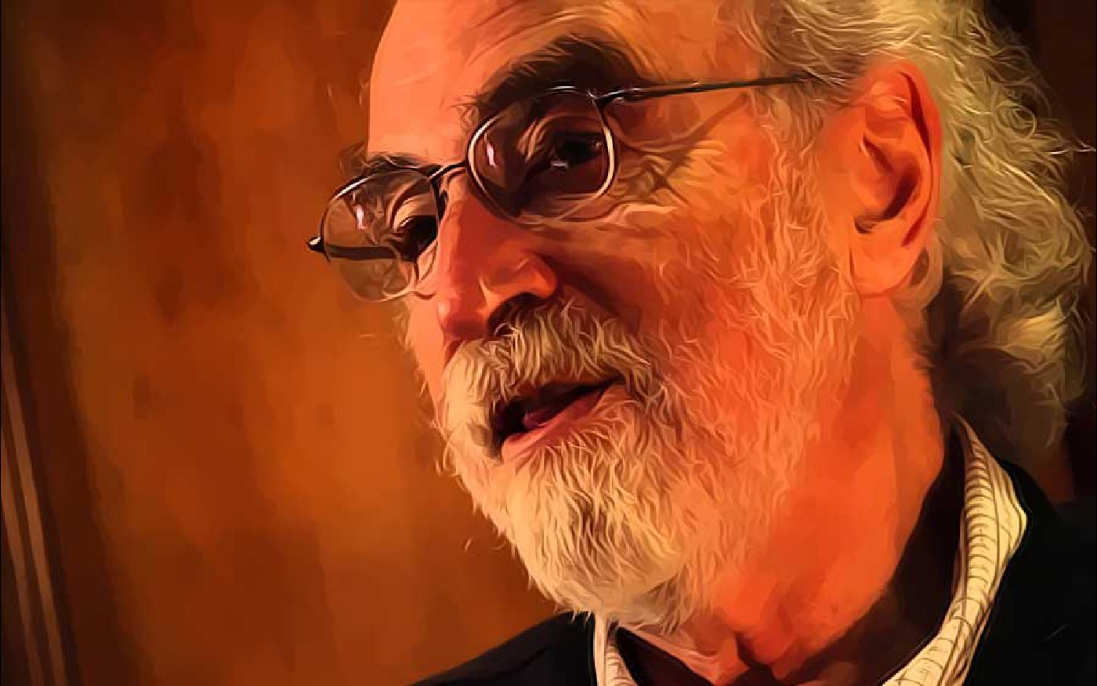
Protein Folding
Formula
InfraRed = Structured H2O
Dr. Gerald Pollack
Natural Immune Response
Notes:
Proteins Molecular Building Blocks

Slide 35
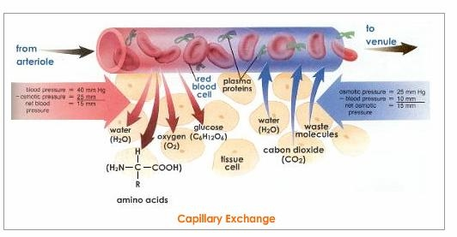
Improved Circulation
InfraRed – Vaso-Dilates
Improves Blood Flow
Improves Nourishment
Improves Oxygenation
Improves Cellular Function
  Nutrition & Minerals – In
  Toxins – Out
Natural Immune Response

Slide 36
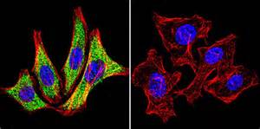
Heat Shock Proteins (HSP)
When the Body goes into healing mode……it generates HSP
To respond to Pathogens…..Cellular inflammation…..
Or even a General Immune Response – Histamine Response
Hyperthermia – “False Fever”
Natural Immune Response

Slide 37
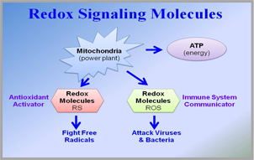
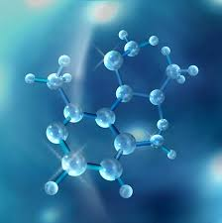
Re-Dox Reaction Lowers Oxidative Stress
The Ultimate Anti- Oxidant
According to Dr. Gary Samuelson –
InfraRed frequencies enhances ReDox Signaling Molecule Reactions
Natural Immune Response

Slide 38
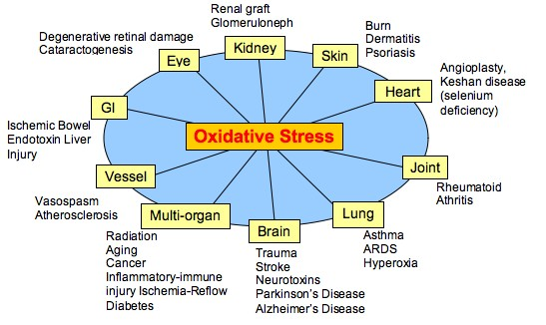
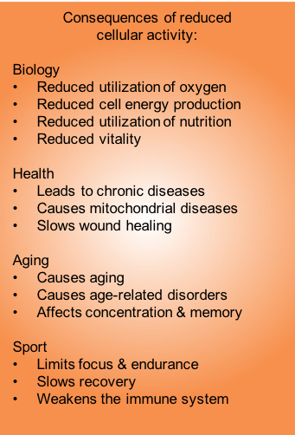
Oxidative Stress – Impact on Health
Courtesy of Dr Klinghardt
Natural Immune Response

Slide 39
Heat Therapy
InfraRed Creates a False Fever
Hyperthermia – 102 F^{O}
Bio Residence – Brakes Covalent Bond
Fat reduction – Toxin Release
Sweating
Environment Toxin – 70 %
Heavy Metals
Natural Immune Response

Slide 40

InfraRed is Safe and Beneficial………
Pregnancy
Hi/Low Blood Pressure
Prosthetics – Implants
Wound Care
Cancer
Diabetes
Children
Heart Condition
Chronic Disorders – Lyme/ Fibro

Slide 41
The Solution

Slide 42
The Platform
Create a Healthy Platform
Detoxify
Nourish to Flourish
  Blood
  Oxygen
  Nutrition
  Cell Health
Building Blocks to Good Health
Heal the Cell to Get Well

Slide 43
Most Efficient Ways to Eliminate Toxins
Sweating
Urination
Defecation
Evaporation
Chelation
Chemicals

Slide 44
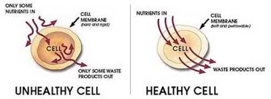
Complete Cellular Cleanse
Heal the Cell and you Heal the Body

Slide 45

Complete Cellular Cleanse
InfraRed Sauna
Hydrate
Macro Binder – Clay - Carbon
Nano Binder – Hydrolyzed Zeolite
Sodium (NA) – Celtic Salt – Sea Salt (not processed)
Trace Minerals & Electrolytes
Advanced Applications
  Niacin Flush

Slide 46
InfraRed & Inflammation / Toxicity
Mobilizes all stored Toxins
Sweating = Detox
Lower Toxic Burden – Lower Inflammation
Structured Water – Cellular Cleanse & Function
Heat Shock Proteins – Natural Immune Response
Improves Cellular Methylation
Detox Protocols – Start with the Basics then Advance

Slide 47
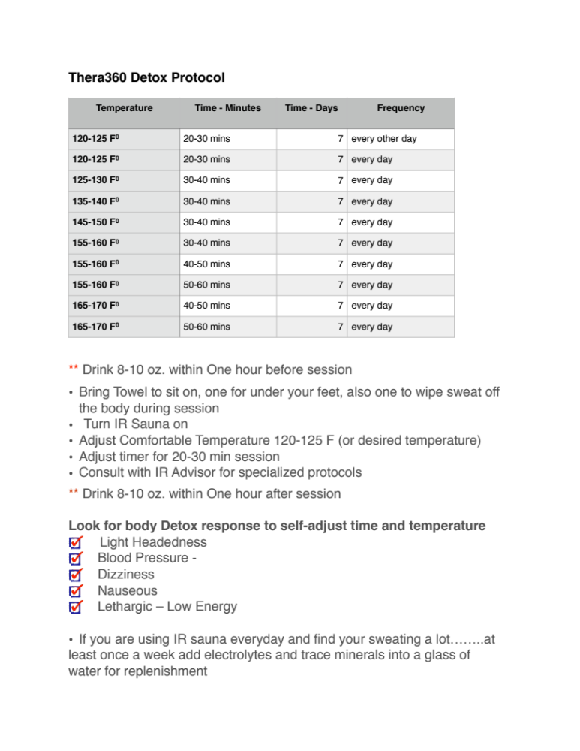
InfraRed Protocols
Bio–Residence Brakes the Covalent Bond
Variables
  Time
  Heat
  Wavelengths
  Bio-Photons Emissivity
  Bio-Photons - Power

Slide 48

Coming Down the Toxic Mountain
Detoxification Methods
Slowly
Safely
The Healthy Way

Slide 49
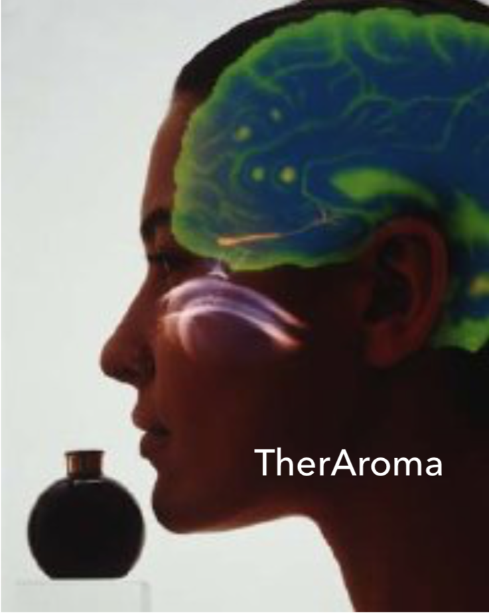
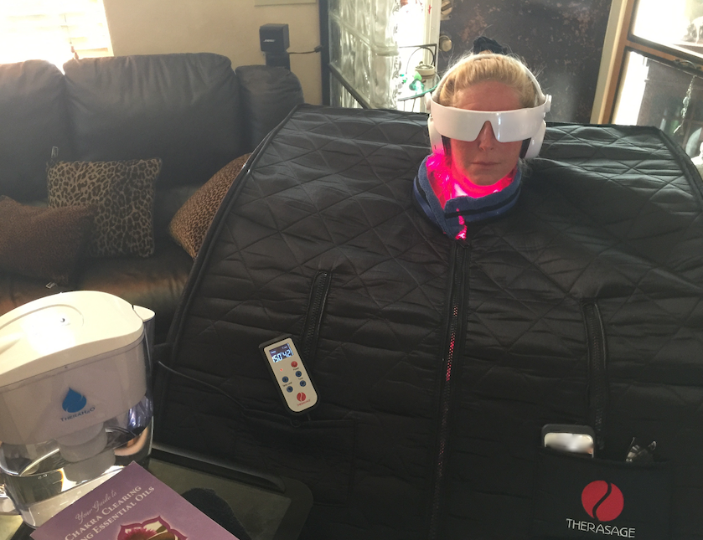
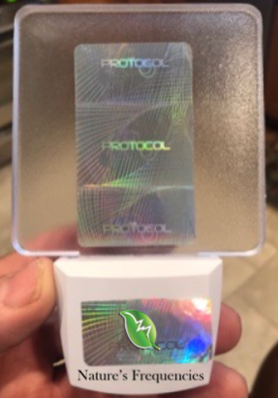
InfraRed Sauna Best Practices
Earliest time of the day for maximum detox
Hydrate – before & after
  8-10 ounces of filter water
Towel Up – Segregate when you wash
Macro Binder - Nano Binder – Niacin Flush
Dry Brush – improve sweating
Electrolytes , trace minerals, pink salt
130 F -30 mins – Start you Day - 1st thing
After session cool down – 6-8 minutes
build up negative ions
Modality Stacking
  Essential Oils
  Oxygen Therapy – Ozone
  EMF – Harmonizers
  Guided Meditation
Guided Meditation
EMF Harmonize
and Remediate

Slide 50


Binders & Detox
Re-Toxification
Macro-Binders
  Activated Charcoals
  Bentonite Clay
Nano-Binders
  Hydrolyzed Zeolite - Vitality
Super Foods
  Chlorella
  Spiralina
  Blue-Green Algae
Herbs
  Cilantro
  Neem
  Milk Thistle
  Black Walnut - Iodine

Slide 51

Recovery Reactions from Detox
Light Headedness
Nauseous
Dizziness
Head ache
Lethargy
Remedy
Stop session ( mark temperature and time )
  Immediately hydrate – 8-10 ounces
  Sensation should abate within minutes

Slide 52
Stacking Modalities
Synergistic Effects
Order and Dosing
Can make a Significant
Difference in the outcome
Stack to Improve Impact

Slide 53
InfraRed Sauna Stack Synergistic Effects
  Oxygen Therapy
    Ozone
    S.O.E
  Aroma Therapy
  Guided Meditation
  Diet – Detox Foods

Slide 54

Dietary Stack
Enhance the Detox
Green & Ginger Tea
Juicing

Slide 55
Traditional
Chinese
Diet
Creates
Season
Tonics
For
Full Body
Detox and
Health

Slide 56

Caster Oil Packing

Slide 57

Mud Packing

Slide 58

I’M So Confused
Internet Over Load
Mis-Information
What if you don’t have the time
to investigate !!
What if you have a chronic health
Challenge and your not clear
thinking !!

Slide 59

Infrared Sauna Choices
Wood Sauna
Portable
Tent
Light Panel
Dome

Slide 60

What you need to know about InfraRed Sauna

Slide 61

Todays World
Hippocrates
Our Toxic Environment
Chemical Toxins – Glyphosates –
Chem Trails – GMO’s – EMF - ETC’s
Food is Your Medicine

Slide 62
Thera360 PLUS
Full Spectrum InfraRed
Portable Sauna
Full Spectrum Infrared
Enhanced NIR Tri-Lite tech
Lowest EMF
Negative Ions
Balance Energetics – Gem Stones
Advanced Earthing Technology
Chemical Toxins – Glyphosates – Chem Trails – GMO’s – ETC’s

Slide 63

Create a Flourishing Environment
Do Something Every Day that will recruit your bodies natural resources to Detoxify
  InfraRed Sunlight
  Binders
  Foods that Detoxify
Choose your Foods wisely – that compliment your body chemistry
Remediate Protect – Yourself from EMF
  Shield, Protect, Harmonize - Turn off the WIFI
  An hour On an hour Off
  Get Grounded (outside hug the Earth)
Love and Laugh
Notes:
Here is some simple things to think about …….simple things to shift in your daily routines that can make a huge difference in the quality of your life while your in Earth Camp………….so as I finish I want to tell you a quick story about a dear friend of mine…..that on the first day we met he asked me to help him make a watch
The most accurate watch on the planet……..this was a magical watch……a watch that never needed batteries……doesn’t need winding……isnt even powered by the sun
This watch is always on time………this watch is a watch of action…..of change…..a watch of true reality………I created this watch and delivered it to him within a month
This watch that I also wear answers only one question……………….

Slide 64

Contact Us
For Additional Information
Therasage
Robby Besner CEO
Science Officer
  info@therasage.com
  Tele 888.416.4441
  www.therasage.com

