Slide 1

Advances in Cancer Treatment: ABCF-1 to IL-33
Standard Enzyme: Nov 8-9, 2019, Georgia
Dr. Rashid A. Buttar, FAAPM, FACAM, FAAIM
Medical Director, Centers for Advanced Medicine

Slide 2
Objectives
Experimentation
Demonstration
Transformation
…And All In The Next Hour

Slide 3
Objectives
Fire Engines and Fires
IL-33 vs AARSOTA
ABCF-1
Curcophenols
Resources – AHEAD Map™

Slide 4

What do you see?
Exercise No. 1

Slide 5
Thoughts vs Beliefs
Your Thoughts Create Your Beliefs
If you want to CHANGE your Results,
You MUST CHANGE your Thoughts First

Slide 6
Perception
Belief

Slide 7
Problem in Medicine
Fire Engines and Fires
Story of Anorexic Peptide
Science vs Houses

Slide 8
Full Disclosure

Slide 9
IL-33 vs
AARSOTA

Slide 10
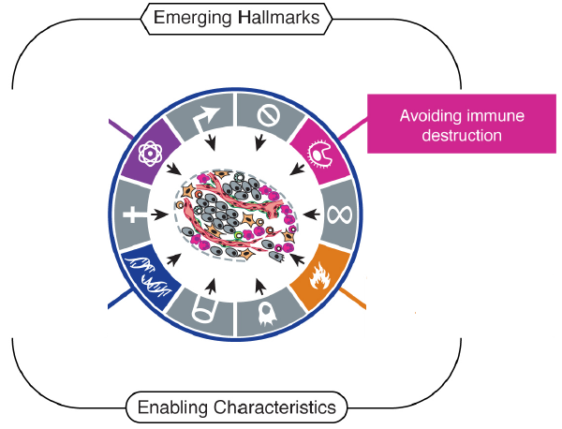

The metastatic gene signature of tumours
Deregulating cellular energetics
Aim: To identify genes
involved in immune
recognition of tumors
Genome instability
and mutation
Tumour-promoting
inflammation
Modified from Hanahan D., 2011

Slide 11
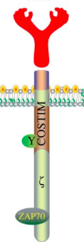
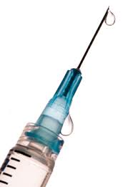
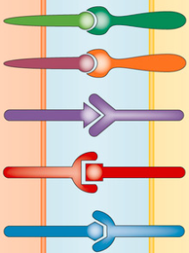


Current Immunotherapy Approaches
Immune Oncolytic CAR T-cells Abs Cancer
checkpoints viruses Vaccines

Slide 12
Hypothesis :
Antigen processing deficits underlie Immune escape in the transition from Primary to Metastatic Tumor

Slide 13
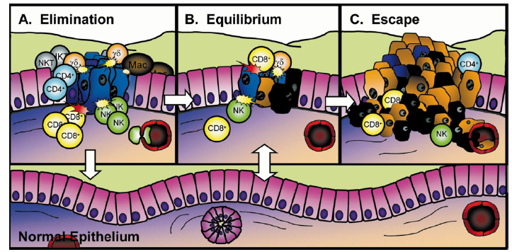
Tumor Escape Hypothesis:
Interactions between immune components and tumors influence disease outcome

Slide 14
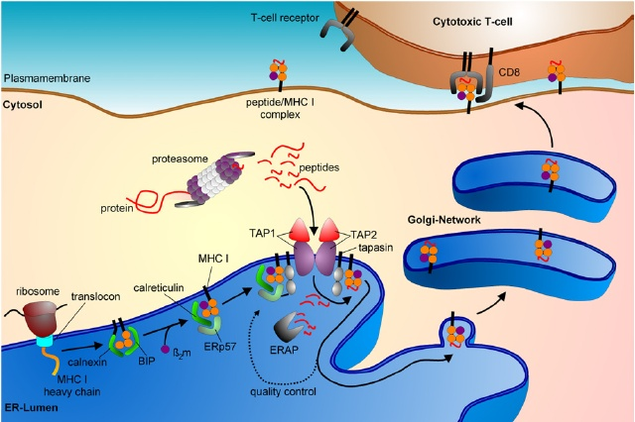
Cancer cells evade immune recognition by turning off antigen presentation

Slide 15
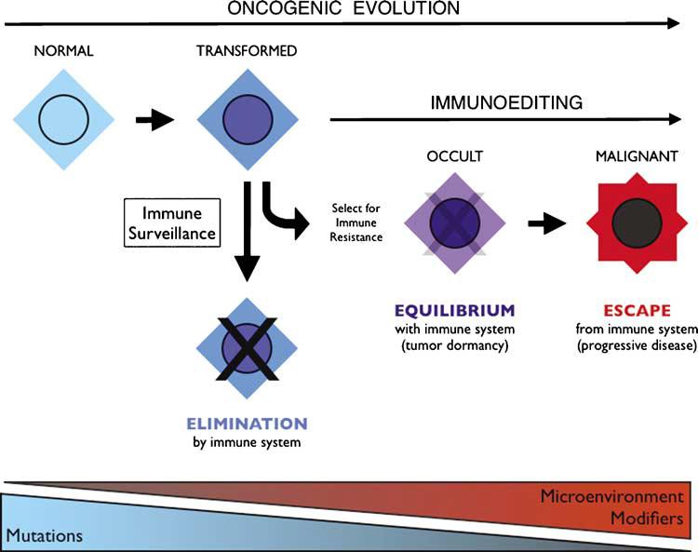
Normal cells
Cancer cells
Escape of abnormal cells from immune surveillance
Down-regulation of MHC-I processing machinery results in escape from immune surveillance
Cancer cells with additional mutations
No additional Mutations
Mutations
Escape immune system
Recognized and killed by the Immune System

Slide 16
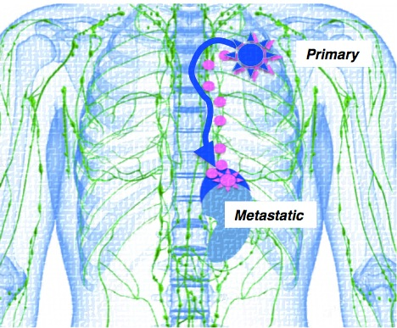
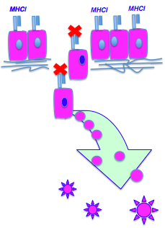
Site of tumour origin
Immune evasiveness as a cancer hallmark
Metastatic spread of
the disease
Notes:
The latest in cancer biology has been summarized as cancer hallmarks and immune evasiveness is one of them. Genes mediating sustaining proliferation, tumor cell survival, motility, invasion, angiogenesis, colonization and immune evasiveness are classified as metastic progression genes.
The proteins encoded by these genes allow tumor cell to overcome cell-to-cell adhesion forces, move to a distal site, survive and colonize there, while being immunologically undetectable.

Slide 17
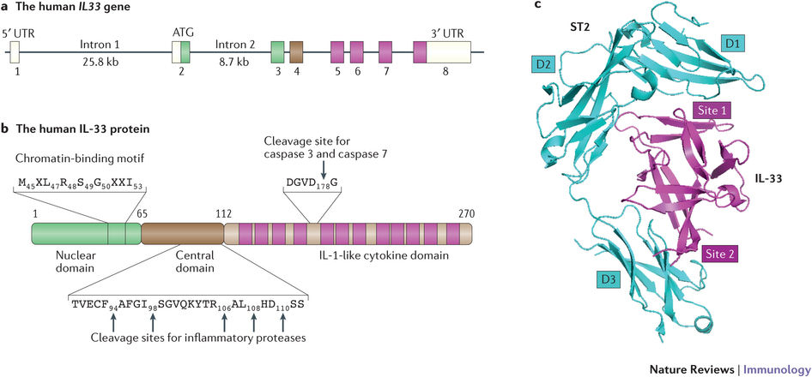
Interleukin-33
Pro-inflammatory cytokine belonging to the IL-1 superfamily with determinant roles in innate and adaptive immune responses.
IL-33 works both as a cytokine and a nuclear factor.
Nature Reviews Immunology
Liew et al., 2016
Notes:
Pro-inflammatory cytokine belonging to the IL-1 superfamily with determinant roles in innate and adaptive immune responses. Mostly expressed by stromal cells. IL-33 can work both as a cytokine and a nuclear factor and is secreted upon cellular damage and necrosis.
IL-33 nuclear domain binds chromatin and can repress NF-Kb. Can be cleaved in central domain.

Slide 18
Immune responses induced by IL33 dependent on:
Type of cells;
Specific microenvironment;
Immune context in diseases.
Th1
Th2
COPD, LCMV.
DC, Th1, macrophage activation.
Anti-tumor through CD8+ T-cell response. (IL-33–ST2–MyD88–STAT4)
Early response after injury.
IL33-ILC2-IL4/IL5/IL9/IL13
Promote ILC2 egress from BM.
Our data demonstrates that IL-33 is down-regulated in the transition from primary to metastatic carcinomas
Notes:
T-bet– and STAT4–dependent IL-33 receptor expression directly promotes antiviral Th1 cell responses
IL-33–induced activation and maturation of mDCs can be regulated, at least in part, by ST2-MyD88–mediated activation of JAK/STAT1 signal-transduction pathways.

Slide 19
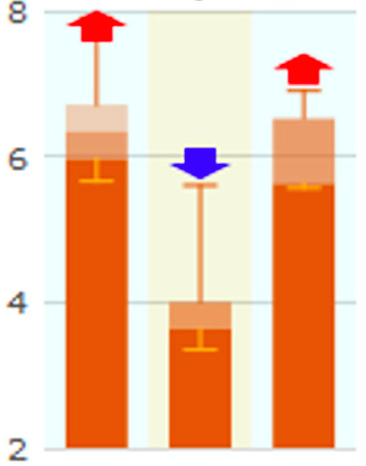
IL-33 expression is reduced in human metastatic prostate cancer
(the European Biostatistics Institute)
enig Metastatic Primary
(human prostate cancer)
8
6
4
2
Fold change

Slide 20
Clinical correlations of changes in IL33
Normal tissue and primary lesions in different tumor types
Cancer type | Patients | Log2_fold_change | p value
Cervical cancer/squamous cell/ Endocervical adenocarcinoma | 3/3(100.0) | -5.75 | 9.66E-16
Urinary bladder cancer | 19/19(100.0) | -2.99 | 1.48E-12
Esophageal cancer | 9/11(81.82) | -2.82 | 1.13E-06
Lung cancer/Lung squamous cell carcinoma | 49/51(96.08) | -2.25 | 3.71E-15
Head and neck cancer | 37/43(86.05) | -2.19 | 4.96E-13
Uterine cancer | 6/7(85.71) | -2.18 | 5.58E-03
Breast cancer | 59/114(51.75) | -1.3 | 4.14E-07
Prostate cancer | 42/52(80.77) | -0.92 | 2.60E-09
Thyroid cancer | 51/59(86.44) | -0.66 | 4.27E-03
Wan, Quan et al. “BioXpress: an integrated RNA-seq-derived gene expression database for pan-cancer analysis.” Database : the journal of biological databases and curation (2015)

Slide 21
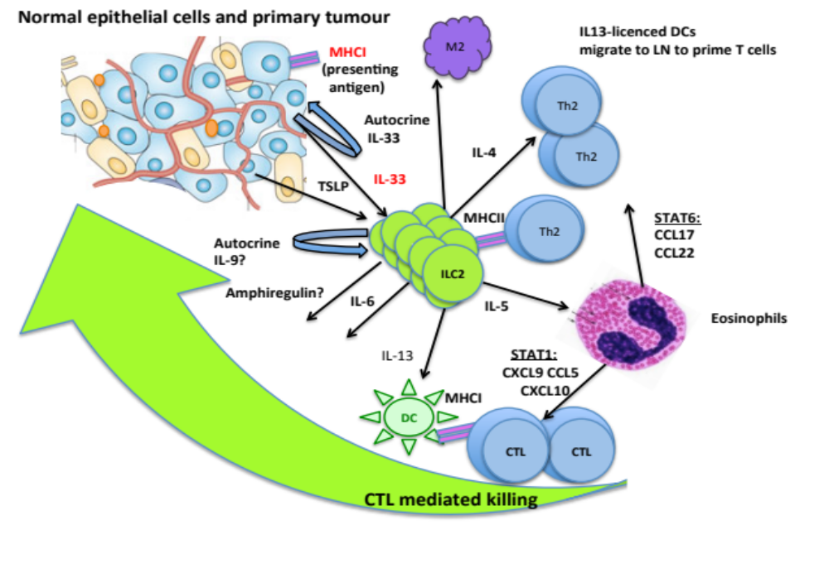
Mechanism of Immune recognition and Immune escape

Slide 22
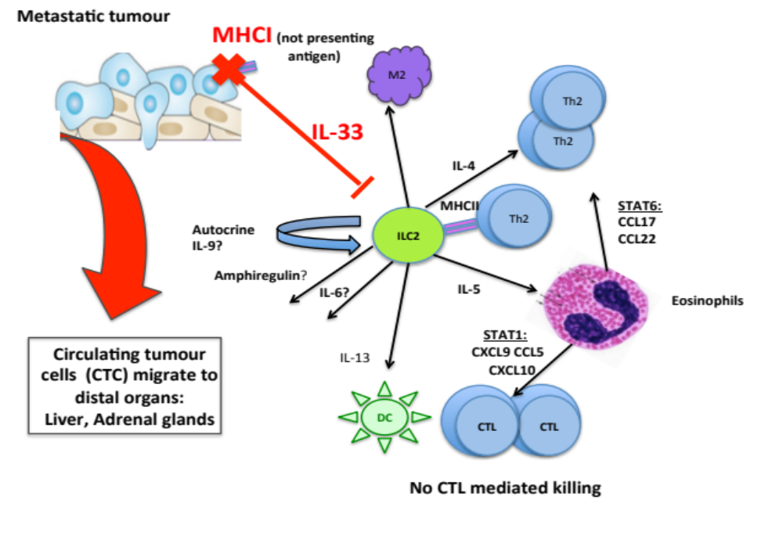
Mechanism of Immune recognition and Immune escape

Slide 23
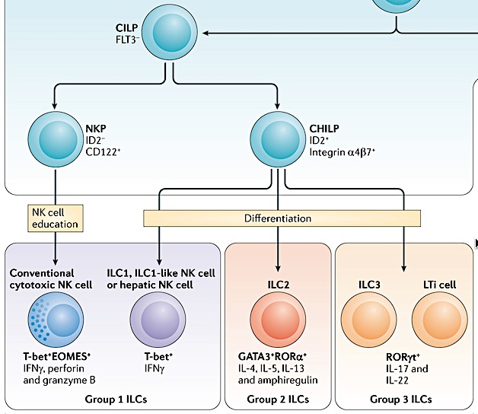
Three main groups of ILC family
Georg Gasteiger and Alexander Y. Rudensky, 2014
Notes:
CILP – common ILC precursor
CHILP- common helper-like ILC precursor

Slide 24
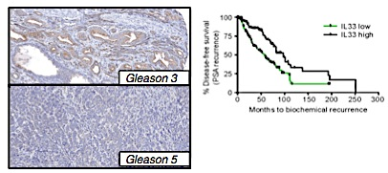
Reduced IL-33 expression is associated with rapid progression of prostate cancer patients
IL-33 protein expression: tissue microarray (VPC)
IL-33 low
IL-33 high
% Disease-free survival
(PSA recurrence)
Time (Months)
Notes:
we examined the expression of IL-33 in prostate cancer specimens obtained at the Vancouver Prostate Centre (VPC). At the mRNA level, IL-33 expression was higher in benign prostate tissue than primary tumours that included naïve tumours (untreated prior to surgery or NHT tumours exposed to neo-adjuvant hormone deprivation therapy prior to surgery (p<0.0001; t-test), and further reduced in castration-resistant prostate cancer (CRPC) in a large cohort of RNA-sequencing data (Fig. 6a), suggesting an inverse correlation with disease progression. Next, we evaluated the protein expression of IL-33 by immunohistochemistry in 342 prostate cancer specimens obtained at prostatectomy. Likewise, low IL-33 expression was significantly associated with reduced time to prostate-specific antigen (PSA) recurrence (a marker of relapse) after prostatectomy
our data shows that the reduced IL-33 expression is associated with progression to metastatic disease. In addition, we demonstrated that IL-33 down-regulation was significantly associated with reduced survival time in human prostate cancer.

Slide 25
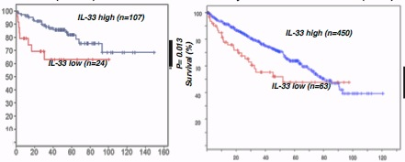
Reduced IL-33 expression is associated with rapid progression in both Prostate and Renal Carcinomas
Prostate tumour (MSKCC) Kidney renal clear cell carcinoma (TCGA)
IL-33 high (n=450)
% Disease-free survival
(PSA recurrence)
P=0.013
% Survival
20 40 60 80 100 120
Time (Months) Time (Months)
Notes:
We found a similar trend in patients with kidney renal clear cell carcinoma (TCGA, access date: March, 2015). Support for our findings can be found in recent reports from others with regards to hepatocellular carcinoma.

Slide 26
Summary
We identify that IL-33 expression is reduced in many carcinomas upon their transition to the metastatic form.
The expression of IL-33 and MHC-I by the tumors is directly correlated
Transfection and re-expression of the IL-33 gene in metastatic tumours induces immune recognition in vivo, similar to the AARSOTA
We demonstrate that IL-33 expression is an immune prognostic biomarker in humans for recurrent and metastatic prostate and renal carcinomas cancer.

Slide 27
Mechanism of
Immune Recognition and Immune Escape
Notes:
Figure 9. IL-33-ILC2 axis links the adaptive and innate immune responses together during tumour development. IL-33 expressing tumour environment stimulates the development of ILC2 cells and functionally activates them through the ST2 receptor pathway. Functionally active ILC2s alter the tumour microenvironment triggering innate and adaptive immune responses. ILC2s recruit dendritic cells through IL-13 production and Th2 cells through direct antigen presentation via MHCII molecules. Through the release of IL-5 by ILC2s and subsequent recruitment of eosinophils, the chemokine profiles of tumour microenvironment is changed to attract CD8+ T cells and to direct the activation of CTL mediated killing and cancer rejection. In metastatic tumours with low IL-33 content the IL-33-ILC2s pathway is halted.

Slide 28
Curcophanols

Slide 29
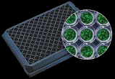

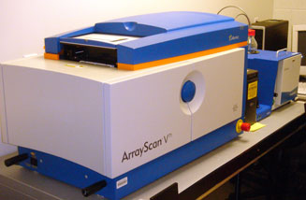
Screening assay will identify new active anti-cancer drugs
Seed LMD pTAP-1-EGFP cells
96-well plate
Add compounds
BioGrid robot
Fixation and DNA staining
Automated image acquisition
Cellomics Arrayscan VTI
(automated fluorescence imager)
High-content image and data analysis
Target activation algorithm
96-well plate
16h incubation
48h incubation
Image acquisition

Slide 30
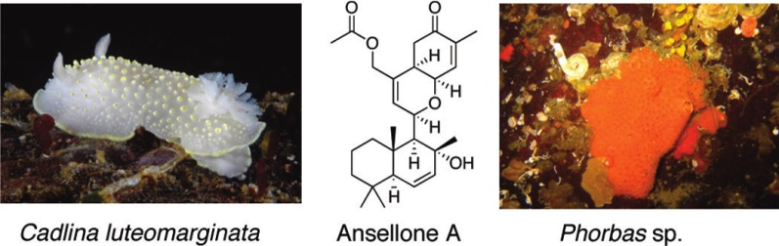
Using the screen to identify new active structures
Crude methanol extracts of a variety of marine invertebrates, mostly marine sponges, collected in many of the world's oceans are used to determine whether these marine extracts can induce reporter gene expression and induce an increase in MHC-I expression on the cell surface.
Determine whether marine extracts restore T cell recognition of cancer cells.
Notes:
The screen will be testing a high number of marine extracts, after multiple fractionatioin of these extracts a single chemical structures will be identified and isolated. These structures will be synthesized and manufactured to test induction of MHC-I expression on the surface of these tumor cells (LMD) and on other tumor cells and tested for recognition of the immune system.

Slide 31
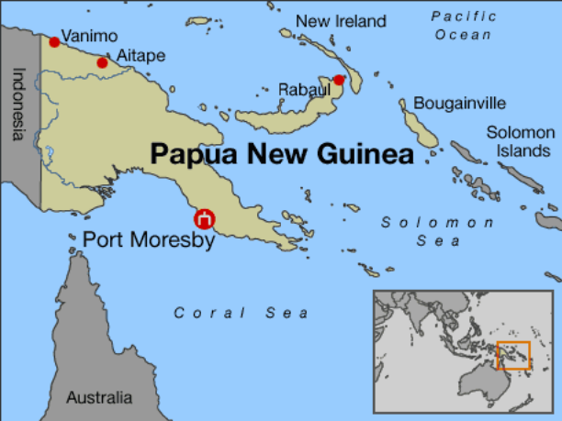
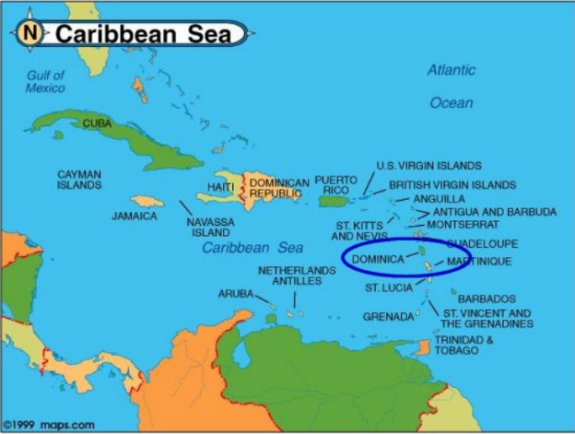
Assays and Extract Libraries
Early days
Anticancer and Antiinflammatory Bioassays
  Antimitotic agents
  IDO inhibitors
  SHIP1 agonists
Source Organisms (Biodiversity ≈ Chemical Diversity)
  sponges, hydroids, soft corals, algae, and microorganisms
  collected in B.C., Papua New Guinea and Dominica
Ray Anderson UBC

Slide 32
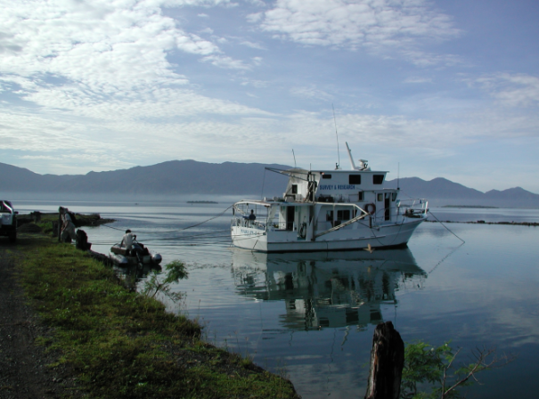
Marine Natural Products: A Rich Source of Novel Chemical Diversity
≈ 60% of drugs are based on natural products
6 out of 7 anticancer drugs approved between 2006 and 2010 are based on natural products
≈ 15,000 novel marine natural products reported
terpenoids, polyketides, peptides, alkaloids, glycolipids
least explored source of natural products

Slide 33
Extract 1
75966-76046
Extract 2
75966-76046
Extract 3
76212-76294
Extract 4
76212-76294
Extract 5
76295-44708
Extract 6
76295-44708
Extract 7
44709-55480
Blue = compounds exhibiting considerable activity.
A
A/B-a
A/B-b
A/B-c
A/B-d
A/B-e
A/B-f
A/B-g
B
D
A
A-a
A-b
A-c
A-d
A-e
A-f
A-g
Extract 2
Phillipine sponge
#76018
Extract 3
Phillipine sponge
#76253
Extract 5
Phillipine sponge
#76336
Extract 6
Non-identified
Invertebrate
Aqueous
EtOAc A
B
C
D
E
Aqueous
EtOAc A
B
C1,2,3
D
Aqueous
EtOAc A
B
C
D
A/B-f-B
A/B-f-D
D
Curcuphenol Analogues
PC-02-113
PC-02-114
PC-02-116
PC-02-123
PC-03-93
PC-03-97-1
PC-03-97-2
PC-03-99
480 extracts
Cellomics and Flow Cytometry - LMD
Cellomics - LMD
Cellomics - LMD
Cellomics and Flow Cytometry - LMD

Slide 34
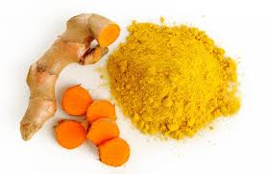
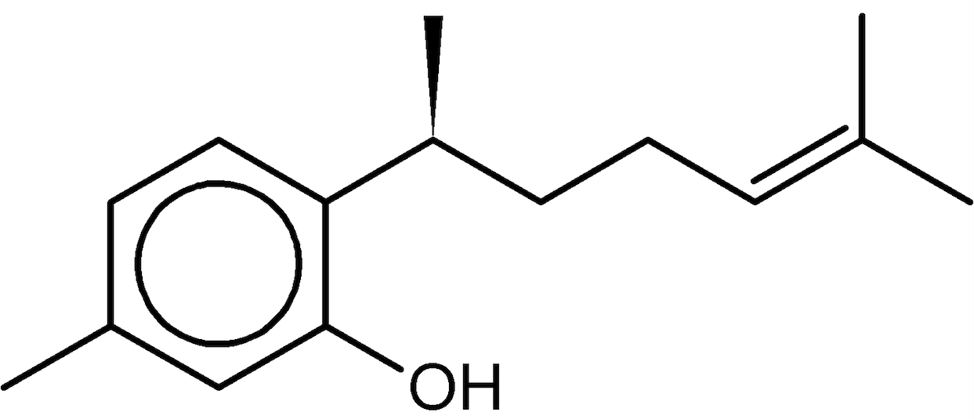
Identified active structures that restore MHC-I expression on tumor cells
Curcuphenol
  Naturally occurring in plants and sea sponges
  Sesquiterpene phenol
C₁₅H₂₂O
218.34 Da

Slide 35
ABCF-1

Slide 36
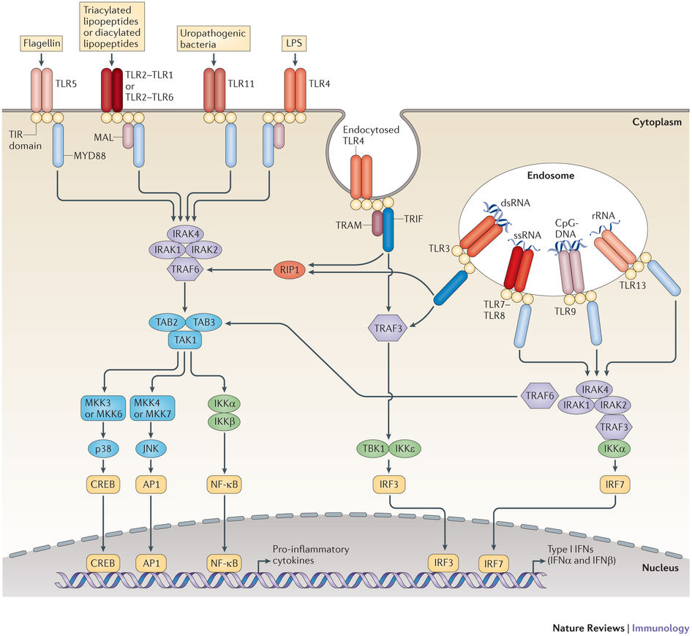
TLR mediated innate immune responses
Luke A. J. O'Neill et. al, 2013

Slide 37
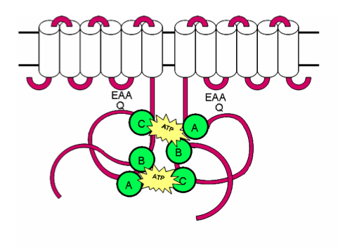
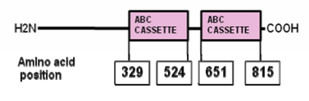
Discovery of ABCF1
An ABC molecule
ABCF1 Structure

Slide 38
ABCF1: What’s known so far
Manon et al., (1998):
Discovered the expression of ABCF1 in TNF-alpha stimulated synoviocytes of Rheumatoid Arthritis patients
Tyzach et al., (2000): ABCF1 recruits' met-tRNA to ribosomes and helps in translation initiation
Ota et al., (2007): ABCF1 is associated with susceptibility to autoimmune pancreatitis
Lee et al., (2013): ABCF1 is involved in regulating innate immune response to cytosolic DNA
Wilcox, Arora, et al. (2017): Generated an Abcf1+/- mice, with Abcf1 KO lethal at 3.5 dpc and studied its role in immune response
Arora, et al. (2018): Homology modeling studies suggested ABCF1 to be the first ABC transporter to ever possess E2 ubiquitin-conjugating activity

Slide 39
Hypothesis
ABCF1 is an ubiquitin enzyme and regulates innate immune responses in macrophages and controls cytokine storm during sepsis

Slide 40
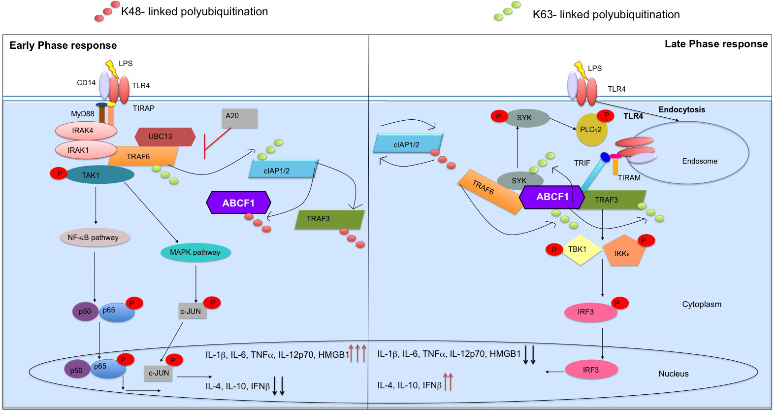
ABCF1 regulates TLR4 endocytosis and macrophage polarization by targeting SYK and TRAF3 for K63- linked polyubiquitination

Slide 41
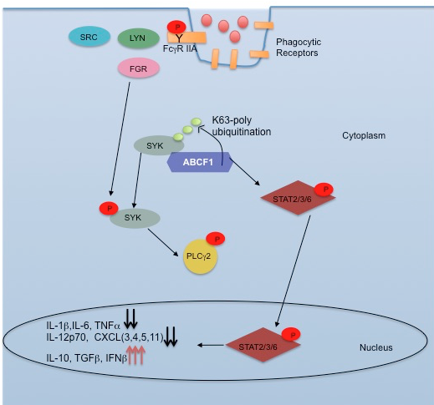
ABCF1 is vital for FcγR IIA mediated phagocytosis

Slide 42
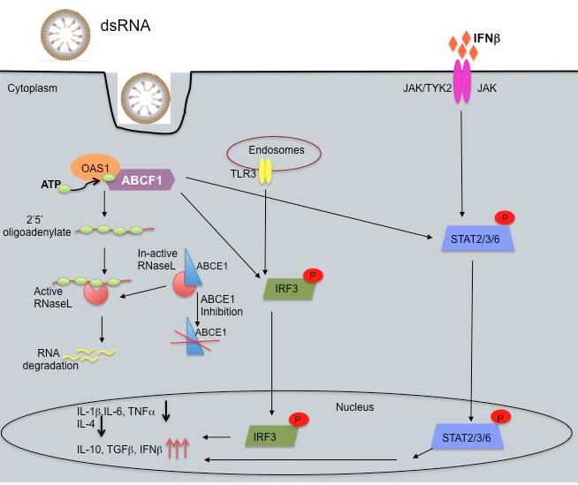
ABCF1 positively regulates IFN-I production in
TLR3 signaling via Oas1 pathway

Slide 43
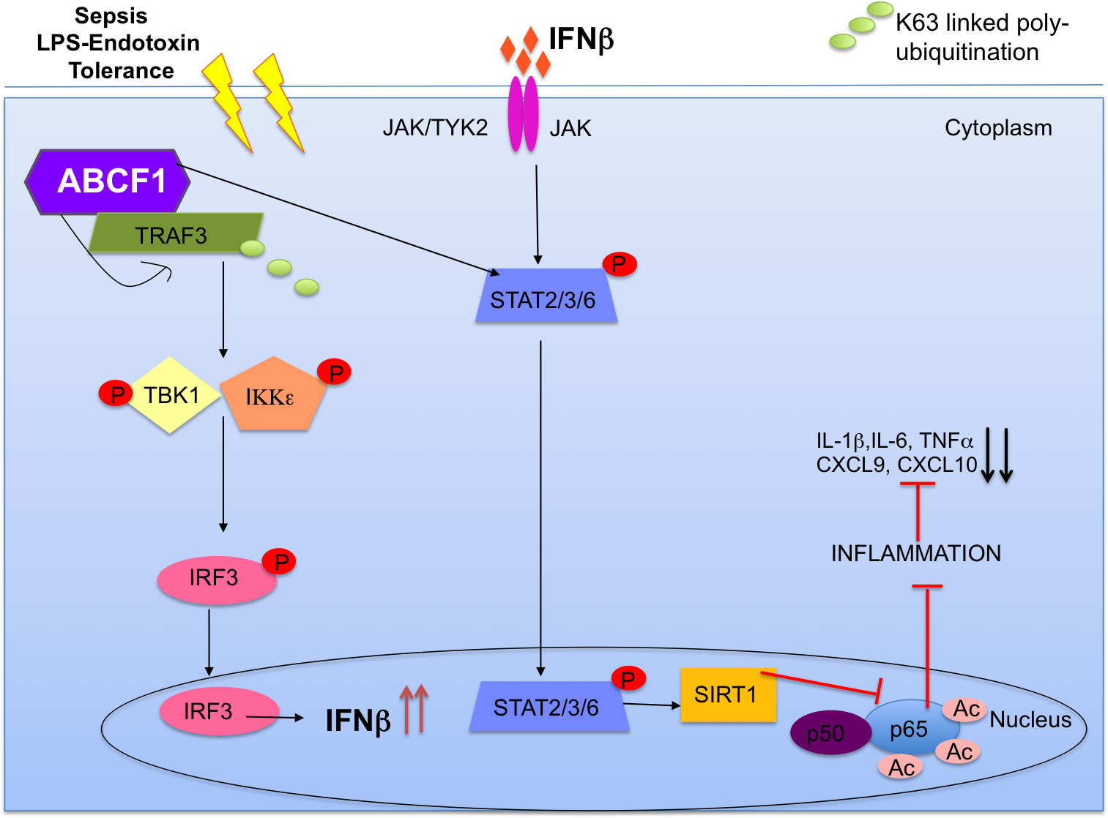
ABCF1 protects against sepsis by regulating
IFNβ mediated SIRT1 expression

Slide 44
Summary
ABCF1 controls the SIRS mediated cytokine storm phase during sepsis
ABCF1 targets TRAF3 for K63-polyubiquitination and controls the SIRS phase to ET phase transition during sepsis
ABCF1 regulates TRAF3-IRF3 dependent IFNβ production, which controls JAK-STAT mediated SIRT1 expression
ABCF1 controls renal circulatory failure and hypotension during sepsis

Slide 45
Significance
Discovery of a potential target for drug development to protect against cytokine storm during inflammatory processes such as cancer and sepsis.
Elucidated a target to control immunological pathways and IFN-I production to help counteract viral infections like HIV and also cancer progression
Established ABCF1 as a potential therapeutic agent to control mortality and cell survival in inflammatory cascades such as cancer, sepsis, etc.

Slide 46
AHEAD Map™

Slide 47


Slide 48
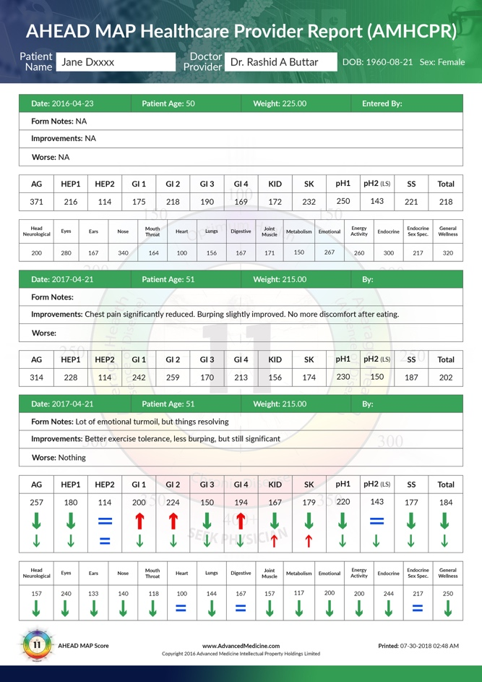
Assess your patients (or yourself if you’re not a provider) and know their entire medical story, how they have been doing, and how they are doing today, all on 1 page, regardless of how many years they have been your patient/client!

Slide 49
AHEAD MAP
Advanced Health Evaluation and Assessment for Detoxification Medical Assessment Plan
Going to show you exactly how easy it is to
”BLESS” yourself and your loved ones and Pay It Forward
by sharing access to the AHEAD MAP

Slide 50
I NEED YOUR HELP TO SPREAD EMPOWERMENT!
AHEAD MAP
Advanced Health Evaluation and Assessment for Detoxification
Medical Assessment Plan
OVERVIEW
AHEAD MAP is the ideal method of automating the process of effective detoxification and customizing YOUR nutritional program, accurately! And it is the ONLY such program in the world to bring this power into the hands of everyone!

Slide 51
I NEED YOUR HELP TO SPREAD EMPOWERMENT!
AHEAD MAP
Advanced Health Evaluation and Assessment for Detoxification
Medical Assessment Plan
UNIQUENESS
AHEAD MAP is the FIRST and ONLY clinical tool to automate the process of effective detoxification and customizing YOUR nutritional program using an advanced neural network. Specific subjective criteria are then measured, combined and calculated using an advanced algorithm to generate an objective numeric value, one that can now be tracked and followed. And it is the ONLY such program in the world to bring this power into the hands of everyone, for FREE!

Slide 52
I NEED YOUR HELP TO SPREAD EMPOWERMENT!
Advanced Health Evaluation and Assessment for Detoxification
Medical Assessment Plan
ACCURATE and THOROUGH
Using a subjective SF-36 outcome based model, YOUR subjective symptoms are carefully collected and evaluated, and converted into a numeric objective value
A clinical tool with 350 years+ of clinical experience behind it, (estimated to be over a $300 value each time you take it)
Automate the process of detoxification and optimization with a 93.57% success rate of improving outcome within 60 days

Slide 53
AHEAD MAP
Advanced Health Evaluation and Assessment for Detoxification
Medical Assessment Plan
AUTONOMY
Use the AHEAD MAP to follow any treatment, protocol, therapy or modality and YOU determine the effectiveness of the therapy. You become your OWN Testing machine.
Track YOUR AHEAD MAP score to see how effective YOUR treatments are (what ever they may be), as well as track the improvement or worsening of your OWN symptoms.
Scores are broken down to each detoxification organ system as well as an over all global score and lesser organ score

Slide 54
AHEAD MAP
Advanced Health Evaluation and Assessment for Detoxification
Medical Assessment Plan
CONFIDENCE
There is NO CLINCIAL TOOL accessible to ANYONE as powerful as the AHEAD MAP to direct your path correctly.
All patients HAVE to take the AHEAD MAP at each visit.
I do NOT see a patient until they’ve done their AHEAD MAP. Why? It’s the most accurate assessment tool I have.
Took 19 years to perfect and refine the AHEAD MAP.

Slide 55
AHEAD MAP
Advanced Health Evaluation and Assessment for Detoxification
Medical Assessment Plan
VALUE
The value of the AHEAD MAP: estimated by an insurance industry actuarial data analysis expert, to be worth about $300 each time it’s taken, based on the information the AHEAD MAP provides to prevent issues from worsening.
It’s absolutely 100% FREE for you, every time you take it.
FOR EVER! You’ll never pay a dime to use the AHEAD MAP
For Doctors/Health Providers: Also use it for FREE!

Slide 56
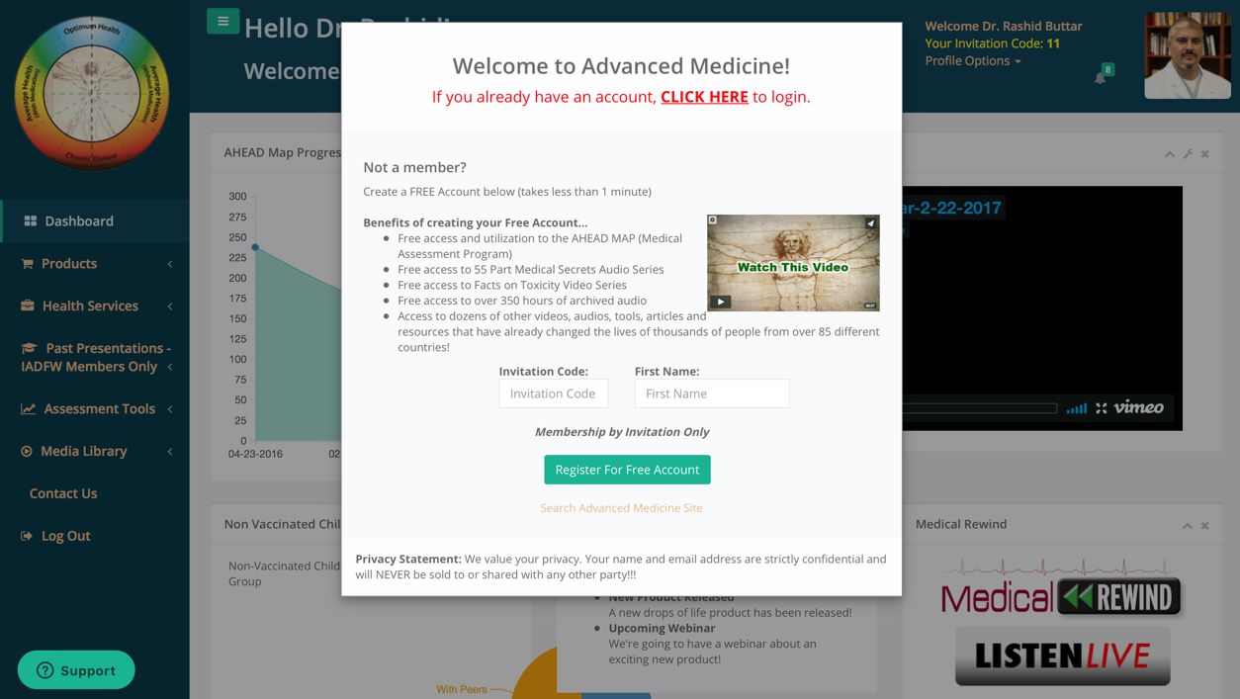

Slide 57
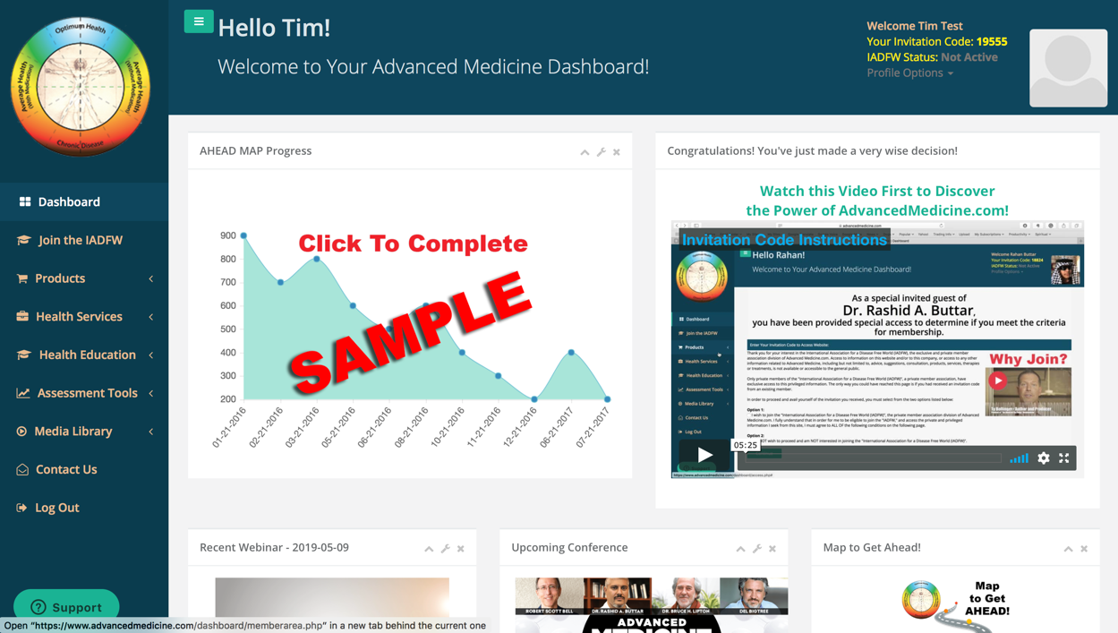

Slide 58
Assess your patients (or yourself if you’re not a provider) and know their entire medical story, how they have been doing, and how they are doing today, all on 1 page, regardless of how many years they have been your patient/client!

Slide 59
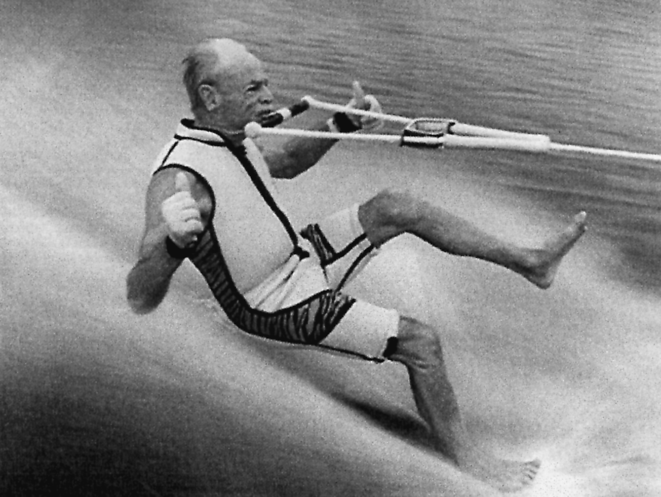

Slide 60
The “MAP to get AHEAD™” Program
Experience:
- Improved sleep,
- Increased energy,
- Better bowel movements
While enhancing your:
sense of well being,
improved concentration
Improvement of focus,
All within 30 days of implementing
2* simple things into your life!
Caution*** Side Effects may occur!

Slide 61
Side Effects
Side effects include, but are NOT limited to improvement in overall mood, decrease in anxiety, reduction in depression, reduced joint pain, improved joint flexibility, drop in body fat, improved skin texture and suppleness with enhanced complexion, reduced acne and skin blemishes, with possibility of improved body counter. Enhanced kidney functioning with overall detoxification may occur!

Slide 62


SLEEP

Slide 63
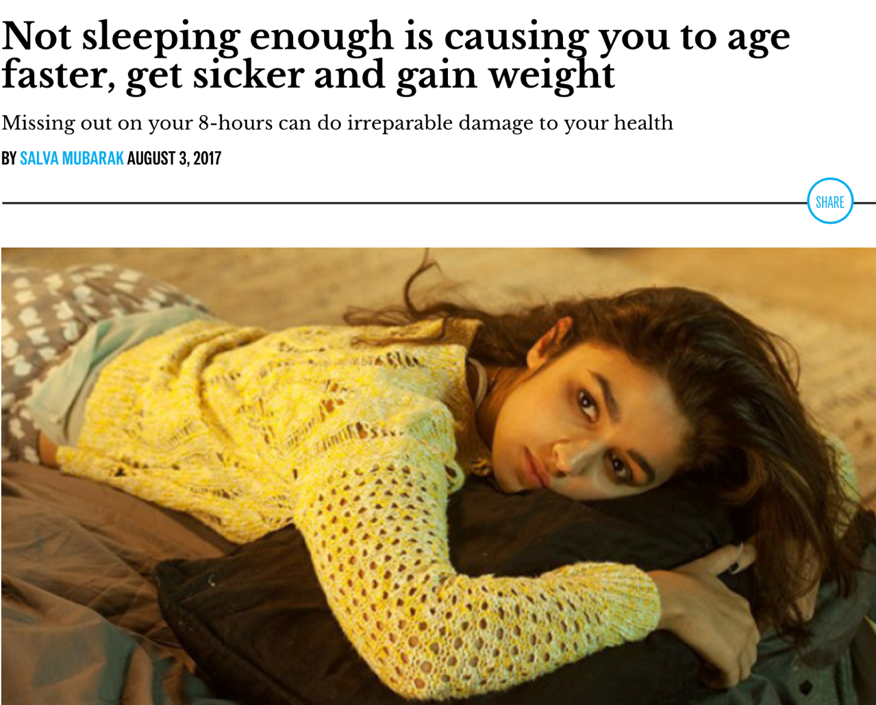
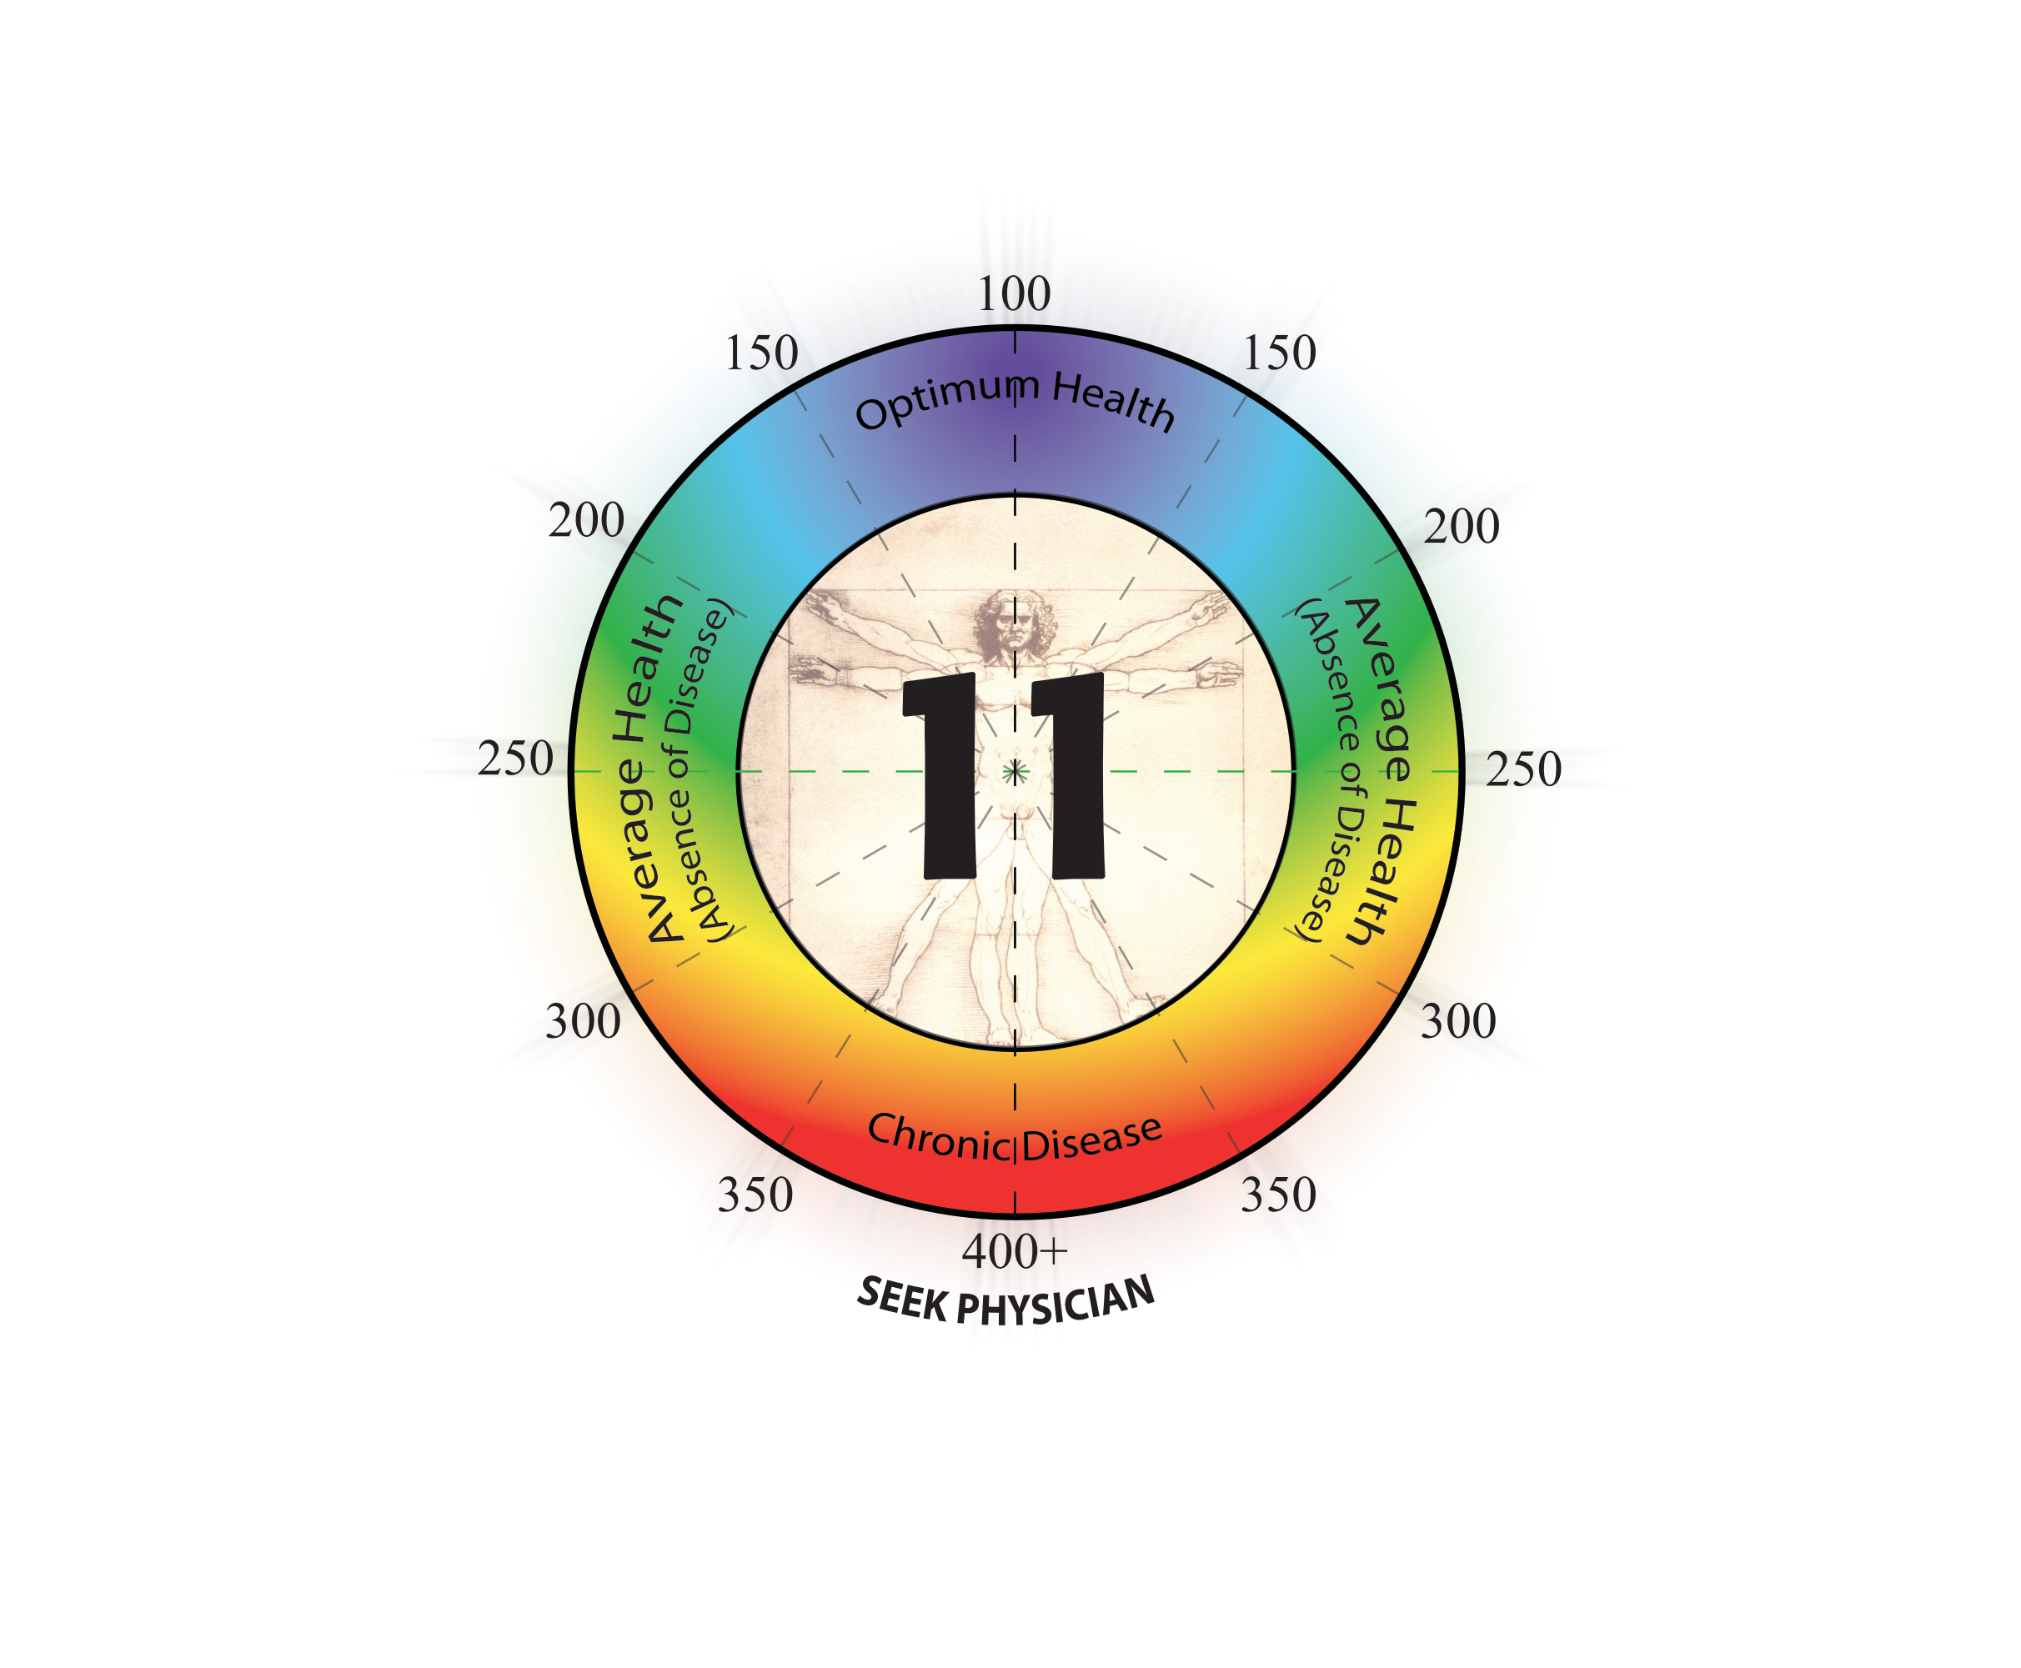
SLEEP

Slide 64

SLEEP

Slide 65

SLEEP

Slide 66

ENERGY
Copyright© 2018 - Dr. Rashid A. Buttar, LLC All Rights Reserved

Slide 67

ENERGY
Copyright© 2018 - Dr. Rashid A. Buttar, LLC All Rights Reserved

Slide 68


ENERGY
Copyright© 2018 - Dr. Rashid A. Buttar, LLC All Rights Reserved

Slide 69

ENERGY
Copyright© 2018 - Dr. Rashid A. Buttar, LLC All Rights Reserved

Slide 70

BOWEL MOVEMENTS

Slide 71
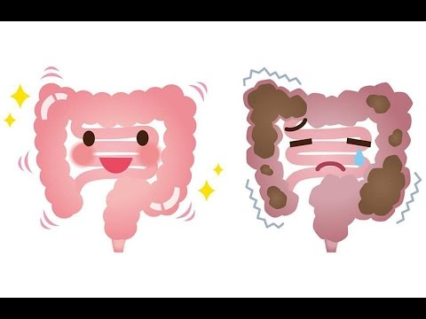
BOWEL MOVEMENTS

Slide 72
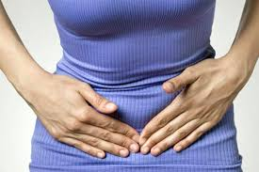
BOWEL MOVEMENTS

Slide 73

BOWEL MOVEMENTS

Slide 74


SENSE OF
WELL BEING

Slide 75

SENSE OF WELL BEING

Slide 76

SENSE OF WELL BEING

Slide 77

CONCENTRATION

Slide 78

CONCENTRATION

Slide 79

FOCUS

Slide 80

FOCUS

Slide 81
The “MAP to get AHEAD” Program
Experience:
- Improved sleep,
- Increased energy,
- Better bowel movements,
While enhancing your:
sense of well being,
improved concentration
Improvement of focus,
All within 30 days of implementing
2* simple things into your life!
Caution*** Side Effects may occur!

Slide 82
Side Effects
Side effects include, but are NOT limited to improvement in overall mood, decrease in anxiety, reduction in depression, reduced joint pain, improved joint flexibility, drop in body fat, improved skin texture and suppleness with enhanced complexion, reduced acne and skin blemishes, with possibility of improved body counter. Enhanced kidney functioning with overall detoxification may occur!

Slide 83
The “MAP to get AHEAD” Program
  Experience improved sleep, better BM’s and increased energy with 2 simple changes in your life! - $150 value
  The 9 Steps to Keep the Doctor Away Hard Cover - $25
  KYO DVD – The 9 Steps to Optimal Health - $89.55
  Subliminal binaural beat audio program corresponding to KYO DVD – 9 Steps - $55
  Lifetime Membership to the IADFW - $99 / YEAR
  Lifetime Access to all the AHEAD MAP tools - $300 /1 x use
  FREE 1 Hour AHEAD MAP Coaching Consultation - $250
  Over 450 hours of radio show archives, access to protocols unavailable to the public, access to special webinars, etc.

Slide 84
Guarantee
1st – The Program Works…BUT:
  This is NO different than anything else in life.
  You will only get out of it, what you PUT INTO it!
  You HAVE to follow instructions and DO THE WORK!
  If you don’t, you simply WILL NOT get the results.
2nd – If Your Mind Set Is About the Guarantee…
  There are NO guarantees in life
  Where ATTENTION goes, ENERGY Flows!

Slide 85
I NEED YOUR HELP TO SPREAD THE TRUTH!
VanVCD.org
Vaccinated and non-Vaccinated Children’s Data
This is an unbelievable tool, where you can see in real time, what the effects of vaccines have been
Based on reports from actual parents of children
Takes 2 minutes to do the survey. Please do it!
You can query the data how ever you like!

Slide 86
Before going over the Resources to Empower…
I Want YOU to Make Me a Promise?
Once you’ve seen the value of the program after the 30 days, will you PROMISE me that you will consider granting me a personal FAVOR?

Slide 87
The “MAP to get AHEAD” Program
  Experience improved sleep, better BM’s and increased energy with 2 simple changes in your life! - $150 value
  The 9 Steps to Keep the Doctor Away Hard Cover - $25
  KYO DVD – The 9 Steps to Optimal Health - $89.55
  Subliminal binaural beat audio program corresponding to KYO DVD – 9 Steps - $55
  Lifetime Access to all the AHEAD MAP tools - $300 /1 x use
  FREE 1 Hour AHEAD MAP Coaching Consultation - $250
  Over 450 hours of radio show archives, access to protocols unavailable to the public, access to special webinars, etc.
  Lifetime Membership to the IADFW - $99 / YEAR

Slide 88
The “MAP to get AHEAD” Program
  Full value of this package,
  when items are sold separately:
  Over $2,468.55
  For Just The 1st Year

Slide 89
The “MAP to get AHEAD” Program
  1 Year Value – $2,468.55
  Over 10 Year Period - $19,559.55
  Over 20 Year Period - $38,549.55
  What is this worth to YOU?

Slide 90
Now, here is the BIG FAVOR I HAVE TO ASK YOU
WILL YOU JOIN ME?
  Because I need YOUR help to help get the truth out
  Because others need YOUR help to help guide them
  Because we have to protect SOCIETY for our children
  Because we need to protect the World for our future
  Because it’s time now, to do what each of us CAN do
  Because Spiritually, we are now evolving!

Slide 91
I NEED YOUR HELP TO SPREAD THE TRUTH!
WHY?
  Because you may be making a Change in someone else’s life you didn’t even realize
  Because it benefits us “energetically”
  Because you’re helping YOUR “tribe” grow
  Because it’s the Right Thing To Do now

Slide 92
I NEED YOUR HELP TO SPREAD THE TRUTH!
HOW?
  Make the Choice to Help, then set the Intention
  Decide today to “Pay it Forward” and then do it
  “Make the Change the World is Waiting For…”
  Share this webinar and information with others, if you have found it to be of Benefit!

Slide 93
I NEED YOUR HELP TO SPREAD THE TRUTH!
The only thing necessary for the triumph of evil, is for good men to stand by and do nothing.
- Edmund Burke

Slide 94
OUR WAY OF SAYING “THANK YOU”!
  First 20 Coaching Calls with Dr. B
  “MAP to get AHEAD”
  Coaching Consultations

Slide 95
The “MAP to get AHEAD™” Program
Experience:
- Improved sleep,
- Increased energy,
- Better bowel movements
While enhancing your:
sense of well being,
improved concentration
Improvement of focus,
All within 30 days of implementing
2* simple things into your life!
Caution*** Side Effects may occur!

Slide 96
Side Effects
Side effects include, but are NOT limited to improvement in overall mood, decrease in anxiety, reduction in depression, reduced joint pain, improved joint flexibility, drop in body fat, improved skin texture and suppleness with enhanced complexion, reduced acne and skin blemishes, with possibility of improved body counter. Enhanced kidney functioning with overall detoxification may occur!

Slide 97
The “MAP to get AHEAD™” Program
  Experience improved sleep, better BM’s and increased energy with 2 simple changes in your life! - $150 value
  The 9 Steps to Keep the Doctor Away Hard Cover - $25
  KYO DVD – The 9 Steps to Optimal Health - $89.55
  Subliminal binaural beat audio program based on KYO DVD – 9 Steps - $55
  Lifetime Membership to the IADFW - $99 / YEAR
  Lifetime Access to all the AHEAD MAP tools - $300 /1 x use
  FREE 1 Hour AHEAD MAP Coaching Consultation - $250
  Over 450 hours of radio show archives, access to protocols unavailable to the public, access to special webinars, etc.

Slide 98
The “MAP to get AHEAD™” Program
  Experience improved sleep, better BM’s and increased energy by implementing 2 simple changes in your life!
  Hard back copy of The 9 Steps to Keep the Doctor Away
  Know Your Options DVD
  Subliminal binaural beat audio program corresponding to KYO DVD – 9 Steps
  Access to special webinars
  Lifetime Membership to the IADFW with full access
  Lifetime Access to all the AHEAD MAP tools
  FREE 1 Hour AHEAD MAP Coaching Consultation
  Over 450 hours of radio show archives downloaded
  Access to protocols not available to the public
  Many other things…

Slide 99
OUR WAY OF SAYING “THANK YOU”!
  IADFW Members:
  $50 Discount – Simply Log Into Your Account
  Book Owners:
  $20 Discount – Coupon Code on Check Out

Slide 100
The “MAP to get AHEAD™” Program
  Full value of this package,
  when items are sold separately:
  Over $2,468.55
  For Just The 1st Year

Slide 101
The “MAP to get AHEAD” Program
  1 Year Value – $2,468.55
  Over 10 Year Period - $19,559.55
  Over 20 Year Period - $38,549.55
  What is this worth to YOU?

Slide 102
The “MAP to get AHEAD™” Program
  New IADFW Members For A Limited Time Only:
  Map to get AHEAD™ Program
  FREE
  Join the IADFW and get it FREE!

Slide 103
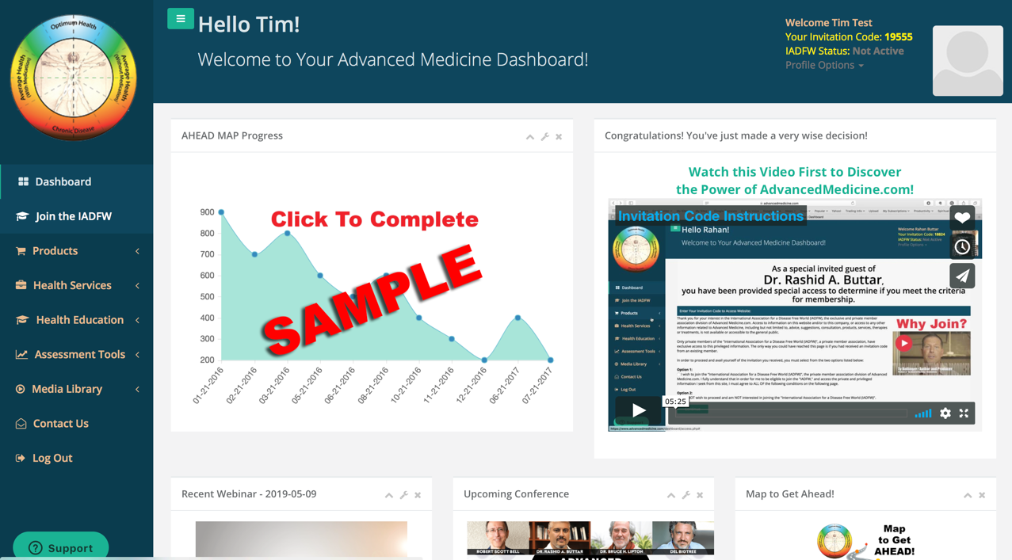

Slide 104
HELP SPREAD THESE FREE RESOURCES!
  AdvancedMedicine.com
  Invitation Code: 1986

Slide 105
HELP SPREAD THESE FREE RESOURCES!
  Website: www.AdvancedMedicine.com
    Give YOUR own personal Invitation Code to allow your guests to access
  Instagram: @DrButtar
  FaceBook: @DrRashidAButtar
  YouTube: Subscribe at youtube.com/DrButtar

Slide 106


