Slide 1
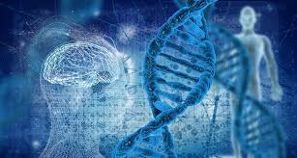
OUR GENES & CELLS
HOW TO CONTROL YOUR GENETICS &
KEEP YOUR CELLS HEALTHY

Slide 2
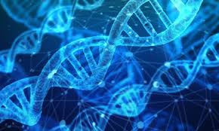
GENETIC CODE
GENES ENCODE PROTEINS
PROTEINS DICTATE CELL FUNCTION
TRANSCRIPTION: DNA TO RNA, TRANSLATION: RNA TO PROTEIN
KEY: CONTROL AND/OR AFFECT THESE PROCESSES
KEY: AFFECT THE CELL
PHOTO CREDIT: CCO PUBLIC DOMAIN

Slide 3
Epigenetics
-DNA modified, chemical compounds added to single genes
-Epigenome comprises all of the chemical compounds that have been added to the entirety of ones DNA
- Epigenetic factors can affect postnatal development. Gluten and casein-free diets have been reported to have positive effects on autoimmune, neurological, and other conditions.

Slide 4
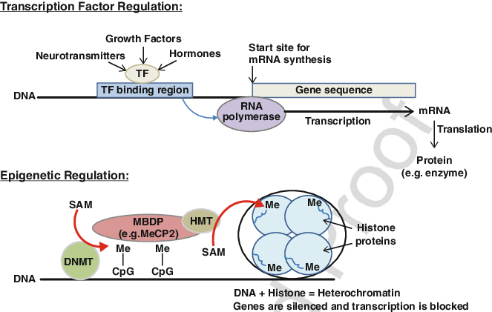
Notes:
Regulation of gene transcription by transcription factors and epigenetic mechanisms. Upper panel: Transcription factors (TFs) bind to specific DNA locations preceding the gene they regulate, leading to binding of RNA polymerase which synthesizes the corresponding messenger RNA (mRNA). Lower panel: Epigenetic regulation involves methylation of DNA at CpG sites, leading to the binding of methyl-binding domain proteins (MBDPs), which in turn bind enzymes such as histone methyltransferase (HMT). DNA wraps tightly around methylated histones , blocking their transcription. S-adenosyl methionine (SAM) is the donor of methyl groups for both DNA and histone methylation, making it a critical factor for epigenetic regulation

Slide 5
Methylation Problems
Hormone Imbalances, Infertility
Cardiovascular diseases, high bp, poor circulation
Mood issues, anxiety, depression, OCD
Autoimmune issues
Memory problems
Chronic Fatigue
Allergies
Digestive issues
Inflammatory conditions

Slide 6
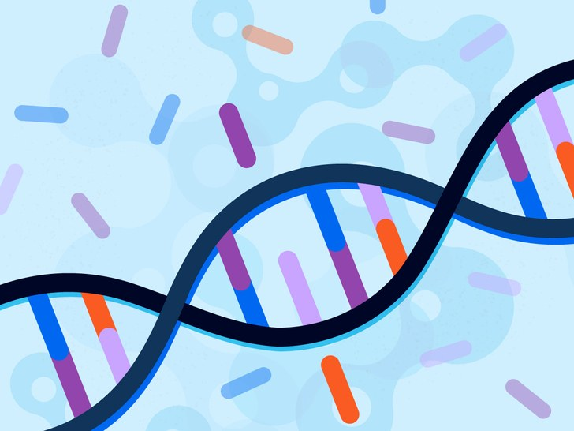
MTHFR GENE MUTATION
The methylenetetrahydrofolate reductase (MTHFR) gene contains the DNA code to produce the MTHFR enzyme.
MTHFR Test detects two of the most common mutations or variations in the MTHFR gene.
Genetic disorders and chronic symptoms.
PHOTO CREDIT: GETTY MS POINT

Slide 7
MICRO RNA (miRNA)
Small non-coding RNA molecule found in plants, animals and some viruses, that functions in RNA silencing and post-transcriptional regulation of gene expression.
miRNA- complexes cause non-destructive inhibition of translation.
Dr. Kedar Prasad

Slide 8
PUBMED
Oxidative Stress, Pro-Inflammatory Cytokines, and Antioxidants Regulate Expression Levels of MicroRNAs in Parkinson's Disease
KN Prasad - Current aging science, 2017 - ingentaconnect.com
Background: Parkinson's disease (PD) is a slow progressive neurodegenerative disease associated with abnormal function of extrapyramidal system. Although several biochemical
and genetic defects are identified, increased oxidative stress and chronic inflammation are one of the earliest events that initiate and promote PD. Oxidative stress also participates in
impaired nonmotor symptoms.
The levels of microRNAs that are evolutionarily conserved
single-stranded noncoding RNAs of approximately 22 nucleotide in length may have a role …

Slide 9
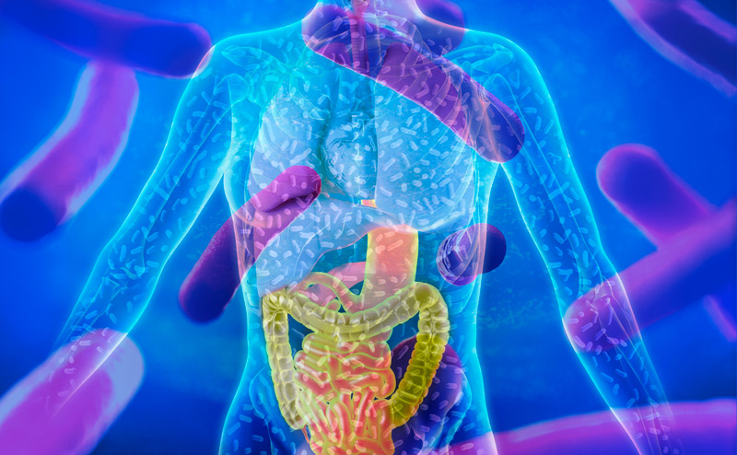
MICROBIOME, GUT/BRAIN
GUT MICROBIOTIA AND BRAIN MUST BE IN SYNC FOR PROPER NEURODEVELOPMENT& NEUROLOGICAL FUNCTION
MICROBIOTIA: COLLECTION OF MICROORGANISMS LIVING ON THE SURFACE AND INSIDE THE BODY
MICROBIOME
ENTERIC NERVOUS SYSTEM, 2ND BRAIN
NEUROTRANSMITTERS
TWO GENOMES, INHERITED, ACQUIRED
PHOTO CREDIT: WORLDOFSCIENCEFESTIVAL.COM

Slide 10
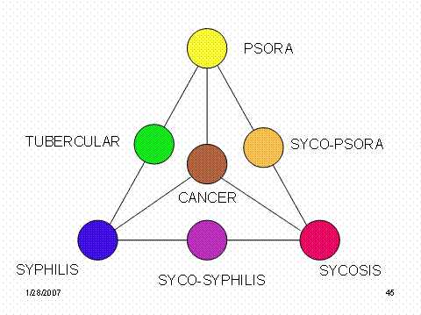
MIASMS
HOMEOPATHY
MIASM: FORCE OR FREQUENCY WITHIN A PERSON CREATING A PREDISPOSITION TO CERTAIN ILLNESS
SYPHILLINUM, SYCOSIS, PSORINUM, HEAVY METALS, CANDIDIASIS
GENETICALLY-LINKED DISEASES
PHOTO CREDIT: HPATHY.COM

Slide 11

HOMEOPATHY AND THE CELL
WHAT IS HOMEOPATHY LIKE HEALS LIKE
NANOPARTICLES
1 nm = 1e9= Divide by 100,000,000 = 1 M
Study: Internalization pathways of nanoparticles and their interaction with a vesicle.
Xiaoming Chen, Falin Tian, Xianren Zhang and Wenchuan Wang
From National Library of Medicine 2006 Mar; 3(1): 13–24. Published online 2006 Feb 5. doi: 10.1093/ecam/nek018PMCID: PMC1375241 PMID: 16550219
Immunology and Homeopathy. 2. Cells of the Immune System and Inflammation
PHOTO CREDIT: MEDIUM.COM

Slide 12

DR. POMPA – 5 R’S INTRACELLULAR DETOX
Remove the source
Regenerate the cell membrane
Restore cellular energy
Reduce inflammation
Restore methylation

Slide 13
PEMF THERAPY
The science behind PEMF is a well-studied* methodology that’s been around for over a hundred years.. It’s used by our clients to mitigate pain, stimulate immune support, improve performance, and enhance brain function* as well as so much more.
According to research from Yale Medical University from as far back as 1932, they discovered that the depletion of electrical energy from the body is the root cause of general dis-ease. PEMF, or a pulsed electromagnetic field, is a donating source of energy that helps the body repair/regenerate/rebuild/get well* naturally, enhancing the functionality of cells.
WWW.PULSECENTERS.COM

Slide 14
PEMF THERAPY
Pulsed Electromagnetic Frequencies
DR. BEEBE: Pemf’s Reduce inflammatory cytokine /chemokines increase pro-inflammatory
Results a week to two weeks after treatment
Enhanced mitochondrial function
Increased in binding membrane affected to bind the fragments to get rid of them
Upregulation of T-cells

Slide 15



WE CAN POSITIVELY AFFECT EXPRESSION OF OUR GENES AND AFFECT OUR CELL HEALTH
DETOX, DRAINAGE AND SUPPORT
STRESS-MEDITATION
EMOTIONAL HEALTH
SLEEP-CIRCADIAN RHYTHM
PEMF THERAPY
MICRO DAILY
PHOTO CREDITS:BABY: ISRAEL21C.ORG
MEDITATION: BULLETPROOF.COM

