Slide 1

ANTIBIOTIC USE AND IMMUNE HEALTH
Dr. MELANIE SIMS HENNING
Annual AONH Conference
Douglasville, GA
2019

Slide 2
CURRENT GLOBAL LANDSCAPE
Antimicrobial-resistant infections kill 700,000 patients every year. By 2050, they are projected to cause 10 million deaths per year at a cumulative global cost of $100 trillion.

Slide 3
MOST COMMON INFECTIONS RESULTING IN ANTIBIOTIC RX
Most antibiotics are empirically prescribed:
  Up to 75% of antibiotics are prescribed incorrectly
  Nearly 50% of antibiotics prescribed may be given longer than necessary
  (CDC 2017 Antibiotic Use in the United States: Progress and Opportunities)
UTI’s are the #1 reason for antibiotic prescriptions after a physician visit (Abbo 2014)
  >95% of uncomplicated UTI’s are monobacterial, yet treated with broad spectrum antibiotics
Data suggests that 41% of overall antibiotic prescriptions are for upper respiratory infections (Annal. Org, 164,6)
Recent study of ambulatory care network showed that 65% of patients seen for URI were prescribed an antibiotic (Annal. Org, 164,6)
Additional data shows that 61% of patients received broad-spectrum antibiotics, when a narrow-spectrum agent would have been more appropriate (Annal. Org, 164,6)

Slide 4

WHY THE EMPHASIS ON TREATING Empirically?
Bacterial and viral infections can present identically
Backed by data
Rapid testing is limited
PCR testing is most accurate, however physicians may be reluctant to recommend outside of network
Broad-spectrum antibiotics cover the gamut
Symptomatic patient may influence a “fix”

Slide 5
The downside of treating empirically
Without PCR testing, traditional cultures can take up to three weeks to run (…AND some pathogens do not even have the appropriate culture medium created anywhere to appropriately diagnose with traditional culture).
Educated “guessing”
Broad-spectrum antibiotics result in an on-slot of negative outcomes. FACT: 89 of 100 Medical Doctors polled in Denver, CO metro-area admitted to using broad-spectrum antibiotics for the following reasons:
  A. Mono-bacterial infections would require different testing to confirm.
    10 Physicians admitted to reluctancy/fear to send patients to another laboratory outside of their contracted payors.
  B. Symptomatic patients demand relief.
  C. Penicillin and other specific antibiotics are generally harder to prescribe (inventory issues), and dosage information is not readily accessible.
Give way to opportunistic bacteria and fungal infections
Antibiotic resistance

Slide 6

Recurrent urinary tract infections
Treatment of uncomplicated urinary tract infections (UTIs) can be based on empiric antibiotic therapy.
Complicated or recurrent UTIs, therapy can be based on laboratory-controlled culture and sensitivity (C&S) reports.
The diagnosis of UTI by clinical criteria alone has an error rate of up to 33%. In addition, positive laboratory culture results do not always indicate a diagnosis of UTI.
The use of prophylaxis antibiotics can cause “false negatives” on point of care tests.

Slide 7
Upper respiratory infections and viral infections
Antipyretic treatment has been shown to increase the spread of infection and prolong influenza, chicken pox, and common colds at the population level and may increase both the rate and duration of viral shedding, further increasing the pathogen’s transmission rate; this effect has been shown experimentally in animal models.
A higher transmission rate in general will lead to larger epidemics and hence to greater morbidity and mortality.
Rapid office tests do not give the whole picture
  Typically Rapid-Strep tests for Streptococcus A only.
Commonly, viral infections can be concurrent with bacterial infections, leading providers to speculating viral and not bacterial.

Slide 8

February, 2019 study
February, 2019: Acute Respiratory and Ear Infections.
An international, multicenter, cohort study, comparing homeopathic and conventional treatment of acute respiratory and ear complaints in a primary care setting with 1.577 patients
857 received homeopathic and 720 conventional treatment
Homeopathic treatment was not inferior to conventional treatment.
Favorable stats for homeopathy:
  Improvement within the first 7 days after treatment was significantly faster upon homeopathic treatment both in children and adults.
  Adverse drug reactions occurred more frequently in adults of the conventional group than in the homeopathic group.
  Homeopathic treatment was associated with much lower use of antibiotics (5% vs. 26%, during the four-week follow-up) and also much lower use of analgesics/antipyretics (3% vs. 26%) and was safe.
  Patients receiving homeopathic treatment demonstrated somewhat quicker symptom resolution and higher caregiver satisfaction.

Slide 9
THE WHO’S RECOMMENDATIONS to patients
Only use antibiotics when prescribed by a certified health professional.
Always follow your provider’s advice when using antibiotics.
Never share or use leftover antibiotics.
Prevent infections by regularly washing hands, preparing food hygienically, avoiding close contact with sick people, practicing safer sex, and keeping vaccinations up to date.
Prepare food hygienically, following the WHO Five Keys to Safer Food (keep clean, separate raw and cooked, cook thoroughly, keep food at safe temperatures, use safe water and raw materials) and choose foods that have been produced without the use of antibiotics for growth promotion or disease prevention in healthy animals.

Slide 10
The who’s recommendations to physicians
Prevent infections by ensuring your hands, instruments, and environment are clean.
Only prescribe and dispense antibiotics when they are needed, according to current guidelines.
Report antibiotic-resistant infections to surveillance teams.
Talk to your patients about how to take antibiotics correctly, antibiotic resistance and the dangers of misuse.
Talk to your patients about preventing infections (for example, vaccination, hand washing, safer sex, and covering nose and mouth when sneezing).

Slide 11

Antibiotic use Overtime=gut permeability and dysbiosis
Natural flora eradicated
Induced chronic inflammation
Possible intestinal infection
Cyclical relapse of infection

Slide 12
Ongoing challenge
While there are some new antibiotics in development, none of them are expected to be effective against the most dangerous forms of antibiotic-resistant bacteria.
Travel: Antibiotic resistance is a global problem, requiring efforts from all nations and many sectors.

Slide 13
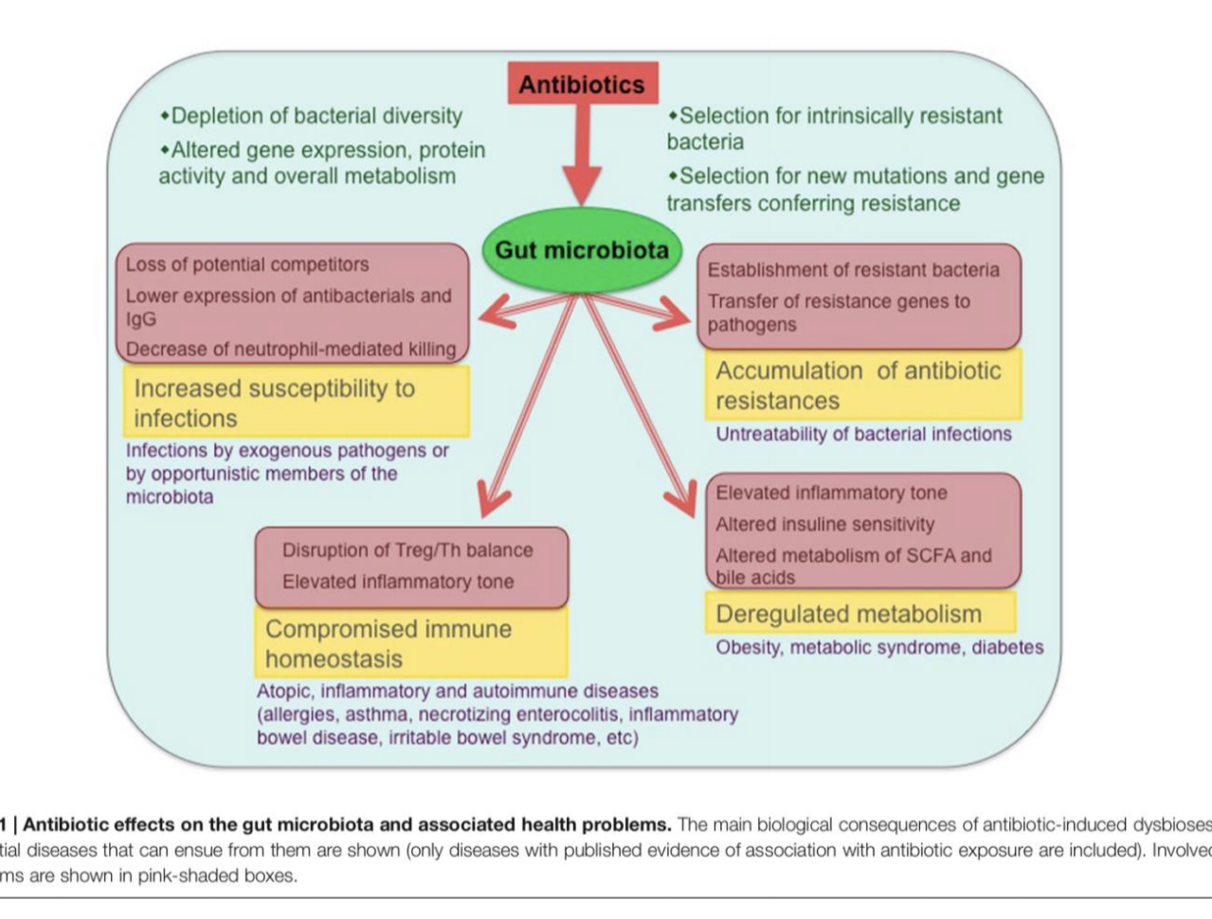
Antibiotic Affects on the Gut and health

Slide 14
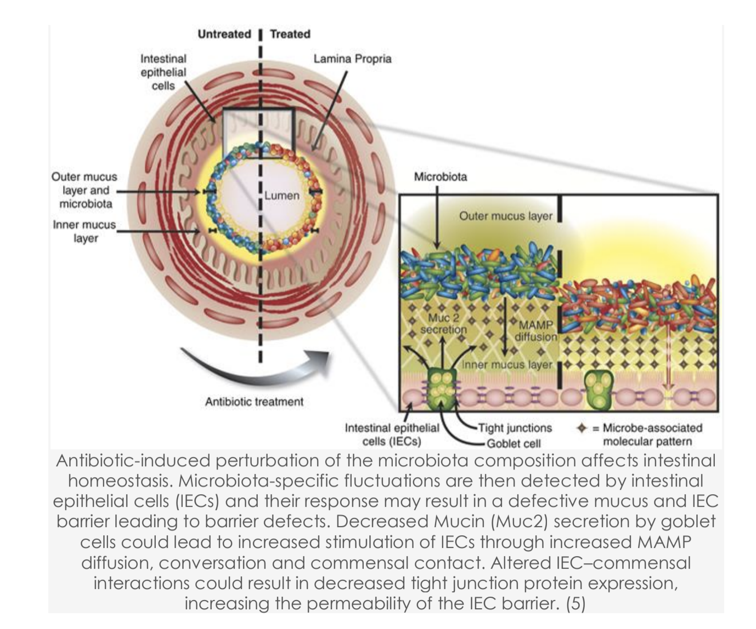
Cellular alterations from antibiotic use

Slide 15
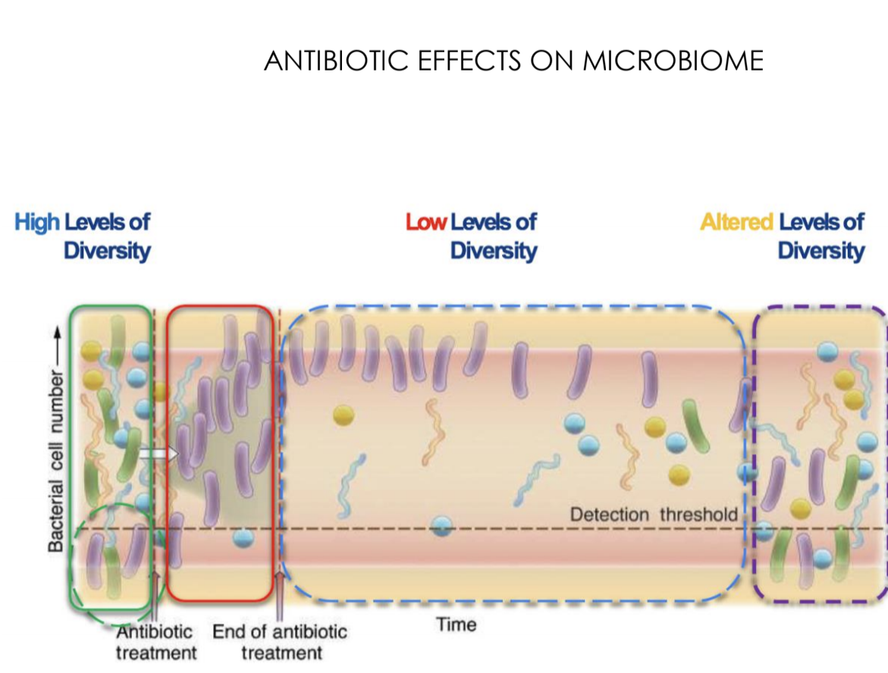
Antibiotics reduce diversity

Slide 16
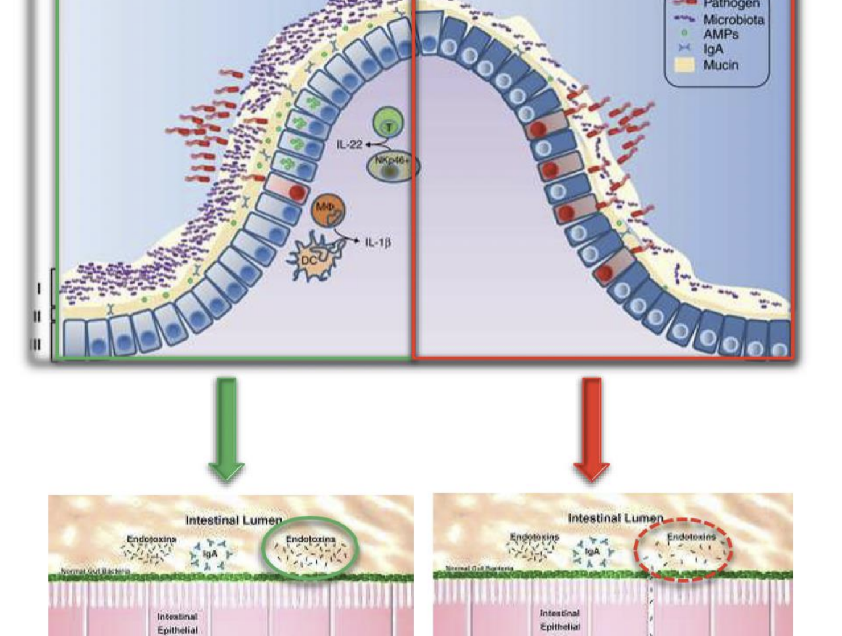
Intestinal permeability

Slide 17
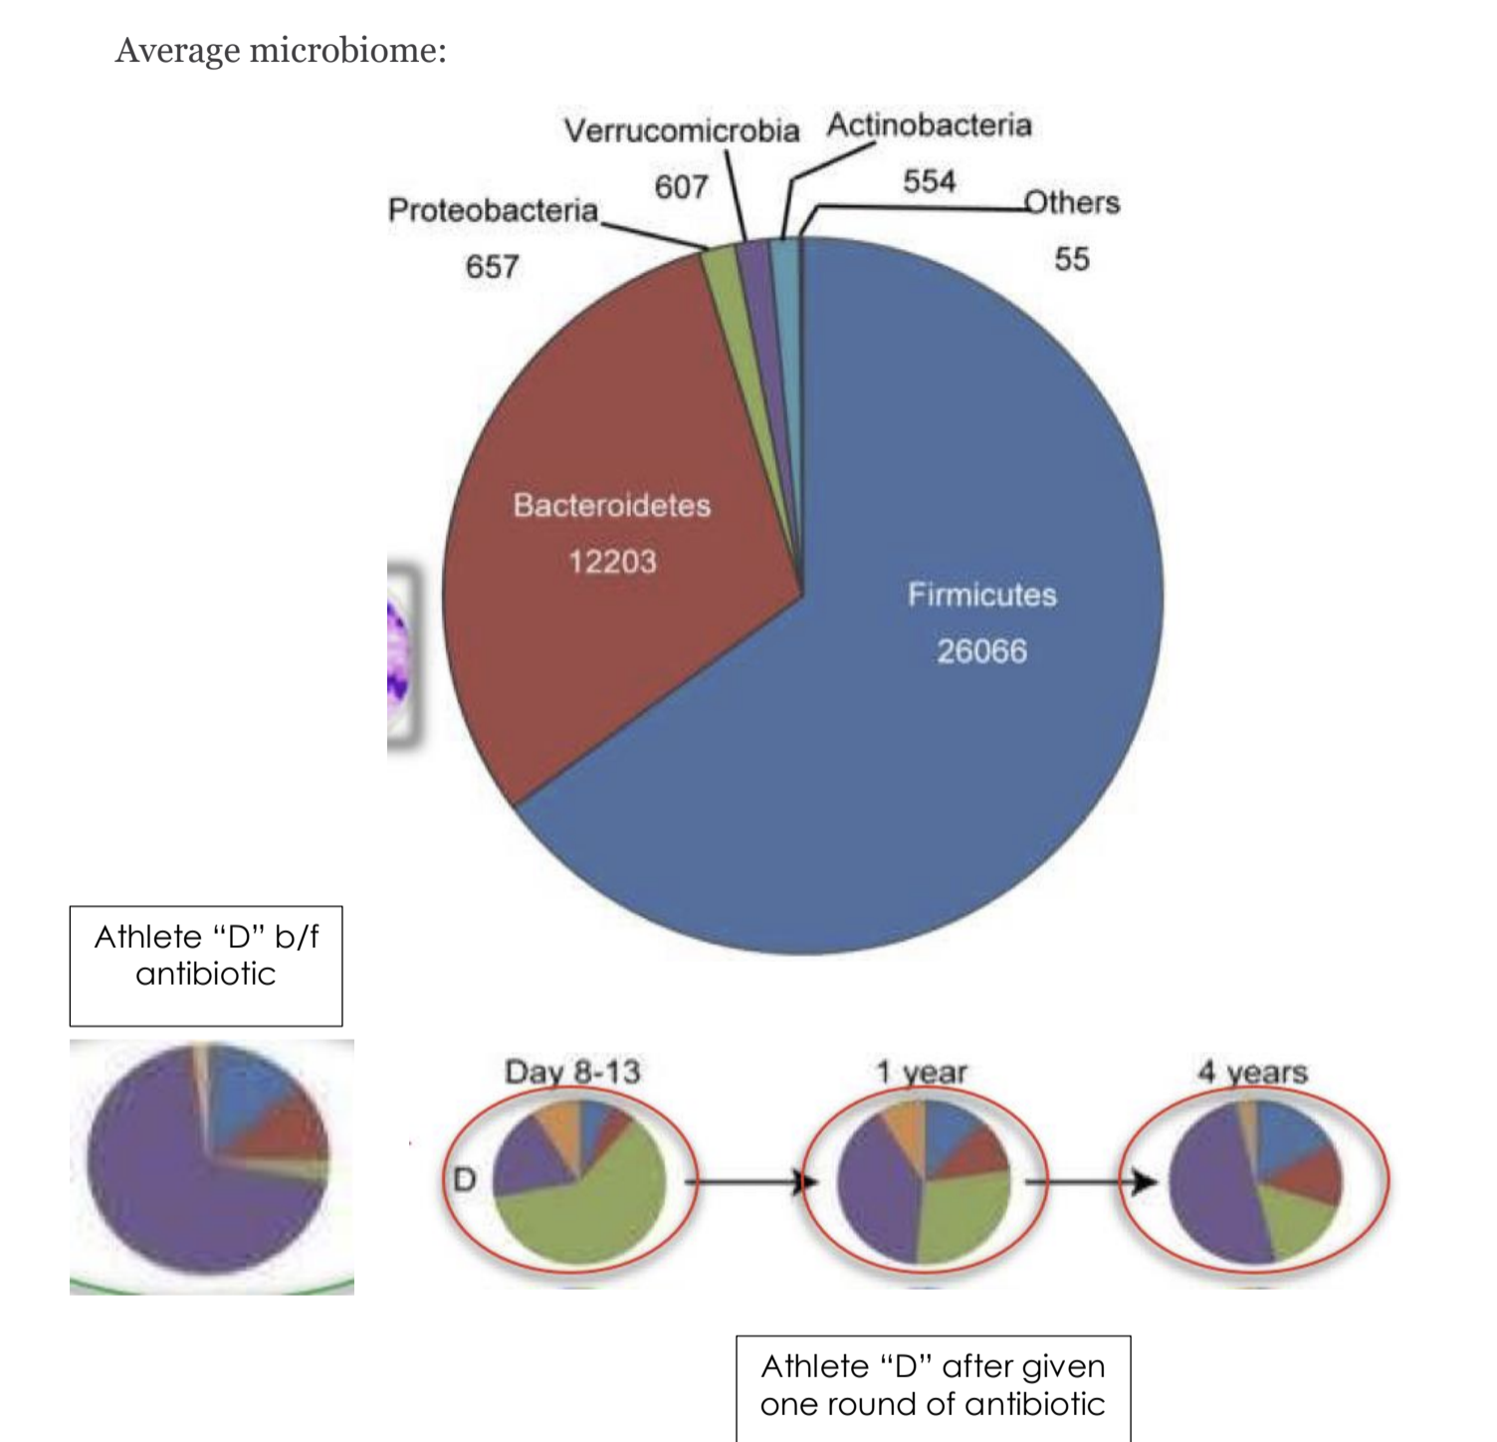
Professional athlete study

Slide 18

Support
Homeopathy
Vitamin/Mineral
Herbals
Fecal Transplant
Prebiotics and Probiotics

Slide 19

Questions?

