Slide 1

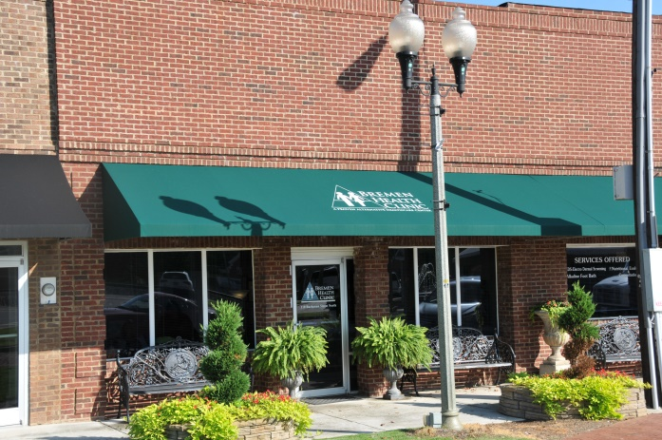
Bremen Health Clinic
A Proven Alternative Health Care Center

Slide 2
Why come to BHC?
Bremen Health Clinic is a whole body wellness clinic.
We offer a variety of therapies all designed to improve you over-all health.
Our clinic staff works as a team in order to help you achieve maximum wellness as well as educates you in how to keep well with diet, exercise, stress management, etc.
Each patient has a specifically designed protocol as to what is best for their
Body.
Affordable services

Slide 3

Electro-Dermal Screening
With Electro-Dermal Stress Analysis technology (VITAL) the computer measures the resistance of the acupuncture points to indicate the balances or imbalances of the body.
You will receive a full report of the results showing the specific health status of every major system of your body.
You will receive a personalized nutritional, vitamin, mineral and herbal program which supports your specific health issues.
Additional customized services and modalities are based on the needs reflected in your EDS screening.

Slide 4
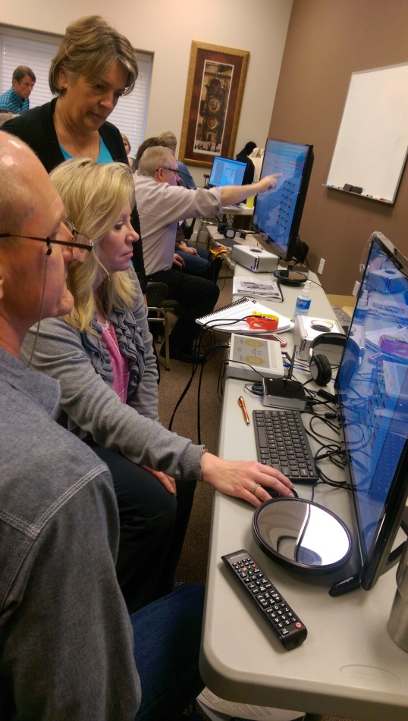
A/O Analyzer
This cutting edge technology evaluates energetic disturbances in the body and generates energetic stimulation for the brain to correct frequency imbalances.

Slide 5
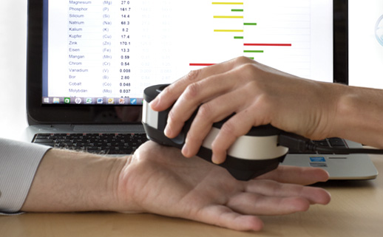
Oligo Scan
This scan evaluates minerals, trace elements, and heavy metals in the body, providing an immediate “snap-shot” of cautionary health issues.

Slide 6
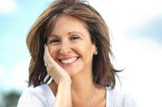
Natural Hormone Replacement
Medical staff guided blood work and questionnaire reveal your hormone “status,” Various options are available to deal with these imbalances (pellets, and oral lozenges, for example)

Slide 7
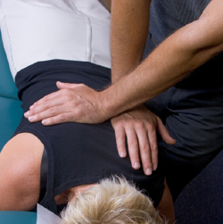
Facilitated Stress Release/Chiropractic
A holistic approach to well-being, focusing on imbalances from past/or present emotional stress (a psychotherapeutic session combining a number of techniques, including B.E.S.T.)

Slide 8
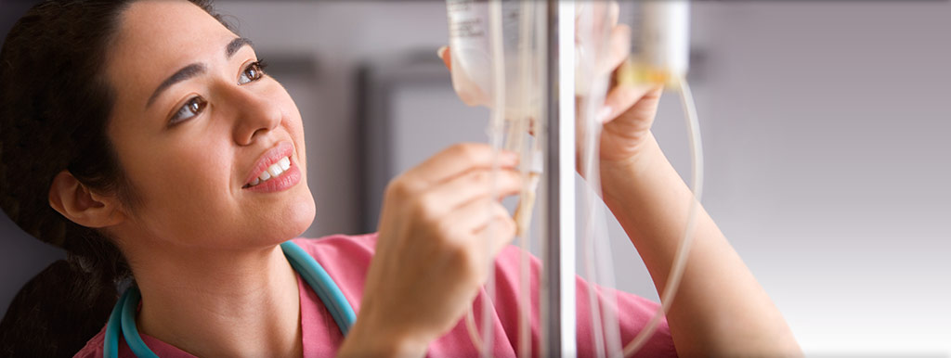
IV Therapy
IV therapies for vitamin/mineral replacement, plaque build-up, mercury and heavy metal chelation. Homeopathic and glutathione IV’s are also offered.

Slide 9
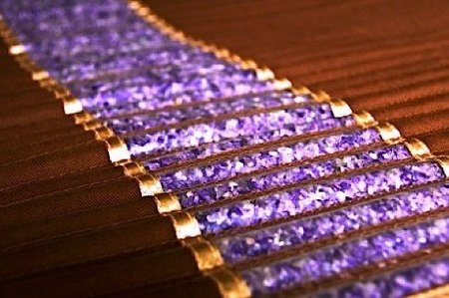
Amethyst Bio-Mat Sessions
Infrared heated therapy which stimulates the body to detoxify and promotes circulation.

Slide 10
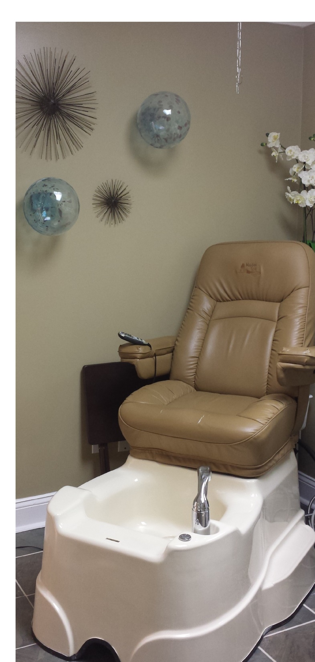
Detoxifying Foot Baths
Helps to restore the body’s pH balance while stimulating the natural detoxification process.

Slide 11
Products We Use at BHC which are Available to You Tonight
Wildcrafted & Organic Natural Skin Care: Renovecer
Essential Oils-Powerful and Professional-Grade Essential Oils
Rainforest Blends-Quality Natural Herbal Blends from Natures Kitchen

Slide 12
Bremen Health Clinic
www.bremenclinic.com
770-537-4445 option 1
Powerpoint template credit smiletemplates.com

